Slide 1
Summary of the latest PMP related activities
Transmitted by the European Commission
Informal document GRPE-65-16
(65th GRPE, 15-18 January 2013, agenda item 7)
Giorgio Martini, Athanasios Mamakos*
Institute for Energy and Transport
Joint Research Centre
*Southwest Research Institute

Slide 2
Summary
Two main activities finalized in 2012
PMP Heavy Duty Round Robin
PMP Volatile Particle Remover (VPR) Calibration Round Robin
Two presentations on the above topics were given by Athanasios Mamakos* during a web/phone conference
*(formerly JRC, now at the SwRI, USA)

Slide 3
Particle Measurement Programme
Heavy Duty Round Robin
Preliminary Analysis of the Results

Slide 4
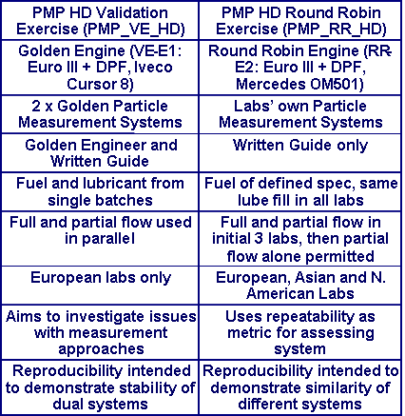
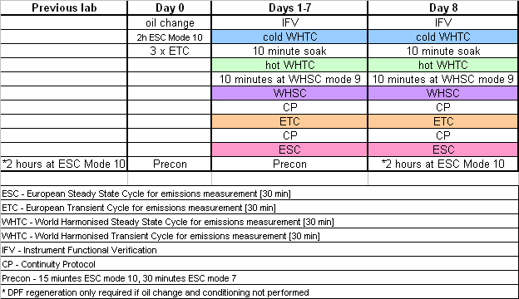
Context
Test Matrix addresses replicate European and World Cycles
8 repeats of each cycle
Control of the DPF fill state

Slide 5
Golden Engine
Daimler OM501 LA
290 kW / 1800 rpm
1850 Nm / 1080 rpm
11946 cm³
Euro III
Catalyzed DPF
Sintered metal type

Slide 6
Participants &
#PN systems
Laboratory | CVS | PFDS
RICARDO | 1 | 1
NTSEL | 3 | 1
JARI | 4 | -
NIER | 1 | -
VOLVO | 2 | 1
UTAC | - | 1
VTT | 3 | -
SCANIA | - | 1
Env. Canada | 1 | -
RWTÜV | 1 | -
Daimler | 1 | -
JRC | 1 | 1

Slide 7
Calculation checks
Calculation cross-checks conducted upon receipt of data revealed a number of errors in the calculations from most laboratories, including:
      Synchronization problems
      Simplified ESC calculations
      The results were recalculated for all labs with the exception of Volvo and Ricardo where no real-time information was available.

Slide 8
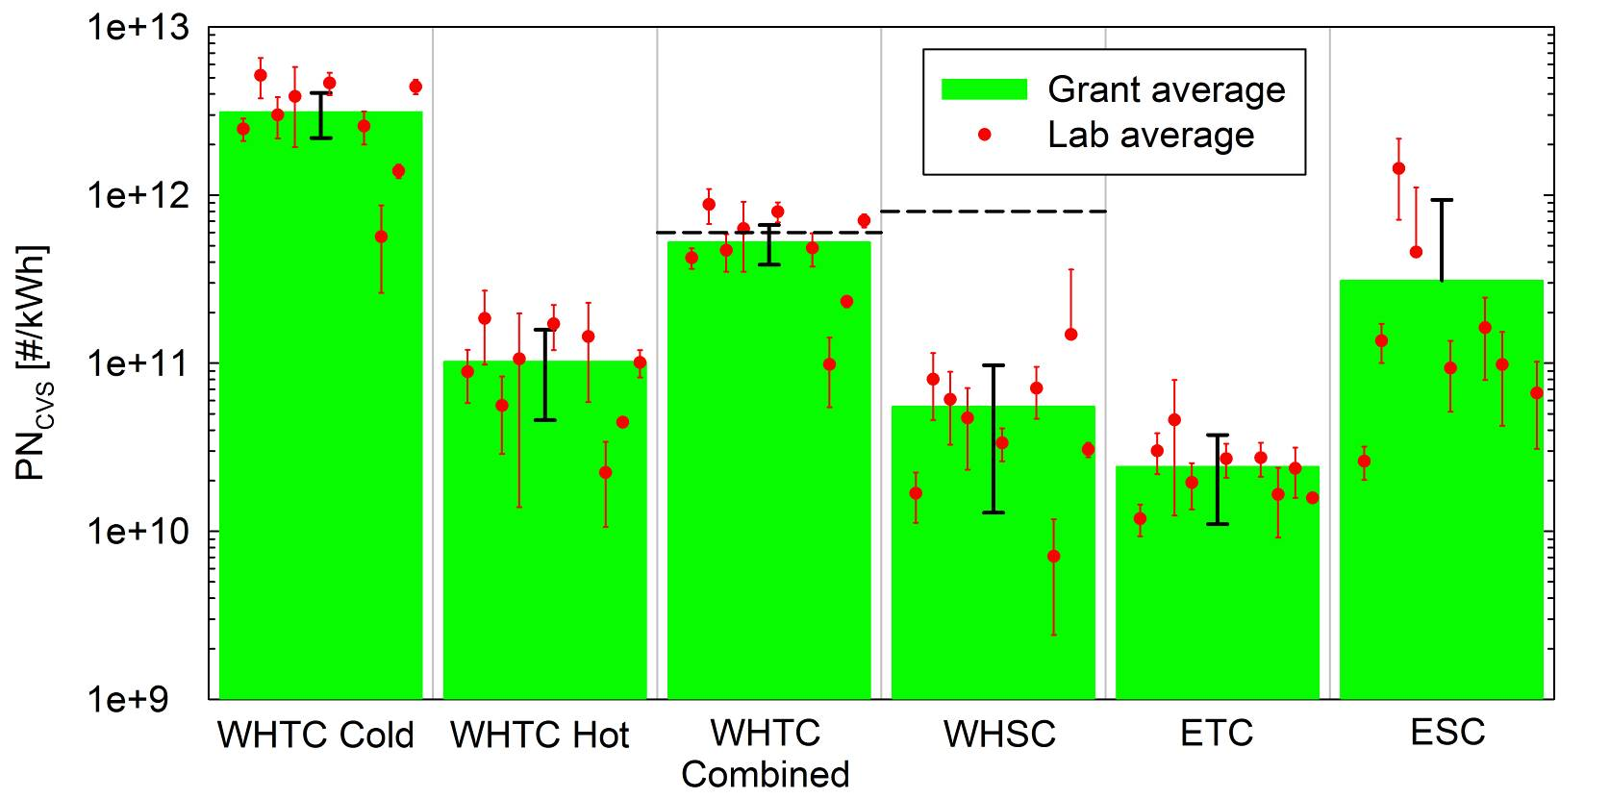
PN_{CVS} overview
PN emissions complied with the WHSC limit (8×10¹¹ #/kWh) but were at the threshold value (6×10¹¹ #/kWh) over the WHTC (14% cold weighting)

Slide 9
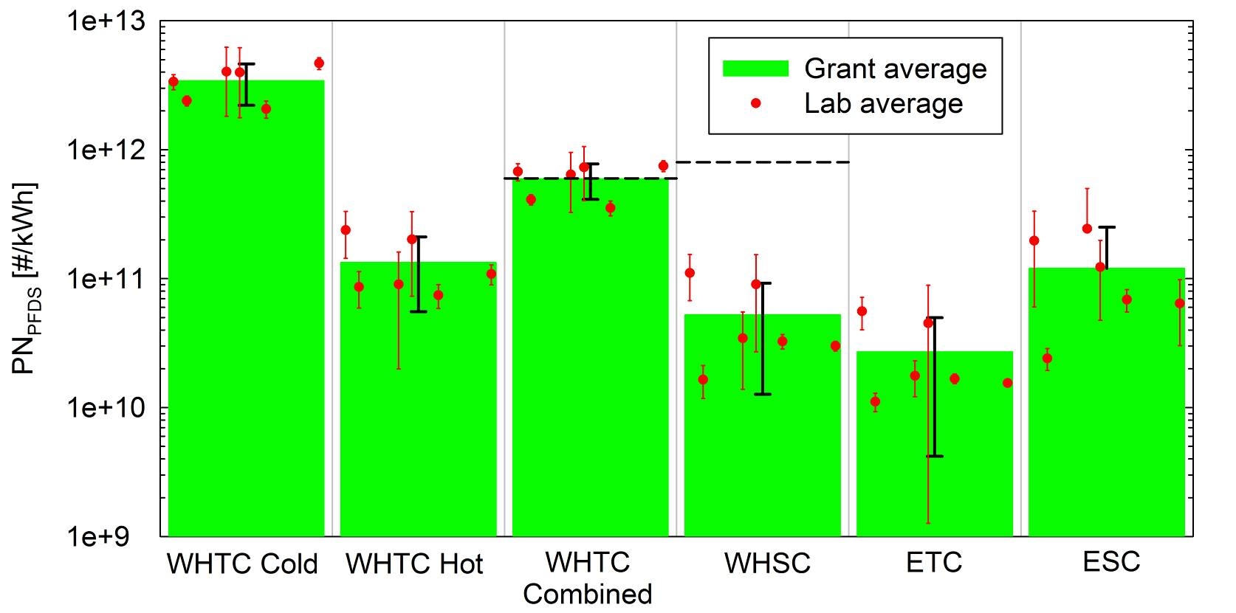
PN_{PFDS} overview
Similar results wth CVS

Slide 10
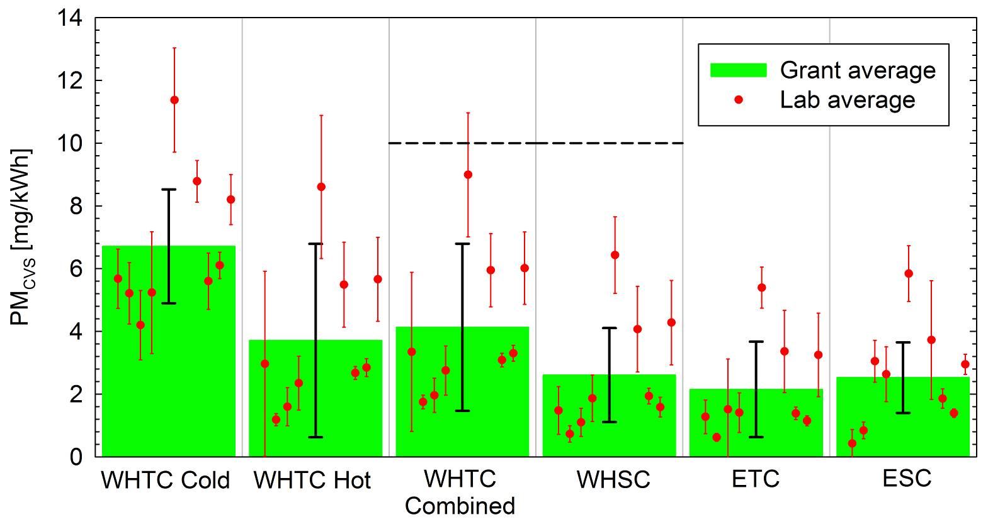
PM from CVS
PM emissions were consistently below the limit of 10 mg/kWh
Cycle effect was statistically insignificant

Slide 11
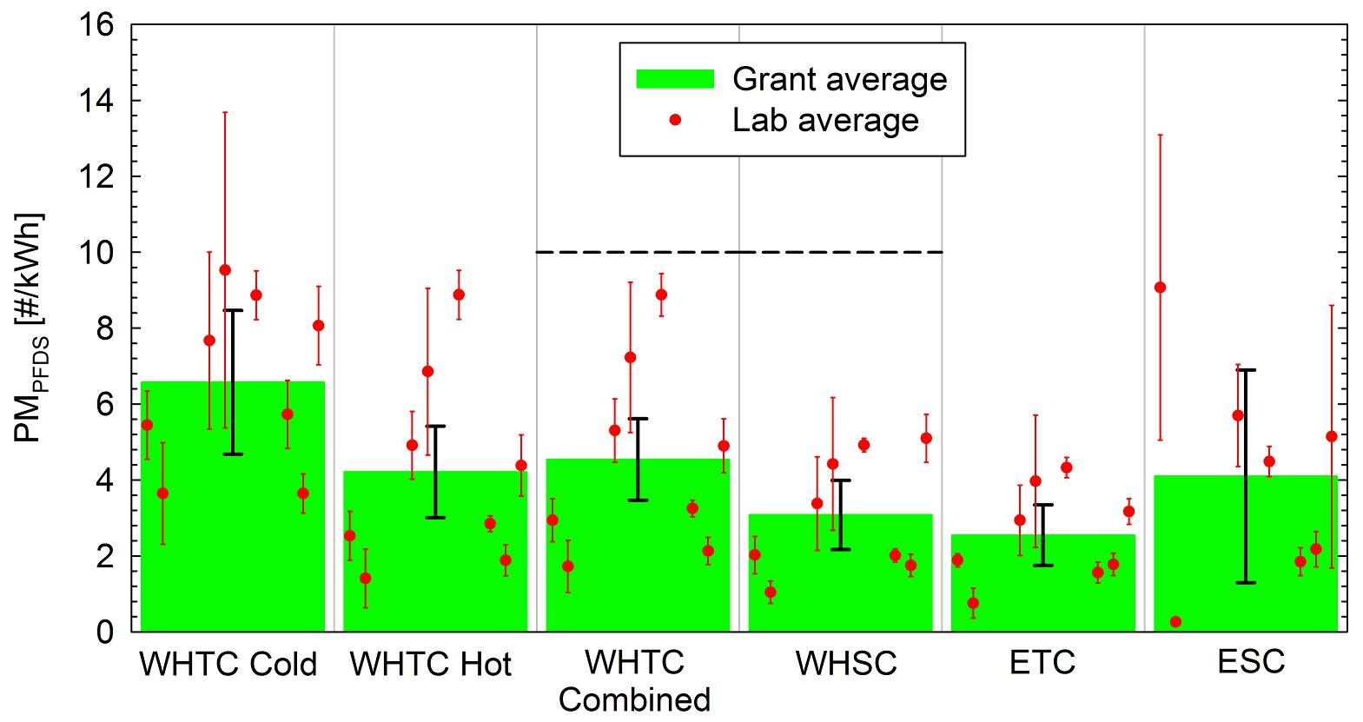
PM from PFDS
Similar results with CVS

Slide 12
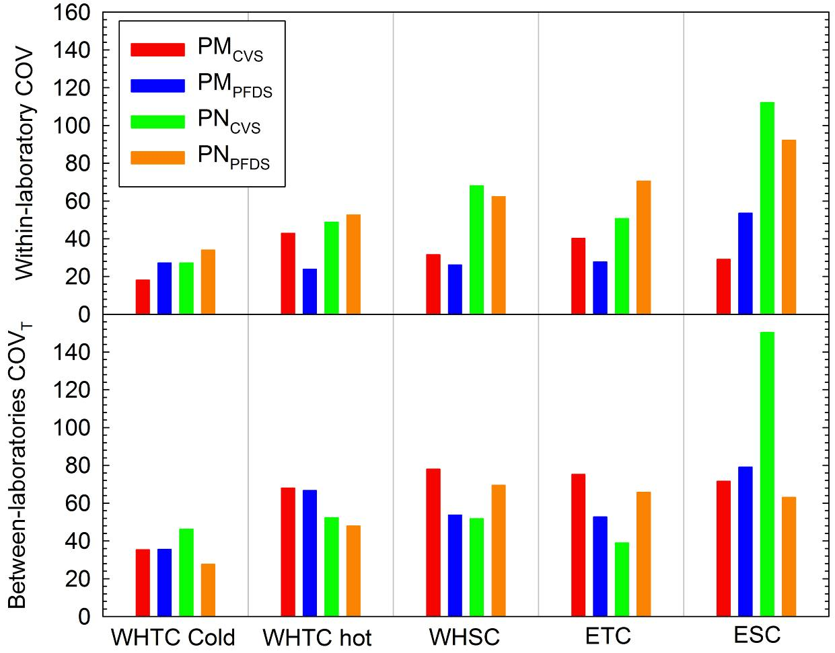
Repeatability & reproducibility
PM:
Repeat: 20-50%
Repr: 35-80%
PN:
Repeat & repr: 30-70% in all cycles but ESC
Over ESC:
    90-110% repeat
    Up to 150% repr.

Slide 13
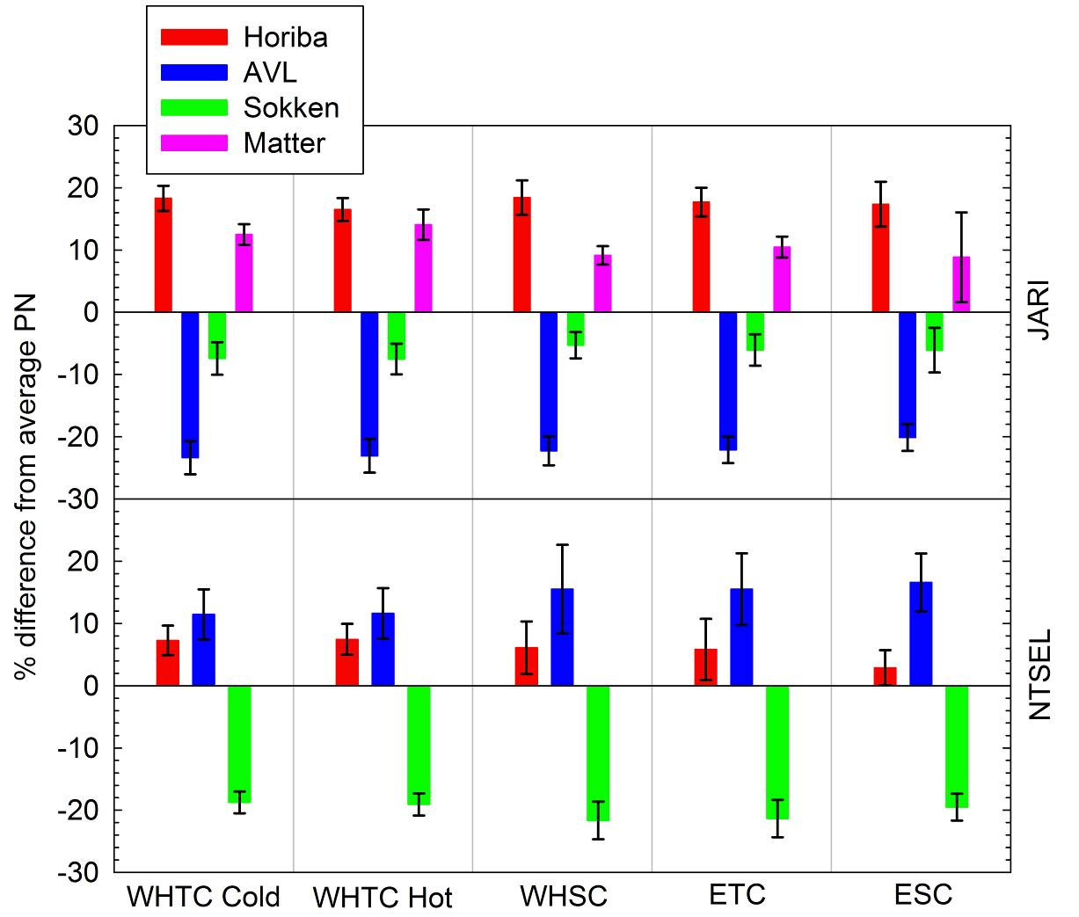
Comparison of different PN systems #1
Different PN systems agreed within ±20%
The deviations were consistent across the cycles ⇨ calibration issues

Slide 14
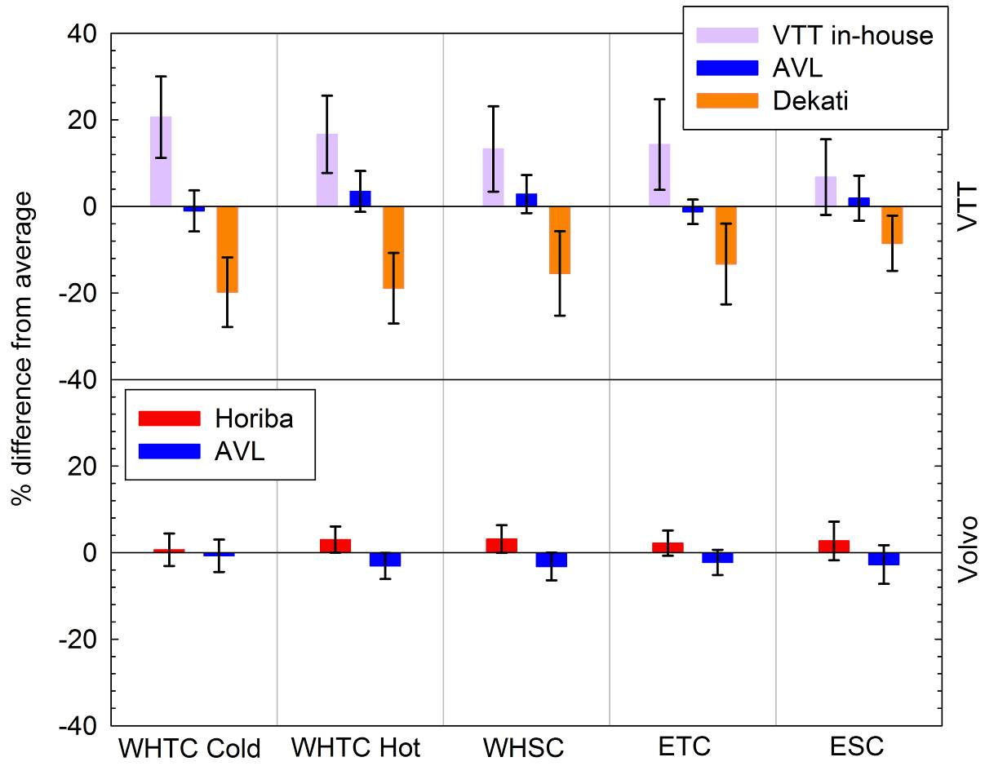
Comparison of different PN systems #2
Different PN systems agreed within ±20%
The deviations were consistent across the cycles ⇨ calibration issues

Slide 15
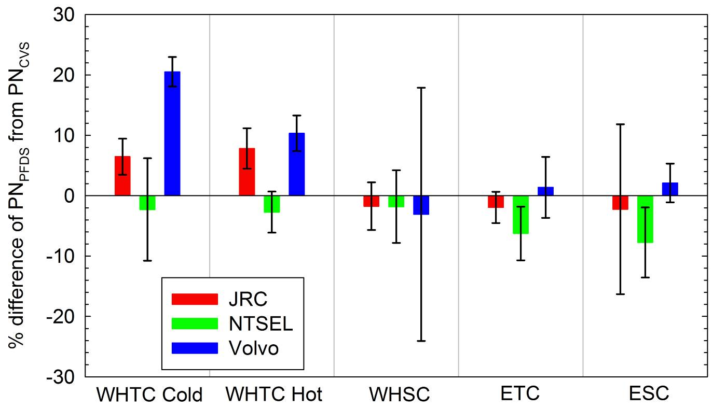
PN_{PFDS} vs PN_{CVS}
On average the difference was generally smaller than ±10%.
Some small dependence on the test cycle, might indicate wrong settings.

Slide 16
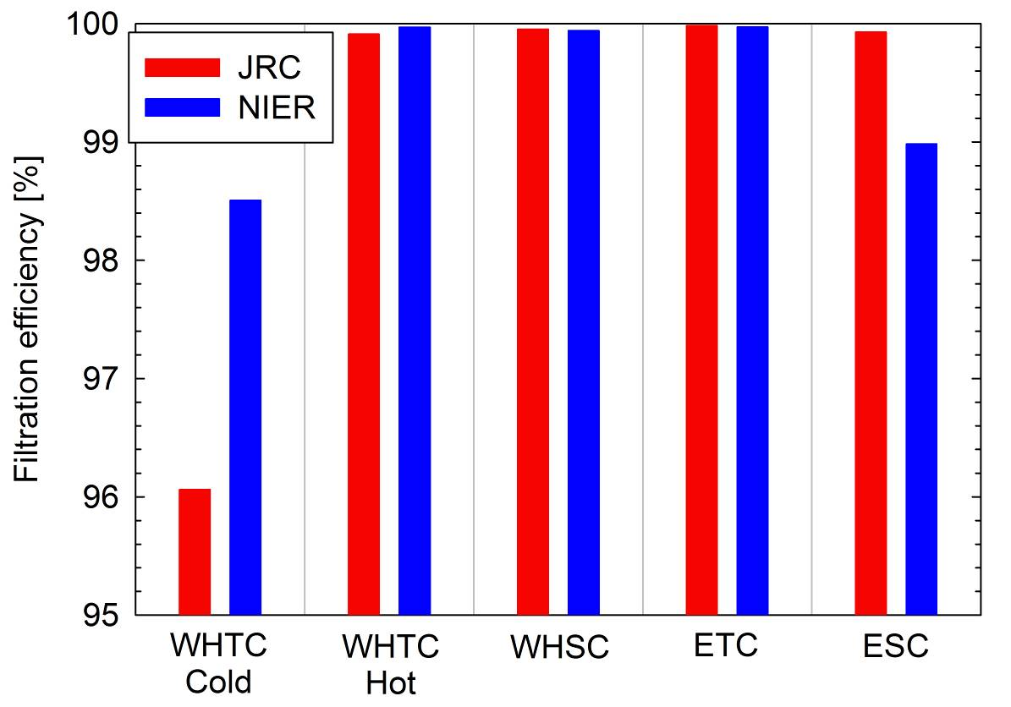
DPF filtration efficiency in PN
>99.9% efficiency over WHTC hot, WHSC and ETC
Reduced efficiency during cold start (WHTC cold) and passive regeneration (ESC)

Slide 17
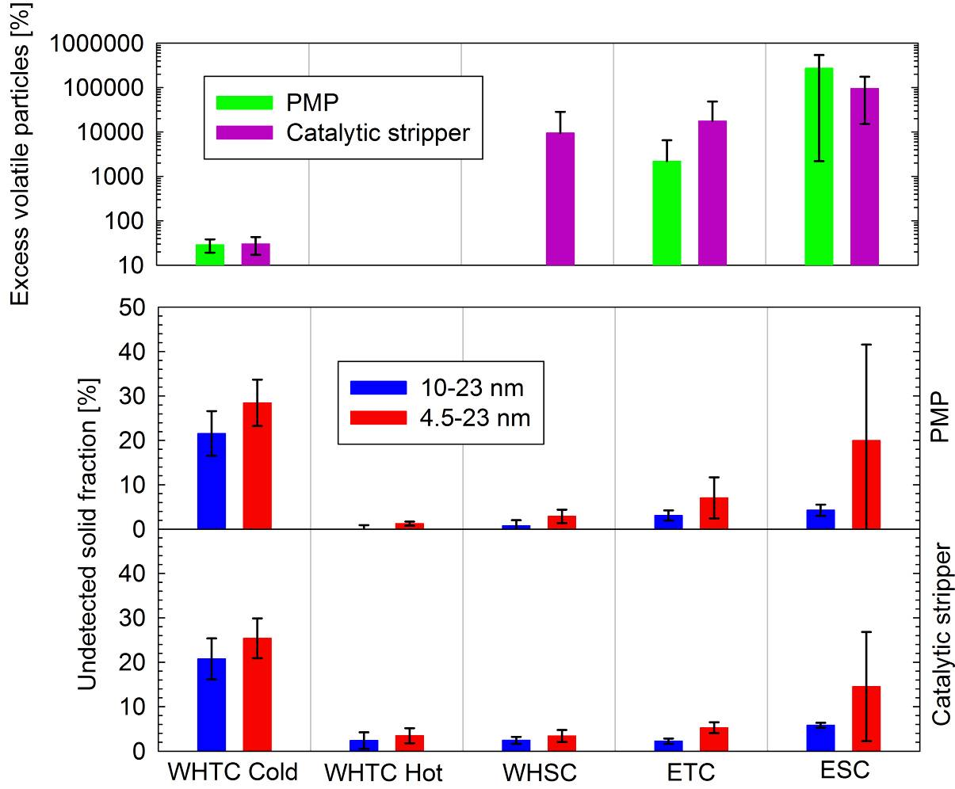
Sub-23 nm particles
Undetected solid fraction:
20-25% during cold start
<5% with engine hot
Volatile artefact during passive DPF regeneration:
Only with CPC@4.5 nm
Evident in both PMP and CS
>99.1% removal

Slide 18
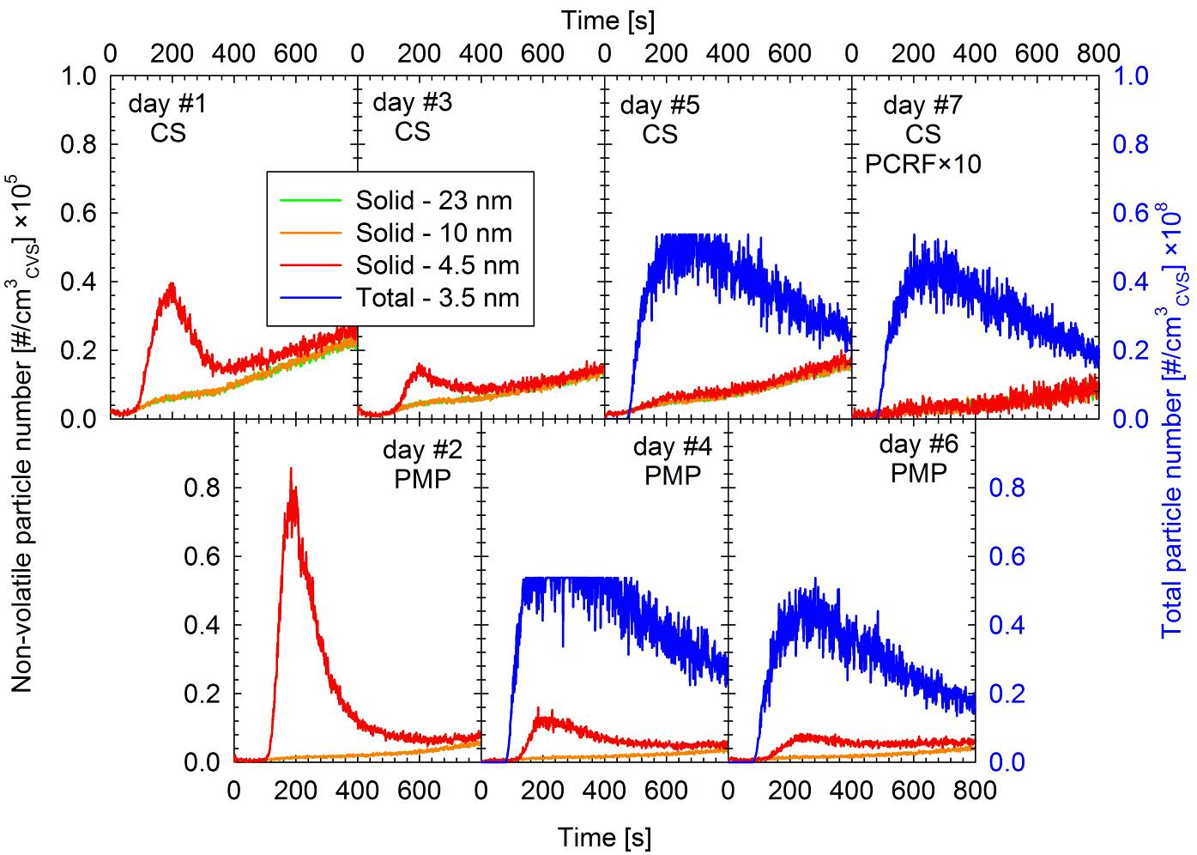
Volatile artefact – DPF regeneration

Slide 19
Conclusions #1
PN emissions were ~one order of magnitude higher compared to those of the Golden engine tested in the PMP HD Validation exercise.
PN emissions complied with the 8×1011 #/kWh limit over WHSC but lied at the threshold of 6×1011 #/kWh over the combined WHTC.
PM emissions below the 10 mg/kWh limit.
Repeatability and reproducibility of PN (30-70%) was similar to that of PM (20-55%) over all cycles except ESC. A higher within-laboratory (90-110%)and between-laboratories (65-150%) variability was observed over ESC possibly due to extensive passive regeneration of the DPF.

Slide 20
Conclusions #2
Different PN systems employed in parallel agreed within ±20% with the relative difference not depending on emission levels or operating conditions ⇨ Calibration issues.
PN emissions determined from PFDS agreed with that from CVS tunnel within ±10%, well within the established agreement of PN systems.
The fraction of undetected solid particles was found to be approximately 20-25% over cold start and remained to very low levels (<5%) with the engine hot.

Slide 21
Conclusions #3 – sub-23 nm
Passive regeneration can lead to significant formation of homogeneously nucleated particles that can exceed in number the solid fraction by more than 4 orders of magnitude.
At these conditions, there some evidence of volatile artefact interference in the responses of CPC having a d50 at 4.5 nm, despite the more than 99.1% removal efficiency of the PN system.
The artefact was somehow reduced with the use of a Catalytic Stripper but was not suppressed.

Slide 22
Summary of main conclusions #1
PMP Heavy Duty Round Robin
The results of the PMP HD Round Robin are consistent with the main conclusions of the HD Validation Exercise
Passive regeneration over the ESC can increase the variability of the PN measurements highlighting the issue of DPF fill state in the regulatory measurements
No indications of volatile artifacts could be identified following the regulated PN procedure even under passive regeneration which led to excessive formation of volatile particles (exceeding in number the solid fraction by 4 orders of magnitude). Volatile interference was only observed when employing a CPC with a cut-off at 4.5 nm
The fraction of undetected sub-23 nm solid particles was rather limited (<25%)

Slide 23
Particle Measurement Programme:
Volatile Particle Remover (VPR) Round Robin
Web conference
12/7/2012

Slide 24
Contents
Programme description
Characterization of the Golden Instrumentation at JRC
Round Robin results
Additional investigations
Conclusions

Slide 25
Contents
Programme description
Characterization of the Golden Instrumentation at JRC
Round Robin results
Additional investigations
Conclusions

Slide 26
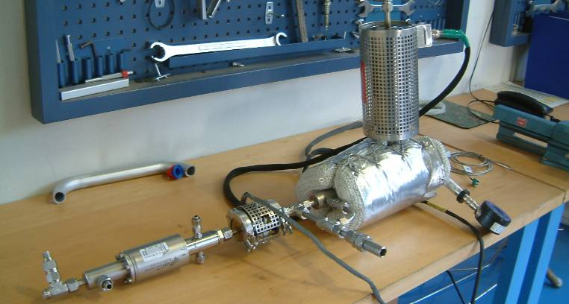
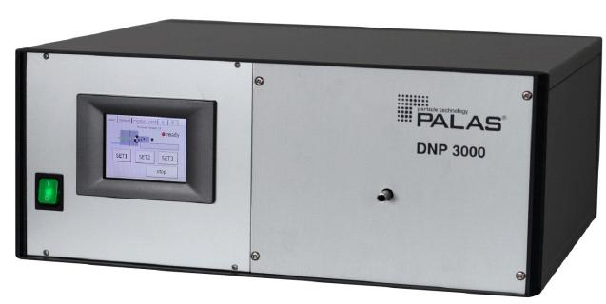
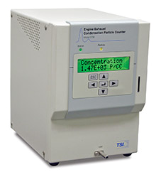
Golden Instrumentation
Golden VPR (GVPR): dual ejector & Evaporating Tube (ET) by Dekati.
Golden Aerosol Generator (GAG): Palas DNP 3000 graphite spark generator.
Golden Condensation Particle Counter (GCPC): TSI 3790 (d₅₀ at 23 nm).

Slide 27
Participants
Laboratory | Test dates | Alternative calibration aerosol | Additional investigations
JRC | 08/2010 | - | Definition of the test protocol, Calibration of the GCPC
LAT | 12/2010 | Thermally treated diesel exhaust | -
AVL | 01/2011 | Thermally treated mini-CAST | -
Horiba | 03/2011 | Thermally treated mini-CAST, sodium chloride | Size classification of non-neutralized particles
EMPA | 04/2011 | Sodium chloride, Palladium | Tandem DMA measurements
Matter Aerosol | 05/2011 | Thermally treated CAST | PCRF at 15 nm
JRC | 07/2011 | - | -
NPL | 09/2011 | - | Calibration of the GCPC against a traceable electrometer
AEAT | 10/2011 | Thermally treated CAST | -
VW | 12/2011 | PALAS DNP 3000 | -
Maha | 02/2012 | PALAS DNP 2000 | Thermal treatment of graphite particles
JRC | 03/2012 | - | -

Slide 28
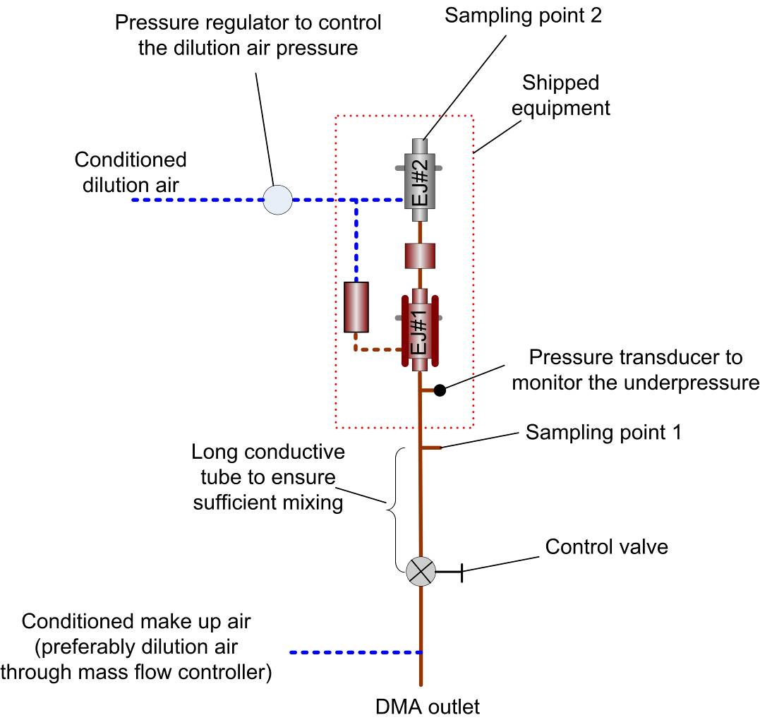
Reference setup
No thermal treatment of the aerosol produced by the GAG.
GVPR inlet pressure at -3 kPa (gauge).
GCPC sampling alternatively upstream and downstream of the GVPR. Pump or other CPC to compensate for the GCPC flow. Third CPC downstream of GVPR recommended.
Dilution factor measurements with a trace gas requested.

Slide 29
Contents
Programme description
Characterization of the Golden Instrumentation at JRC
Round Robin results
Additional investigations
Conclusions

Slide 30
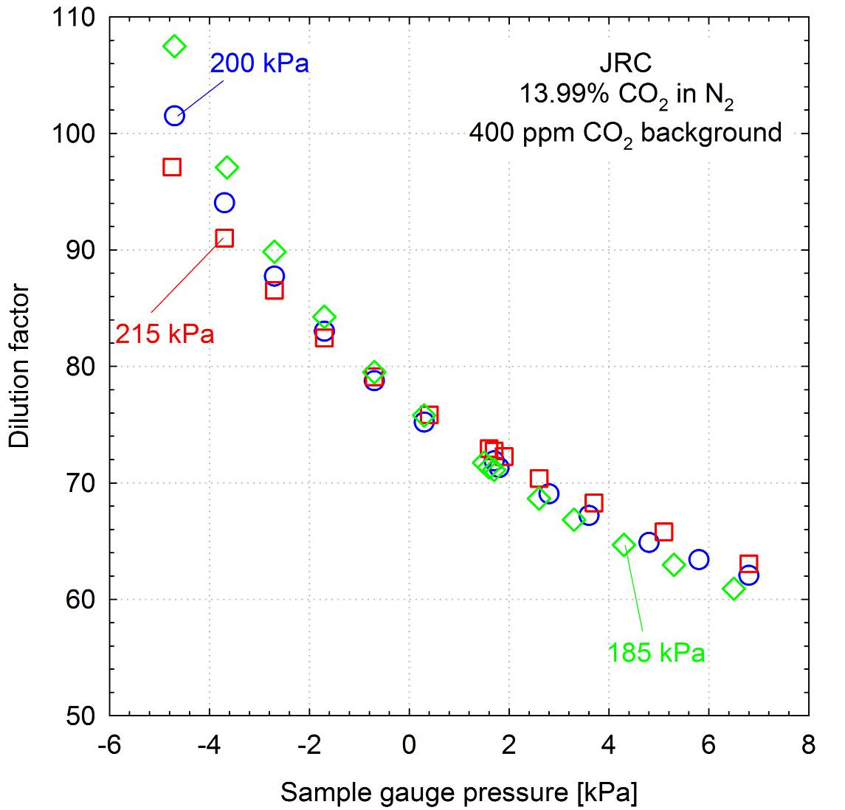
Dilution Factor (DF)
DF of the GVPR very sensitive to changes in the sample pressure. A -2.7 kPa underpressure led to 14% higher DF.
DF was also affected by dilution air pressure but to a lesser extent. A 7.5% uncertainty in the dilution air pressure results to ±2.5% uncertainty in DF at -2.7 kPa underpressure.

Slide 31
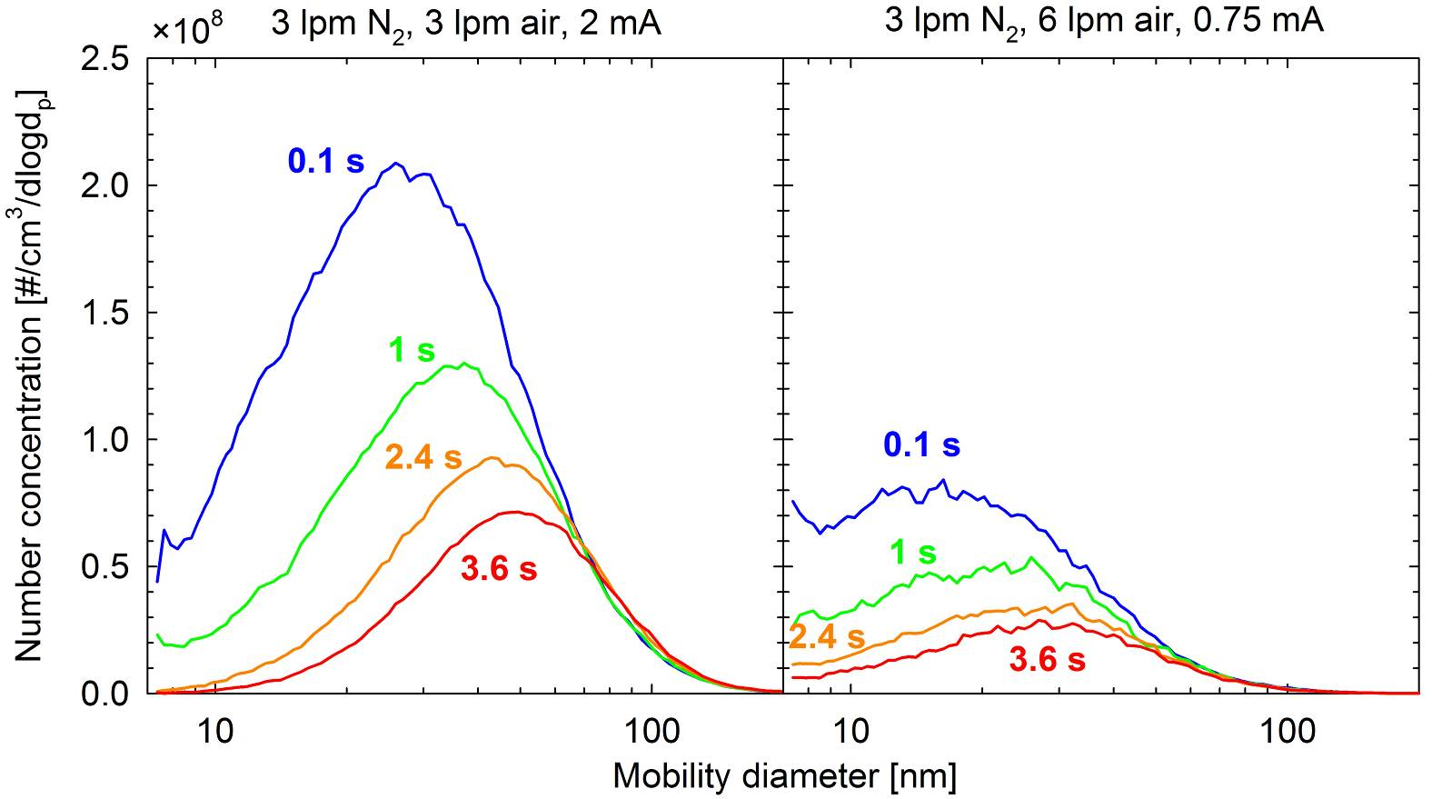
GAG
The high number concentration of the aerosol produced by the GAG can lead to significant coagulation, unless immediately diluted.

Slide 32
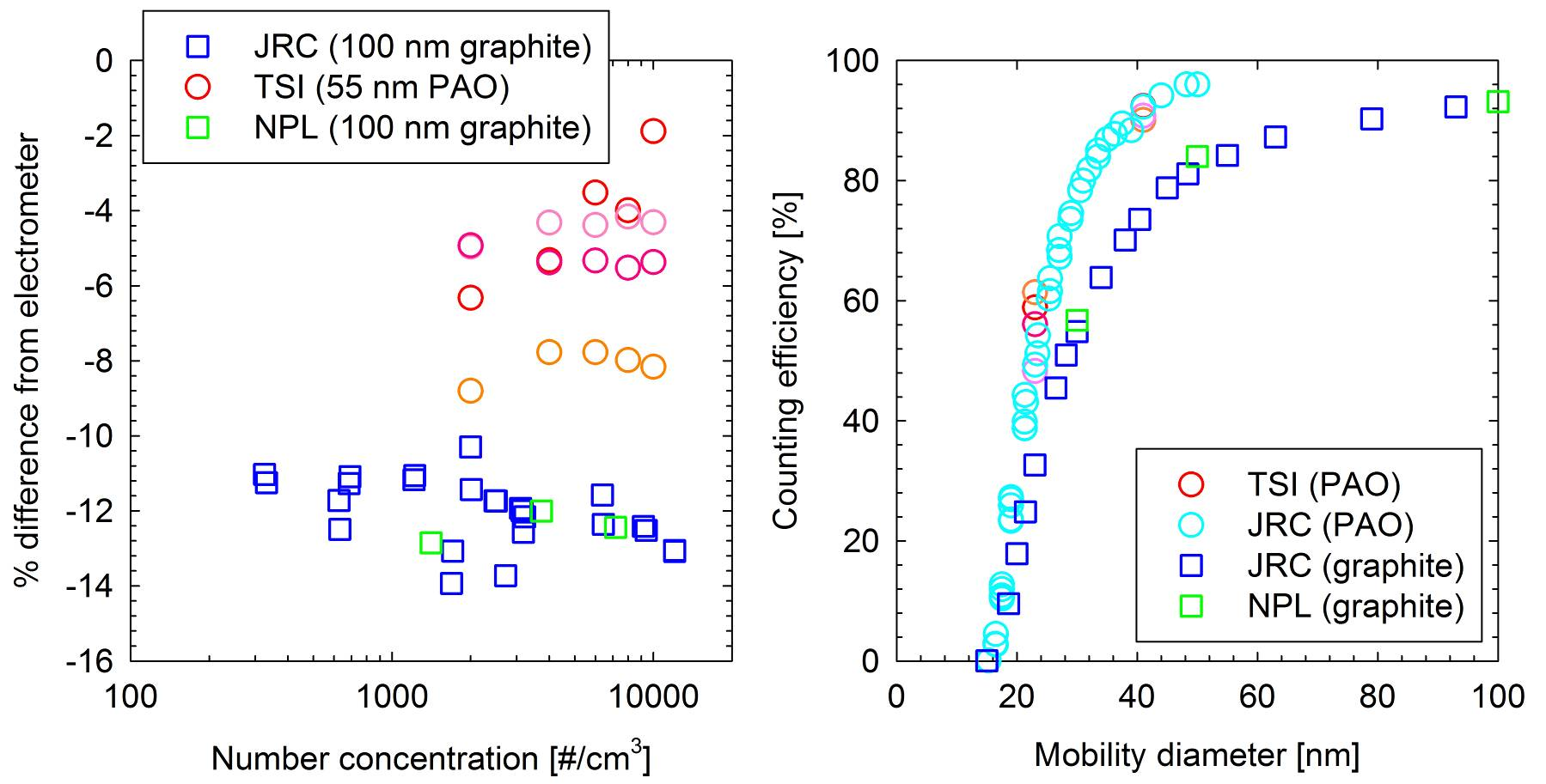
GCPC
GCPC exhibits lower detection efficiency for graphite particles even at 100 nm.

Slide 33
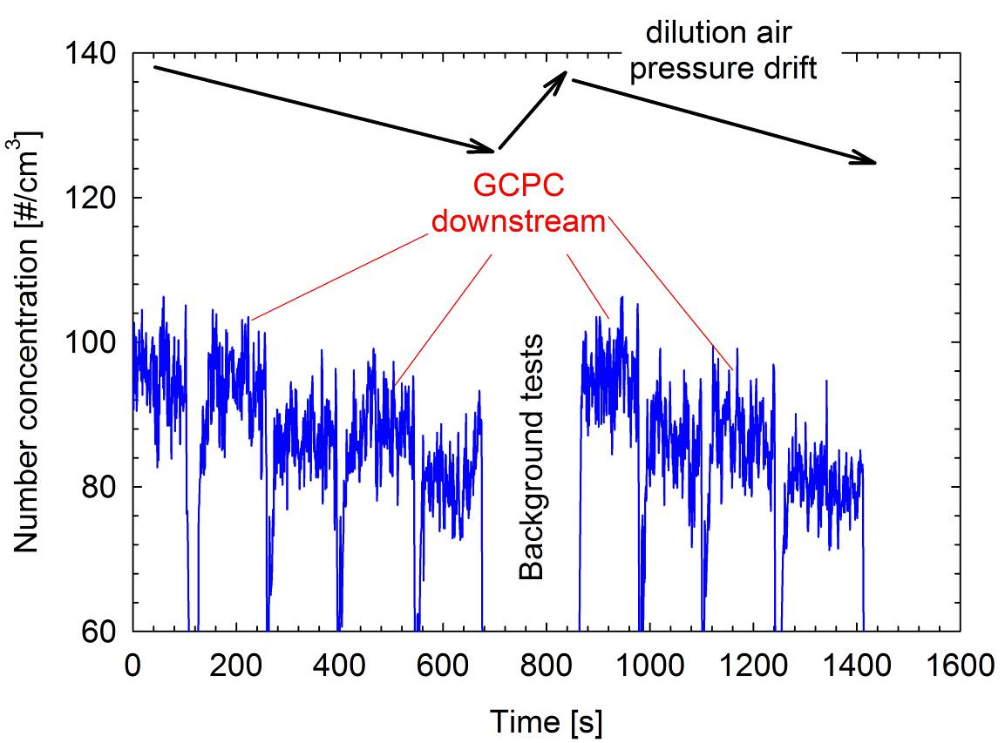
Stability
Downstream concentrations where very sensitive to small drifts of the dilution air pressure (±2.5%) and small differences in the sample flows of the two CPCs (~5%).
Operating the calibration setup at overpressure can improve the stability.

Slide 34
Contents
Programme description
Characterization of the Golden Instrumentation at JRC
Round Robin results
Additional investigations
Conclusions

Slide 35
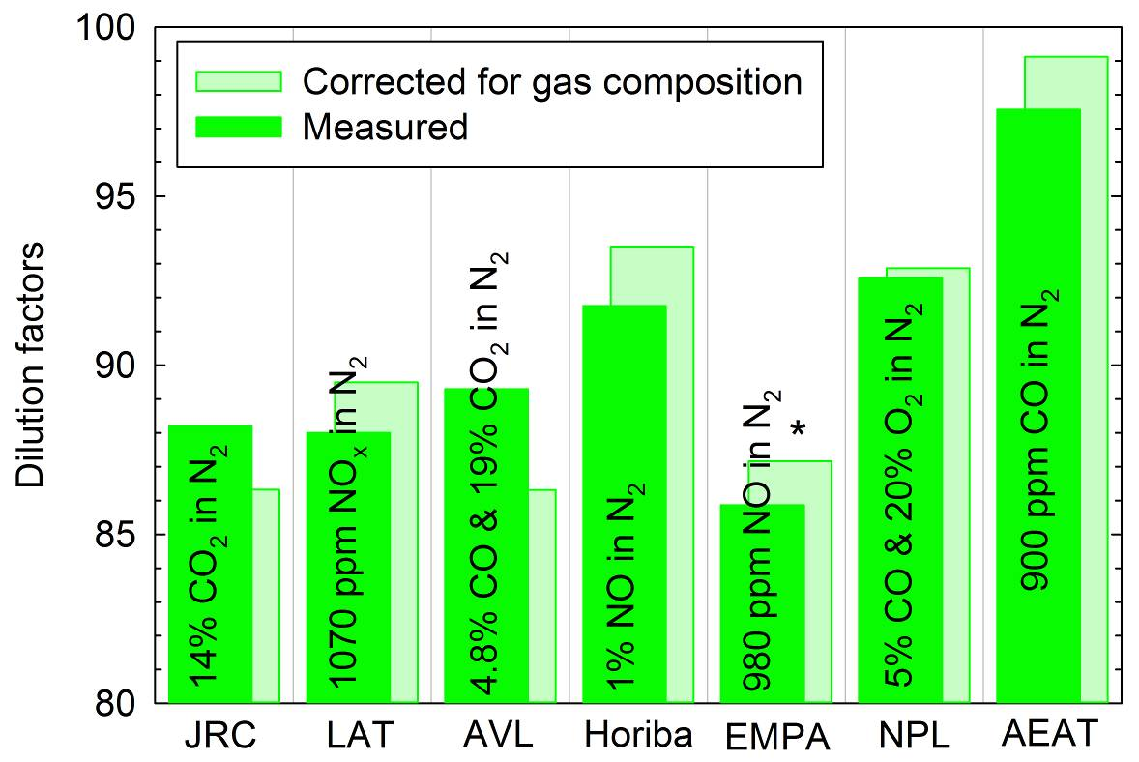
DF results
Only 7 laboratories measured the DF.
Measured DFs agreed within ±4%. AEAT stood out as an outlier measuring ~10% above average.
Effect of gas chemical composition was estimated to be less than ±2%.

Slide 36
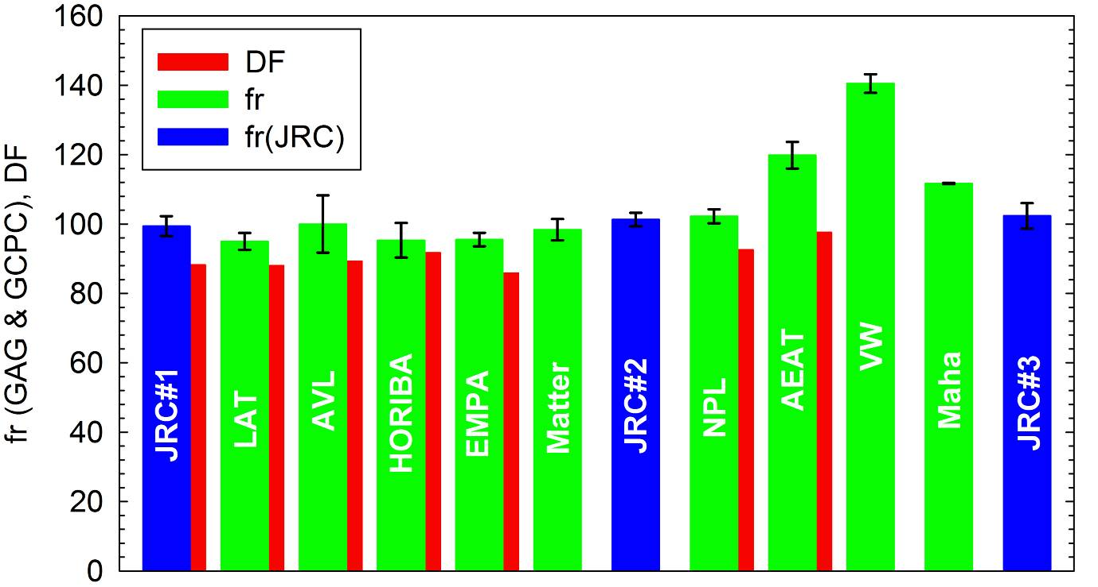
Particle Concentration Reduction Factors
Repeated tests at JRC differed by less than 1.5%.
Average losses at 30, 50 and 100 nm ~5-10%.

Slide 37
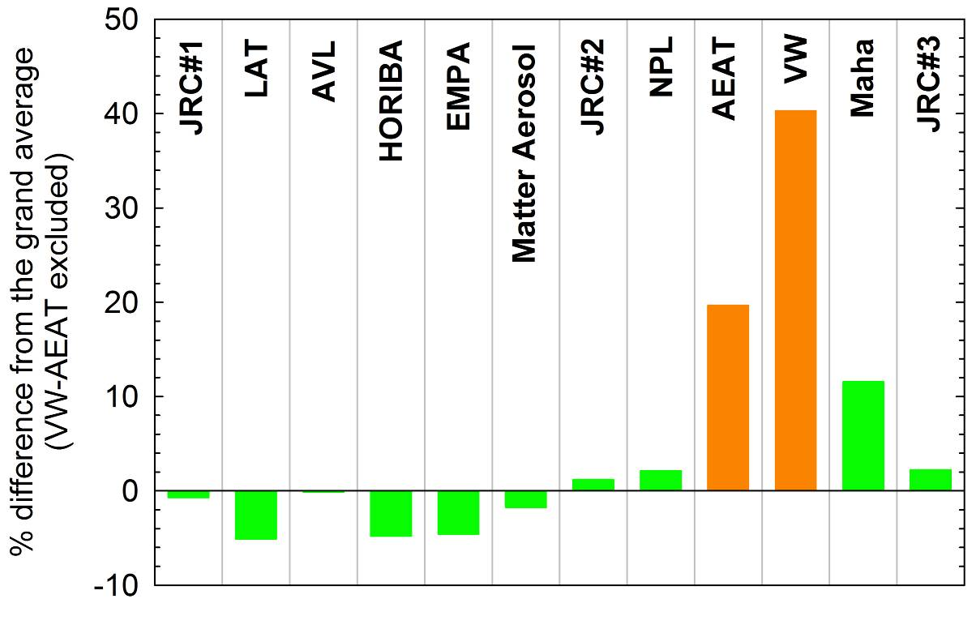
Particle Concentration Reduction Factors
Measured values generally differed by less than ±5% with three exceptions:
    AEAT: +20% (high DF)
    VW: +40%
    Maha: +10%

Slide 38
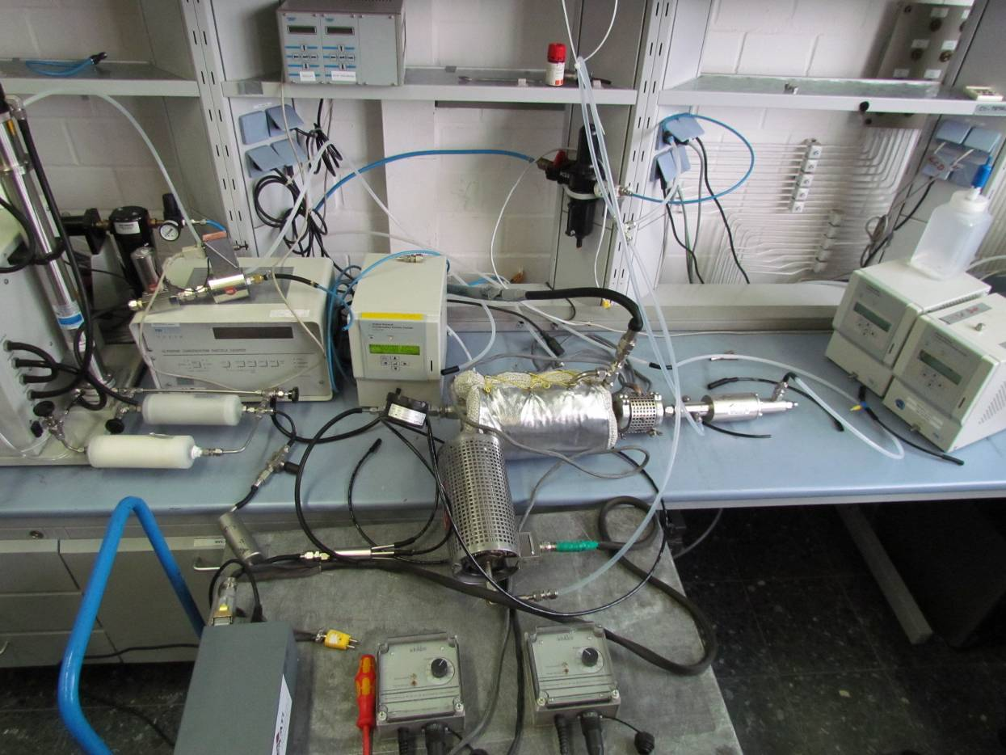
Excessive backpressure at VW
The long, narrow tube employed at VW to vent the exhaust of the 2nd ejector probably led to excessive backpressure that can severely affect the DF.

Slide 39
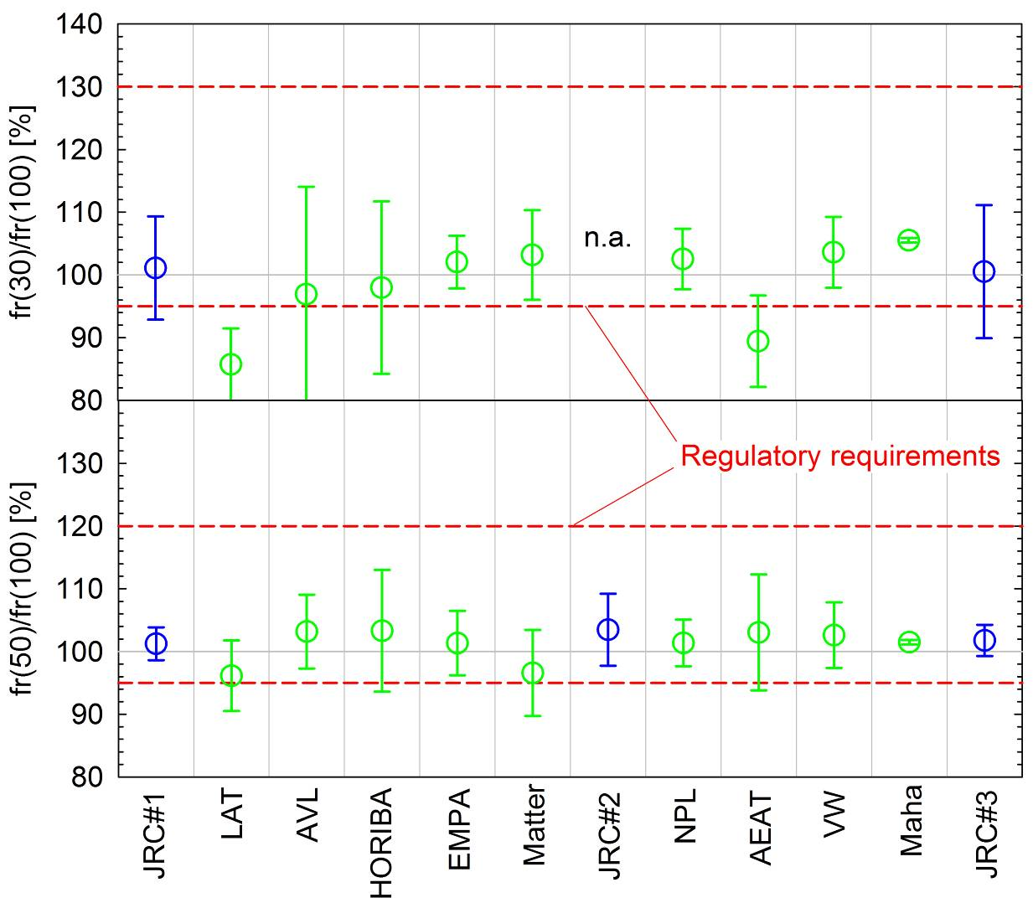
Size-dependent losses
The particle losses in the GVPR were found to be largely size-independent.

Slide 40
Contents
Programme description
Characterization of the Golden Instrumentation at JRC
Round Robin results
Additional investigations
Conclusions

Slide 41
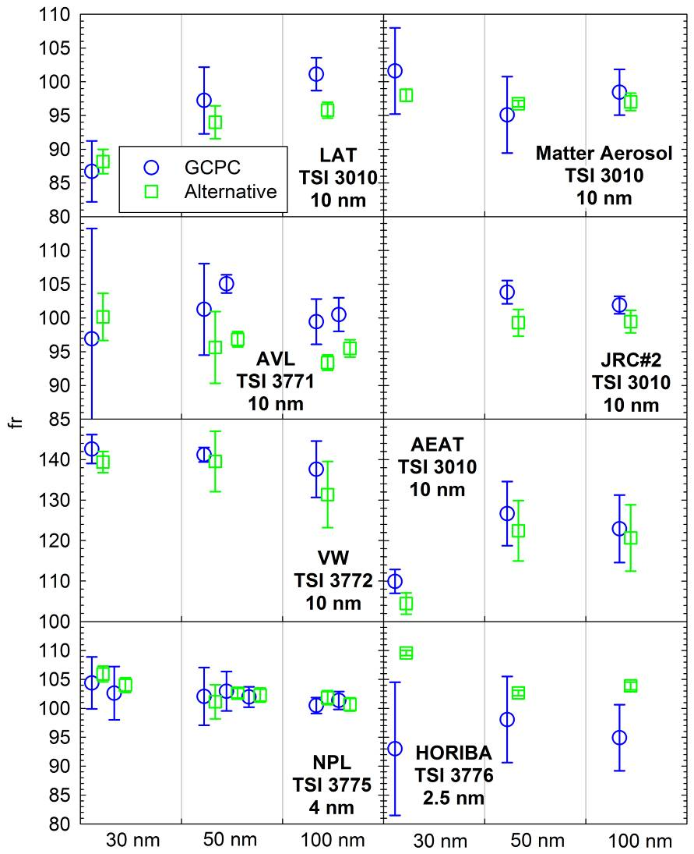
GAG/low cut-off size CPCs
The particle concentration reduction factors measured with low cut-off size CPCs agreed within ±5% to those determined with the GCPC.
Individual differences generally lied within the experimental uncertainty.

Slide 42
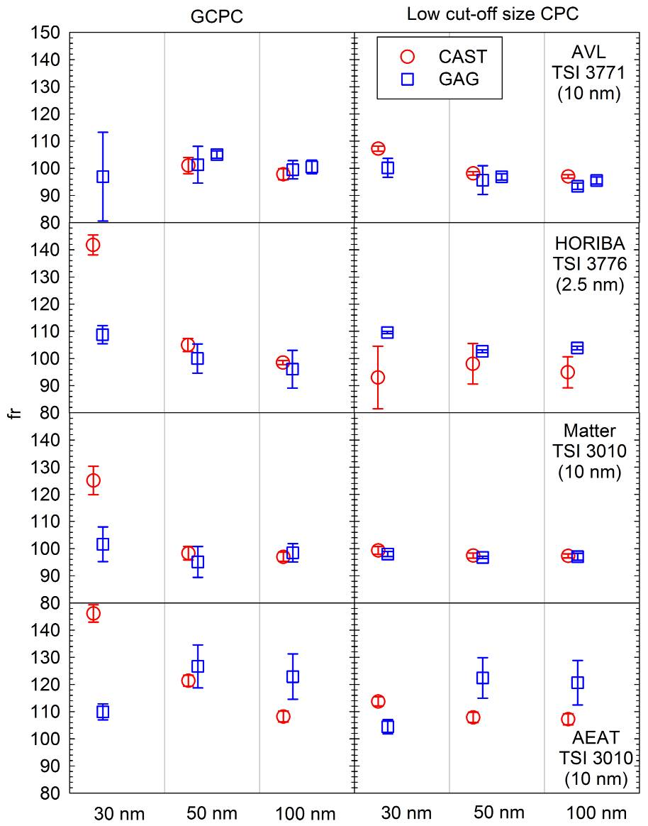
CAST
Low cut-off size CPCs gave similar results for CAST and GAG particles with the individual differences lying within ~±8% at all sizes
GCPC gave systematically higher particle concentration reduction factors for 30 nm CAST particles (~30% higher than GAG). ⇨ 30 nm CAST particles not thermally stable.
Lab | Temperature | Dilution
AVL | 350°C | 3.5:1
Horiba | 350°C | Not specified
Matter | 300°C | 2.5-3.5:1
AEAT | 350°C | No

Slide 43
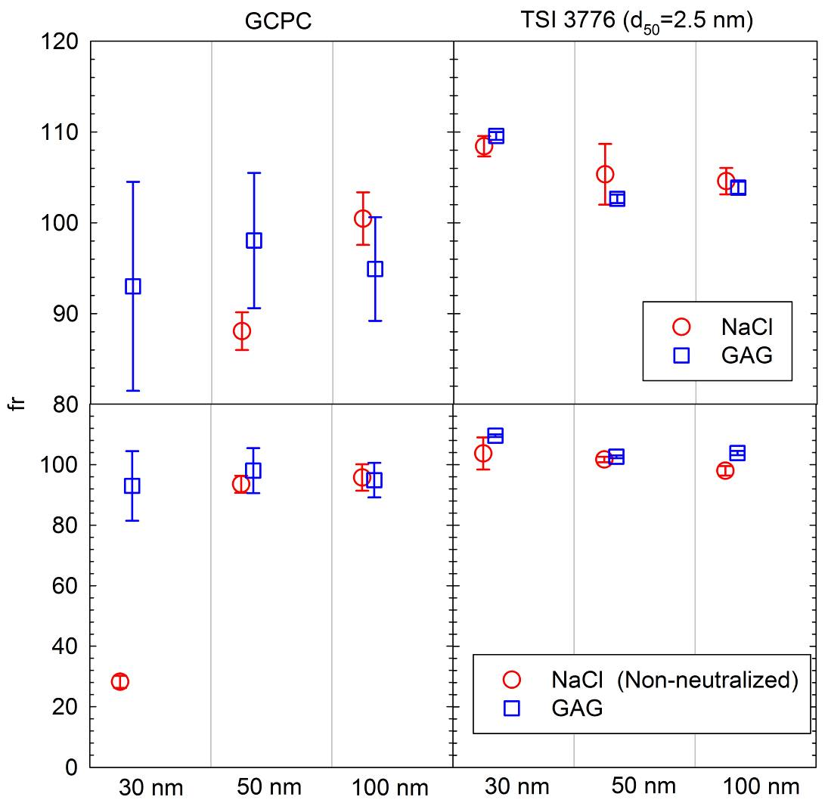
NaCl
Low cut-off size CPC: CAST and NaCl results agreed within ±5%
GCPC: Unrealistically low PCRF values were determined with 30 nm NaCl particles. This most probably reflects some hygroscopic growth.

Slide 44
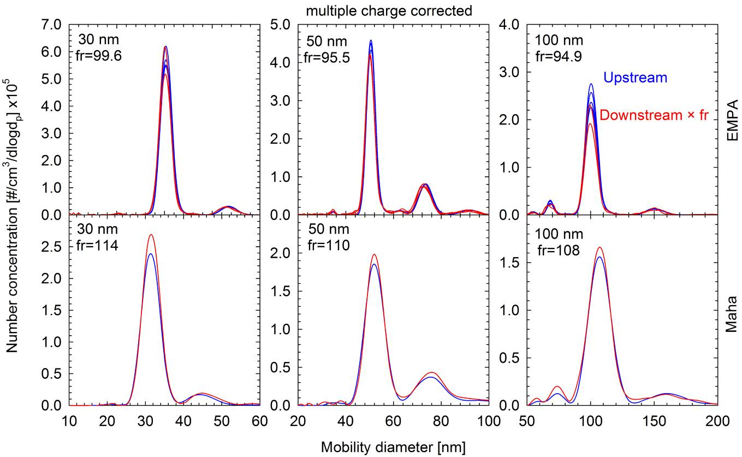
Thermal stability of GAG aerosol
Size distributions of DMA-classified graphite particles upstream and downstream of the GVPR suggest that graphite particles are stable at the 300°C of the GVPR ET.

Slide 45
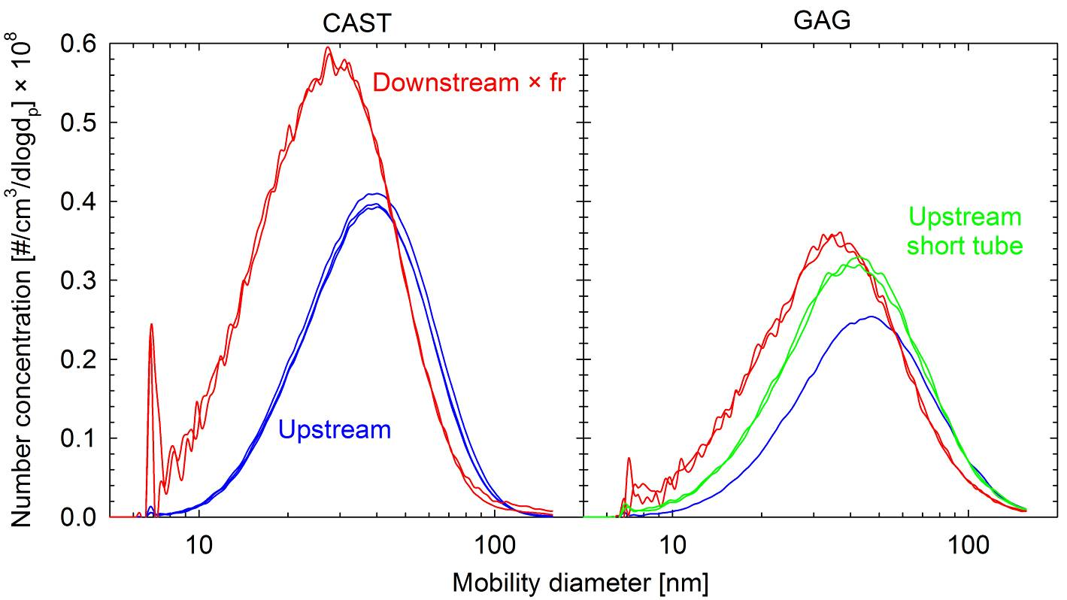
Polydisperse measurements
The high number concentrations can lead to significant coagulation. Care needs to be taken to ensure similar residence times when sampling upstream and downstream of the VPR

Slide 46
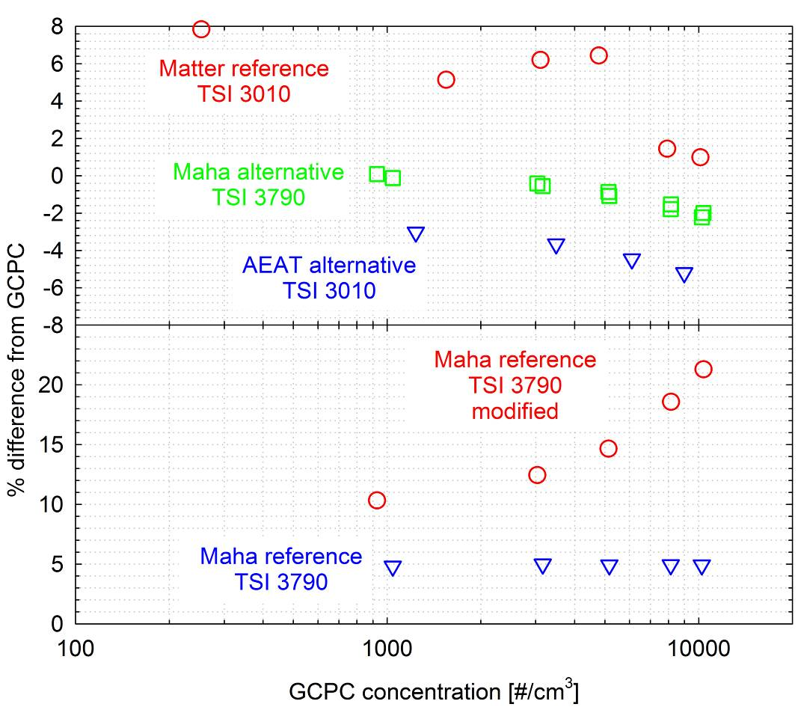
CPC linearity checks
No significant linearity issues were observed in cross checks of 14 in total CPCs against the GCPC.
The change of the operating temperatures of TSI 3790 CPC can lead to a highly non-linear beahaviour however.

Slide 47
Contents
Programme description
Characterization of the Golden Instrumentation at JRC
Round Robin results
Additional investigations
Conclusions

Slide 48
Conclusions #1
The dilution factor of the GVPR was very sensitive to the inlet, outlet and dilution air pressure.
With three exceptions, the measured PCRF values agreed within ±5%. Three labs measured systematically higher values (by 20%, 40% and 10%) and for two of them there exists evidence of dilution missadjustment.
Graphite particles were found to be thermally stable at least at the 300°C of the GVPR.
Salt particles and thermally treated CAST particles at 30 nm were not stable, and the GCPC (d50 at 23 nm) yielded 70% lower (NaCl) and 23-33% (CAST) higher PCRF values, respectively.

Slide 49
Conclusions #2
The use of low cut-off size CPCs, yielded equivalent results for GAG, CAST and NaCl particles even at 30 nm.
No significant linearity issues could be identified in the 15 in total CPCs characterized in the campaign. Operation of TSI 3790 CPC at elevated temperature differences can lead to a highly non-linear behaviour and should therefore be avoided.
Characterization of the GVPR using polydisperse aerosol is a rather challenging task as the high number concentrations can lead to significant particle coagulation.

Slide 50

Thank you for your attention
Acknowledgments:
T. Tzamkiozis (LAT), L. Ntziachristos (LAT), Barouch Giechaskiel (AVL)
A. Bergmann (AVL), D. Scheder (Horiba), K. Lenz (Horiba)
U. Dierks (Horiba), D. Schreiber (EMPA), P. Dimopoulos (EMPA)
D. Imhof (Matter Aerosol), M. Kasper (Matter Aerosol), P. Quincey (NPL) J. Tompkins (NPL), D. Sarantaridis (NPL), I. Marshall (AEAT)
J. Southgate (AEAT), S. Carli (VW), S. Usarek (VW)
D. Hitzler (Maha), H.-G. Horn (TSI), E. Lamminen (Dekati)
The experimental work conducted at JRC was partially funded by the EMRP-ENV02 PartEmission project. The EMRP is jointly funded by the EMRP participating countries within EURAMET and the European Union.

Slide 51
Summary of main conclusions #2
PMP VPR Calibration Round Robin
A VPR being very sensitive to sample conditions was intentionally selected to help identify critical elements of the calibration setup
Despite that, the measured PCRF values agreed within ±5%, with three exceptions. For two of them there exists evidence of dilution missadjustment.
Graphite particles were found to be thermally stable at least at the 300°C of the GVPR. Salt particles and thermally treated CAST particles at 30 nm were not stable leading to lower and higher, respectively, PCRF values when using PMP complying CPCs
For this reason, it is recommended to use low cut-off size CPCs, unless a verified thermally stable aerosol is employed
Additional recommendations expected from the EU EMRP ENV02 project

Slide 53
Next steps
Revision/update of the mandate
Definition of revised terms of reference as well as tasks and deadlines
  Phone/web conference to be organized asap followed by a face to face meeting (JRC-Ispra?)

Slide 54
Open issues on PN-PM emissions
Investigation of sub-23 nm particles emissions and of a possible need of extending the PMP methodology
PN measurements during active regeneration (WLTP)
Calibration related activities carried out within the EMRP ENV 02 project
Heavy duty related issues?
WHO statement about the carcinogenicity of the diesel exhaust: Inputs from the PMP WG needed?

Slide 55
Thank you!
Questions?

