Slide 1

Submitted by the expert from Sweden
Informal document GRPE-69-19
69th GRPE, 05- 06 June 2014
Agenda item 16(a)
Heavy-Duty Diesel Initiative
Lead Partners: United States, Canada, United Nations Environment Program, International Council on Clean Transportation
http://www.unep.org/ccac

Slide 2
Background
At the 68th GRPE the expert from Sweden reported about the diesel initiative under Climate and Clean Air Coalition.
From the report from the 68th GRPE meeting concludes that “... GRPE also welcomed the proposal of the expert from Sweden to present the activities of the Climate and Clean Air Coalition (CCAC), … in the next GRPE session”
This presentation is prepared by UNEP and presented by Sweden as a CCAC Partner and Co-Chair of the CCAC Working Group.

Slide 3
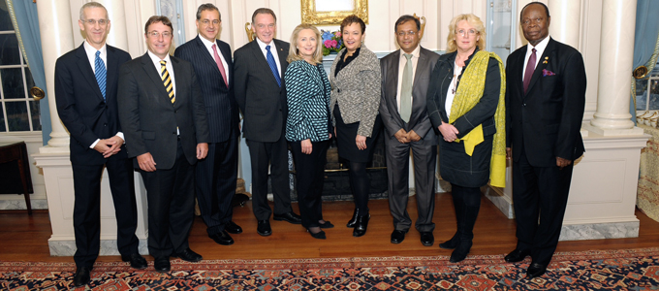
The Climate and Clean Air Coalition to Reduce Short- Lived Climate Pollutants (CCAC) is the first global effort to treat short-lived climate pollutants.
Founded in 2011 by Todd Stern, U.S. Climate Envoy; Achim Steiner, UNEP; Mexican Environment Minister Juan Rafael Elvira; Canadian Environment Minister Peter Kent; U.S. Secretary of State Hillary Clinton; U.S. EPA Administrator Lisa Jackson; Bangladesh Environment Minister Hasan Mahmud; Swedish Environment Minister Lena Ek; Ghanian Ambassador to the USA, Daniel Ohene Agyekum (Photo courtesy U.S. State Dept. 2011)

Slide 4

The Coalition's initial focus: methane, black carbon, and HFCs
Action on short-lived climate pollutants must complement, not replace, global action to reduce CO2
Black carbon, methane HFCs are responsible for a substantial fraction of current global warming, large impacts in urban areas, the Arctic, and have harmful health and environmental impacts
The Coalition's objectives are to address short-lived climate pollutants by:
  Raising awareness on impacts and mitigation strategies
  Enhancing and developing new national and regional actions and mobilizing support
  Promoting best practices
  Improving scientific understanding of short-lived climate pollutant impacts and mitigation strategies
Getty Images

Slide 5
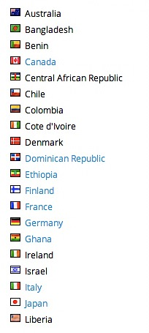
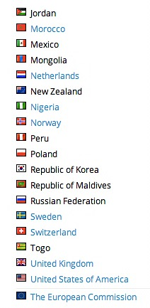
39 state + 53 non-state partners, 10 initiatives
Reducing Black Carbon Emissions from Heavy Duty Diesel Vehicles and Engines
Mitigating Black Carbon and Other Pollutants From Brick Production
Mitigating SLCPs from the Municipal Solid Waste Sector
Promoting HFC Alternative Technology and Standards
Accelerating Methane and Black Carbon Reductions from Oil and Natural Gas Production
Addressing SLCPs from Agriculture
Reducing SLCPs from Household Cooking and Domestic Heating
Financing of SLCP mitigation
Supporting National Planning for action on SLCPs (SNAP)
Regional Assessments of SLCPs

Slide 6
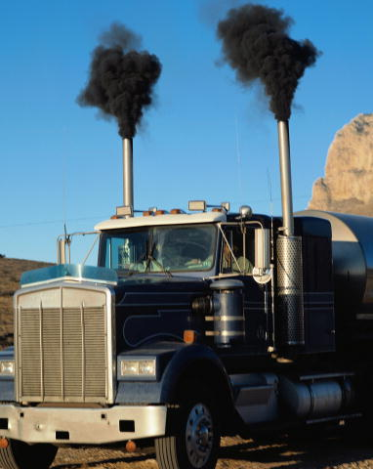
Initiative: Reducing Black Carbon Emissions from
Heavy Duty Diesel Vehicles and Engines
Works to reduce the climate and health impacts of black carbon and particulate matter (PM) emissions in the transport sector
An estimated 19% of global black carbon emissions from transportation sector
Heavy duty diesels are a major source of fine PM emissions (PM 2.5 or less)
These particles are responsible for 3.2 million early deaths worldwide per year
On vehicles without a diesel particulate filter, BC accounts for 50-80 per cent of PM

Slide 7
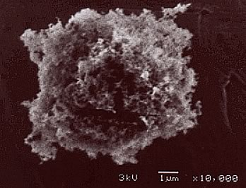
Black Carbon at the nexus of air quality and climate change, co-benefits are significant
Air Quality
Air Quality
PM
NOx
VOC
SOx
HC
CO
Metals
Ozone
PM
Black Carbon
Methane
  N₂0
Climate Change
CO2
UNEP
Fuel Quality/Emission Controls
Fuel Economy

Slide 8
By eliminating barriers to adoption of cleaner vehicle and fuel standards globally, potential for:
reduction of 2.7 million metric tons of fine particles
1.9 metric tons of black carbon emissions from heavy-duty vehicles globally
up to 1.4 million fewer cases of premature deaths
Potential black carbon savings equivalent to 6.1 gigatonnes CO2-equivalent with a 20-year global warming potential

Slide 9
Heavy-duty Diesel Initiative:
Structure and Work
Co-leads: US, Canada, ICCT and UNEP
Partners: Mario Molina Center Chile, Smart Freight Center, Clean Air Asia, Natural Resources Defense Council
Objective: To virtually eliminate fine particles and black carbon emissions from new and existing heavy duty diesel vehicles and engines (including marine vessels) by:
  Steadily reducing sulfur in diesel fuel…
  Establishing more stringent emission standards with interested nations and parties…
  Cleaning up existing fleets…
  Cleaning up ports and marine transport
  And developing a global Green Freight initiative

Slide 10
      Current HDD activities funded by CCAC:
        National and Regional Programs: East, West, Southern Africa; Asia; Latin America; Indonesia; Mexico; China; Arctic
  Global Strategies: Low Sulfur Fuel and Green Freight
  Marine Vessel and Ports Project:
    Jakarta, Indonesia
    Chittagong, Bangladesh
    Aqaba, Jordan
    Valparaiso, Chile
    Tema, Ghana
  CCAC financial support to date: $3.5 million + co-funding from co-leads

Slide 11
Regional and country level
  LAC
    Chile, Peru, Mexico
    Regional action plan
  Africa
    East Africa
    Regional action plan
  Asia
    Indonesia, China, Vietnam, Bangladesh
    ASEAN sub-regional action plan
Global
  Green Freight
  Green Ports
  Global Financing and Markets Sulphur strategy
First results: countries adopt clean diesel strategies and standards; global recognition of problem – health & climate; development of global programs

Slide 12
Regional and National Implementation Case Studies: East Africa, Latin America

Slide 13
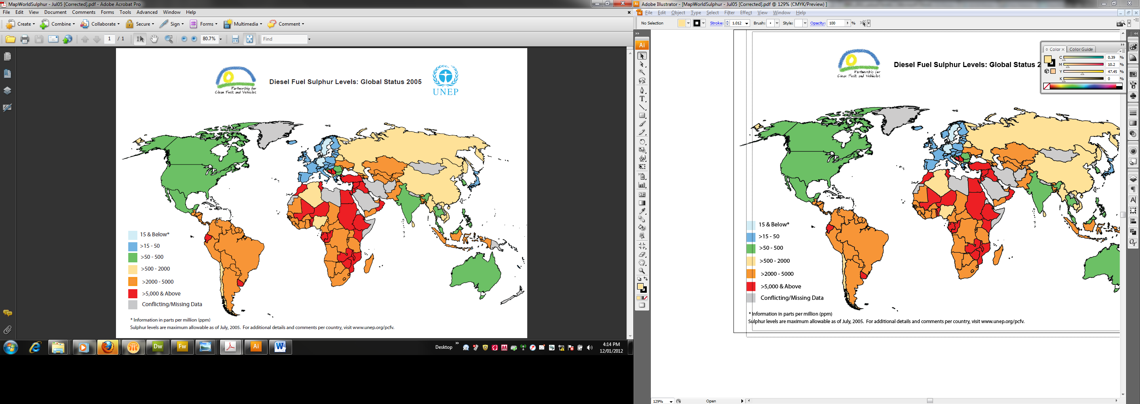
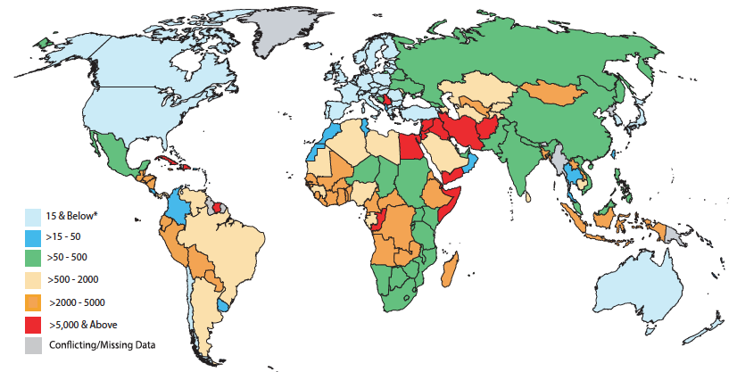
Countries World-Wide are Introducing Low Sulfur Diesel
Major improvements in all regions
First developing countries with ULSD
But much to be done and need to speed up
2005
2014

Slide 14
CCAC Clean Fuels and HDD Support
East Africa
June 2013: East African Community Decision for 50 ppm diesel and 150 ppm petrol
September 2013: Kenya refinery is shut down
December 2013 EAC harmonizes standards - effective January 2015
East Africa first non-OECD sub-region to adopt low sulfur fuels

Slide 15
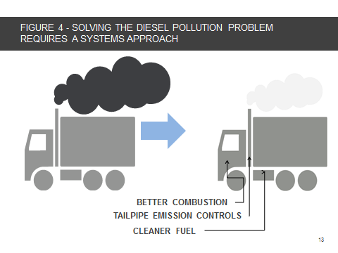
Clean Diesel Latin America, 2013 - 2015
Development of HDD emission standards, Chile
Black Carbon Inventory, Chile
Clean Diesel Strategy, Peru
Regional fuel quality and diesel standards harmonization through Latin America Environmental Ministers Forum
Diesel filter demonstration, retrofits in Lima, Montevideo, Santiago de Chile

Slide 16
HDD Initiative Plans 2014 +
Expand CCAC developing country membership in all regions, especially East Europe
Complete low sulfur fuels transition: West Africa, Southern Africa
Low sulfur adoption in Mexico City, Beijing
Diesel retrofits programs in Latin America: Mexico City, Lima, Montevideo, Santiago de Chile
Expand ports work in Asia, Africa, Latin America

Slide 17
THANK YOU!
http://www.unep.org/ccac

