Slide 1
Informal document GRPE-69-28
69th GRPE, 05 - 06 June 2014,
Agenda item 14
Proposal for Vehicle Indoor Air Quality (VIAQ)
5-6 June 2014
KATRI, The Republic of KOREA
(Korea Automobile testing & research Institute)

Slide 2
Contents
1. Background
2. Case Study in KOREA
3. International Status of VIAQ Status
4. Conclusions
Notes:
2

Slide 3


Background
Increasing concerns about Vehicle Indoor Air Quality(VIAQ)
Various chemical substances to harmful to human body are emitted from
vehicle interior materials
Many countries research & manage vehicle indoor air quality
Netherlands, France, Sweden, Germany, Japan, USA, China, Korea
ISO Standard(12219-1:2012), China(GB/T 27630-2011), Korea(Notification No.
2013-889)
Need to unified regulation on vehicle indoor air quality(VAIQ)
to protect driver’s health and safe driving

Slide 4

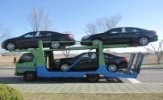
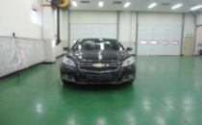
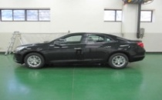
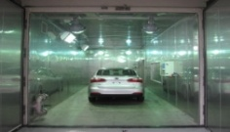
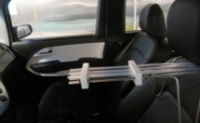
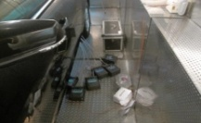
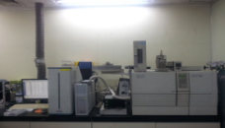
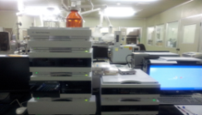
Case Study in KOREA
    Korea government established VIAQ guideline in 2007
    Verification test : 2011~ , No penalty but notification to consumer
    Verification test whether automobile manufactures comply with VIAQ guideline
Car Preparation
14days
28days
2 hours
Room Temperature Stabilizing
Sampling
Temp. Stabilizing
Sampling
Sample
Analysis
  4
GC/MS
HPLC
Content Analysis

Slide 5
Case Study in KOREA
    Verification test results of VIAQ year by year
YEAR | Item | Formaldehyde | Toluene | Ethylbenzene | Styrene | benzene | Xylene
Limit(μg/m³) |  | 250 | 1,000 | 1,600 | 300 | 30 | 870
2006 (36 new model) Before VIAQ guideline | Averg. | 98 | 518 | 222 | 64 | 111 | 828
 | Min | 22 | 51 | 49 | 12 | 7 | 112
 | Max | 955 | 2384 | 632 | 185 | 385 | 2164
2011 (9 new model) After VIAQ guideline | Averg. | 35 | 1046 | 102 | 14 | - | -
 | Min | 8 | 108 | 20 | 7 | - | -
 | Max | 56 | 2846 | 470 | 25 | - | -
2012 (8 new model) After VIAQ guideline | Averg. | 20 | 328 | 66 | 33 | 7 | 199
 | Min | 4 | 85 | 18 | 4 | 5 | 45
 | Max | 49 | 753 | 131 | 136 | 13 | 379
2013 (4 new model) After VIAQ guideline | Averg. | 24 | 206 | 28 | 5 | 1 | 80
 | Min | 5 | 65 | 8 | 3 | 1 | 21
 | Max | 38 | 430 | 51 | 7 | 3 | 140

Slide 6
Case Study in KOREA
    Comparison of 2006 (Not Apply) and 2011~2013 (VIAQ) test results
After the VIAQ regulation, vehicle indoor air quality levels drastically improved
VIAQ management regulation is proven to be effective to reduce VOCs inside new vehicle
(* VOC : Volatile organic compound)
<Formaldehyde>
<Toluene>
< Ethylbenzene>
<Styrene>
<benzene>
< Xylene>

Slide 7
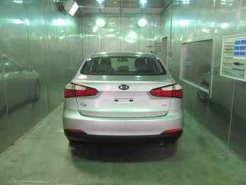
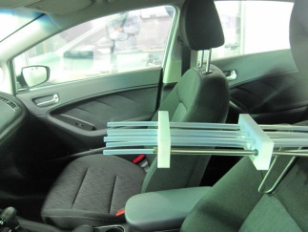
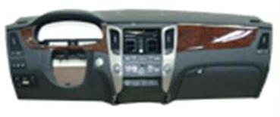
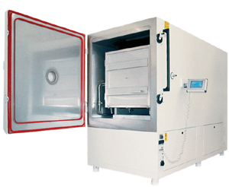
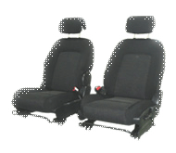


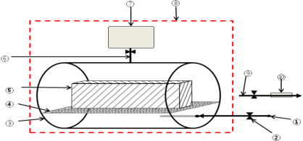
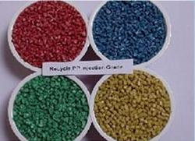
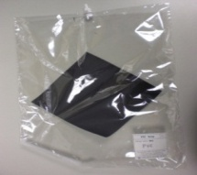
Case Study in KOREA
    Improvement case of VIAQ
Hazardous substances are reduced by using environmentally material, BTX free adhesive…
There are assessment test each step for managing VIAQ to reduce VOCs inside new vehicle
Tier 1
Completion of Assembly
VIAQ Assessment test
Tier 2
Assembly VOC test
Unit components
Tier 3
Environmentally material
BTX Free adhesive
Vacuum and thermal process
- hot dry process(infra-red heat)
- water soluble solvent

Slide 8
International Status of VIAQ
    VIAQ Standards Worldwide – Test conditions
KOREA | CHINA | JAPAN | VDA | ISO-12219
Mistry of Land Infrastructure and Transport | Ministry of Environmental Protection and State Administration of Quality Supervision, Inspection and Quarantine | JAMA ‘Self-Commitment’ & Ministry of Health, Labor and Welfare | ‘Self-Commitment’ of the German Association of the automotive Industry | International Organization for Standardization Technical Committee ISO/TC 146, Air quality, Subcommittee SC 6, Indoo air
Control Standard for in-car air quality for new motor vehicles MOLIT Notification NO. 2013-546(2013.09.24) | Voluntary Standard GB/T 27630-2011 Implementation date : 1 March 2012 National Standard of the People’s Republic of China | Voluntary Standard since 2005 | Voluntary Guideline since 1993 | ISO 12219-1 International Standard
Temperature Stabilization 25±2℃ For 20h Ventilation for 30 min seal for 2h sampling after 15 min | Temperature 25±1℃ Relative air humidity 50% Vehicle standstill, all vehicle doors, windows and passenger compartment vents closed, the engine and air- conditioner deactivated | Temperature 40℃ for 4,5h Sampling after 15/30 min AC setting : AC on, circulation | Temperature 65℃ Air exchange rate 0.6 N㎥/h | Temperature 23±2℃ Constant Heating with 400W/㎡ ac on Fresh air circulation Vetilation on
* ACEA Presentation in Beijing 2013

Slide 9
International Status of VIAQ
    Comparison of vehicle indoor air quality limit
Vehicle Indoor Air Quality limit values differ between countries due to test conditions
There are no VIAQ limit value in ISO-12219
(Unit : ㎍/㎥)
Harmful Substances | Korea | China | JAPAN (JAMA) | ISO-12219
Formaldehyde | 210 | 100 | 100 | -
Benzene | 30 | 110 | - | -
Toluene | 1,000 | 1,100 | 260 | -
Ethyl Benzene | 1,000 | 1,500 | 3,800 | -
Xylene | 870 | 1,500 | 870 | -
Styrene | 220 | 260 | 220 | -
Acetaldehyde | - | 50 | 48 | -
Acrolein | 50 | 50 | - | -
Total | 7 types | 8 types | - | -

Slide 10
International Status of VIAQ
    Management status of manufacturers
Manufacturers | Management Status
GM | VOC management based on GM standard
FORD | VOC management based on FORD standard
VOLVO | Management based on Chinese regulations
Nissan, Honda, Toyota | Management based on Japanese Automobile Manufacturers Association (JAMA) guideline
Porsche | Management based on German Automobile Industrial Association VDA 270 (smell test) , VDA 275 (measurement of formaldehyde emission), VDA 278 (volatile organic compound) regulations
Jaguar Land-rover | Applies Japanese and Chinese regulations
Hyundai, Kia | Management based on Korean and Chinese regulations
Notes:
10

Slide 11
The Progress of VIAQ
    2007 Standard for vehicle indoor air quality for new motor vehicles KOREA
    2013.06 GRPE-66-03 “Proposal for a new UN Global Technical Regulation on Vehicles Indoor Air Quality”
    2013.06 WP29-160-38 “Proposal for a new UN GTR on Vehicle Indoor Air Quality (VIAQ)”
    2013.11 WP.29-161-12 “Proposal for development of a new UN Global Technical Regulation on Vehicle Indoor Air Quality”
    2014.03 WP.29-162-16 “Implementation of Vehicle Indoor Air Quality”
Notes:
11

Slide 12
The Comment of VIAQ
    Canada : Continue to follow the VIAQ issue
    Russian Federation : an active participation in this work
    European Commission : Concern to involve the proper experts for chemical legislation
    OICA : based on an international standard and be addressed in the Consolidated Resolution for the Construction of Vehicles (R.E.3) and the special resolution S.R.1.
    Additional comments are needed from other CPs and stakeholders
Notes:
12

Slide 13
Conclusion
    VIAQ could be considered not only as a chemical issue but as a safe driving environment issue for vehicles
    There are several different standards on VIAQ
    - Korea, China, Japan(JAMA), ISO-12219 …
    After Korea’s applying the VIAQ regulation, VIAQ have been improved rapidly. It has been proved that VIAQ regulation is effective
    For further review of CPs and stakeholders on VIAQ, it is needed additional period of time
    With these reviews and comments from CPs and Stakeholders, Korea will propose, as a first step, the development of guideline VIAQ at the next GRPE meeting
    It is necessary to active cooperation of CPs and Stakeholders
Notes:
13

Slide 14

Thank you very much ! !
Notes:
14

