Slide 1
Dutch Campaign ‘Choose the Best Tyre’
Informal document GRB-62-01-Add.1
(62nd GRB, 1-3 September 2015,
agenda item 9)
Transmitted by the expert from the Netherlands

Slide 2
Partners
Royal Dutch Touring Club (ANWB), >50% (4 mil. Members)
Dutch Association of Mobility Retailers (Bovag), +10,000 members, ~100 % car dealers and garages
Automobile and Bicycle Industry Association (RAI), +500 manufacturers and importers, ~100%
Dutch Tyre and Rim Association (VACO), >90%
End of Life Tyre management in NL (RecyBEM), ~100%
Dutch Noise Abatement Society, 1000 members
Band op Spanning (Translation: Tyres at pressure), Foundation
Ministry of Infrastructure and Environment

Slide 3
Goals of the campaign
Raise awareness
Raise knowledge
Reduce casualties, noise and CO2

Slide 4
Campaign Message
Choose the Best Tyre
-tyre label
-tests internet
-tyre specialist
Tyre maintenance
-tyre pressure, every 2 months
-profile, 1.6-2.5 mm
-damages

Slide 5
Instruments
Each partner does what it can
Ministry of Infrastructure and Environment
Backside of letter on the yearly required general car inspection
Digital Route Information PanelS
Carfleets on Best Tyres!

Slide 6
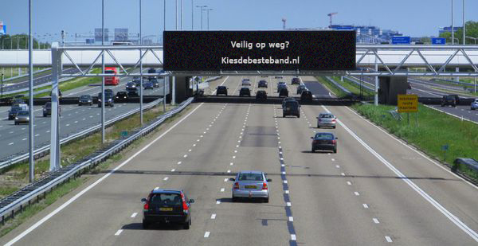

Slide 7
Declaration on Best Tyres
40% of new cars are leased by companies
Potential of using Best Tyres
Declaration on Best Tyres

Slide 8
Potential of using Best Tyres
‘Triple A studies’
Fleets on Best tyres

Slide 9
Triple-A tyres – benefits for environment, noise, safety and economy
Potential benefits of Triple-A tyres in the Netherlands, the EU and Rotterdam
Rotterdam
0.626 million inhabitants
Area 210 km²
Roads/streets 1100 km
5 billion km (10% heavy duty)

Slide 10
Benefits Triple A in EU
Potential benefits | Energy | Safety | Noise | TOTAL
Annual fuel savings [ billion l] | 17 | - | -
Annual CO₂ reduction [ MtCO₂] | 42 | - | -
Reduced number of fatalities | - | 2567 | -
Reduced number of slight/ serious injuries | - | 19631/ 12353 | -
Reduced number of annoyed people [millions] | - | - | 13
Reduced number of sleep disturbed people [ millions] | - | - | 6
Annual cost savings [ billion €] | 13 | 10 | 11 | 34

Slide 11
Benefits Triple A (correct tyre pressure) in Rotterdam
Potential benefits | Energy | Safety | Noise | TOTAL
Annual fuel savings [ million l] | 28 (6) | - | -
Annual CO₂ reduction [ tCO₂] | 69(15) | - | -
Reduced number of fatalities | - | - | -
Reduced number of slight/ serious injuries | - | 3/6 | -
Reduced number of annoyed people [thousands] | - | - | 7.4
Reduced number of sleep disturbed people [ thousands] | - | - | 5.7
Annual cost savings [ million €] | 20.5 | 0.9 | 3.2 | 25

Slide 12
Fleets on Best Tyres
Potential Benefits of energy-efficient tyres and correct tyre pressure maintenance of the vehicle fleets of:
Dutch National Road Authority (RWS)
Amsterdam
Rotterdam

Slide 13
Fleets on A for Energy and correct tyre pressure
Potential benefits | RWS | Amsterdam | Rotterdam
Number of vehicles | 1575 | 781 | 1097
Vehicle average [ km/yr ] | 26000 | 17200 | 17300
Annual fuel savings (correct pressure) [ thousands ltr] | 152 (26) | 147 (33) | 200 (45)
Annual CO₂ reduction [ ton CO₂] | 388 | 379 | 514
Annual cost savings [ thousands €] | 237 | 224 | 304
Annual cost savings per vehicle [€] | 150 | 287 | 277

Slide 14
200 large cities in Europe

Slide 15
Declaration on Best Tyres
We Eurocities, aware that EU urban traffic causes:
Traffic accidents: 10,000 deaths in 2010
Poor air quality: 33% citizens exposed > Air Q. limits
Climate change: biggest contributer to CO₂
Noise exposure:
50% citizens exposed > 55 dB L_{DEN}
15 % citizens exposed > 65 dB L_{DEN}
10,000 premature deaths
We also know that Better tyres:
have major benefits
are widely available
do not cost more

Slide 16
Declaration on Best Tyres
We Eurocities declare to:
provide municipal fleets with ‘Best Tyres”
evaluate the progress
include ‘Best Tyres’ in our Green Procurement pol.
strive to achieve 50% ‘Best Tyres’ in 2020
provide municipal fleets with TPMS
consider a EU wide benchmark
endeavour to report every 2 years

Slide 17
Declaration on Best Tyres
contribute to stricter emission limit values for cars
contribute to stricter emission limit values for tyres
promote the use of ‘Best Tyres’
call upon (fleet-owners) to apply ‘Best Tyres’

Slide 18
Declaration on Best Tyres
Where/when can I sign up?
Invitation letter to all Eurocities
Signing at the combined meeting of POLIS and EUROCITIES mobility Forum 2016
Information
website www.best-tyres-now.eu
e-mail to henk.wolfert@dcmr.nl

Slide 19
Thank you for your attention

