Slide 1
Proposal Netherlands Tyre Noise Limits
Transmitted by the expert from the Netherlands
Informal document GRB-62-11-Add.1
(62nd GRB, 1-3 September 2015,
agenda item 7)
Original GRB-61-03

Slide 2
C1 tyres
Stage 3
Nom. sect. width | Limit dB(A)
185 and lower | 67
185 up to 245 | 68
245 up to 275 | 69
Over 275 | 71

Slide 3
C2 tyres
Stage 3
Category of use | Limit dB(A)
 | Other | Traction tyres
Normal tyre | 70 | 71
Snow tyre for use in severe snow conditions | 71 | 73
Special use tyre | 72 | 73

Slide 4
C3 tyres
Stage 3
Category of use | Limit dB(A)
 | Other | Traction tyres
Normal tyre | 69 | 71
Snow tyre for use in severe snow conditions | 71 | 72
Special use tyre | 71 | 73

Slide 5
Policy Indicator Noise Emissions Roadtraffic
Eroad surfaces + Etyres + Epowertrain -->
# People annoyed/sleepdisturbed

Slide 6
Scenario’s
2015: present situation
2030 BAU: 1% growth traffic/yr, autonomous policy vehicles and tyres
2030 NL proposal: reduction ~ 2-3 dB
(GRB 61-03)

Slide 7
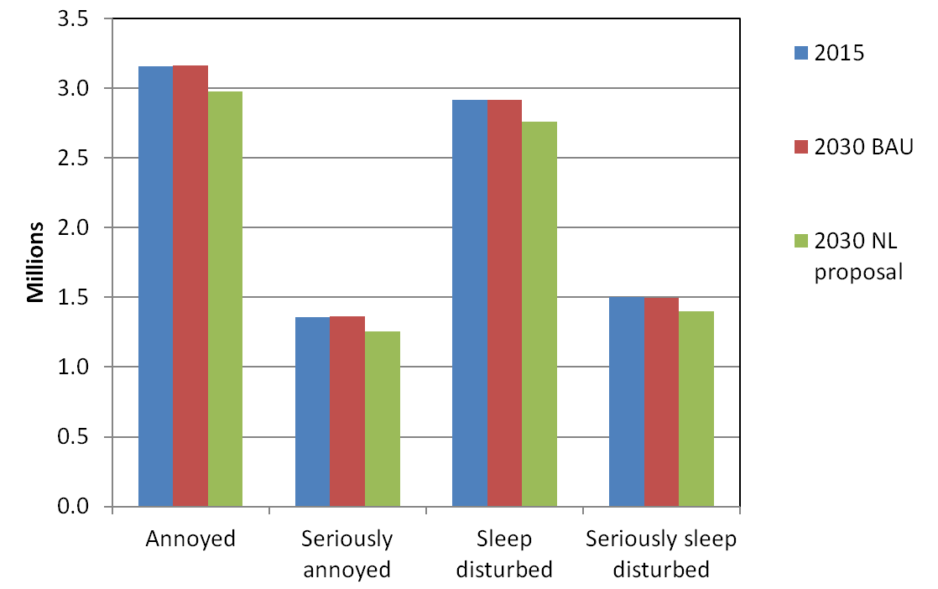

Slide 8
Scenario | Annoyed | Reduction from Sc.1 | Seriously annoyed | Reduction from Sc.1
2015 | 3161245 |  | 1360113
2030 BAU | 3165333 | -0,1% | 1364278 | -0,3%
2030 NL pr | 2975205 | 6% | 1252984 | 8%

Slide 9
Scenario | Sleep disturbed | Reduction from Sc.1 | Seriously sleep disturbed | Reduction from Sc.1
2015 | 2917483 |  | 1500615
2030 BAU | 2914577 | 0,1% | 1499111 | 0,1%
2030 NL pr | 2761946 | 5% | 1400251 | 7%

Slide 10
NLs proposal: GRB-62-11
OEM tyres -1 dB
Stages 3
Amendment 12.10 and 12.11

Slide 11
12.10 As from 1 November 2020, Contracting Parties applying this Regulation shall refuse to grant approval if the tyre type to be approved does not meet the requirements of this Regulation as amended by the 02 series of amendments, and shall, in addition, refuse to grant approval if the stage 3 rolling sound requirements set out in paragraphs 6.1.1. to 6.1.3. of this Regulation are not complied with.

Slide 12
12.11 As from 1 November 2024, any Contracting Party applying this Regulation may refuse to allow the sale or entry into service of a tyre which does not meet the requirements of this Regulation as amended by the 02 series, and which does not meet the stage 3 rolling sound requirements set out in paragraphs 6.1.1. to 6.1.3. of this Regulation.

