Slide 1

A Policy Indicator for Road Traffic Noise Emission
Transmitted by the expert from the Netherlands
Informal document GRB-62-14-Add.1
(62nd GRB, 1-3 September 2015,
agenda item 9)
GRB 62, Geneva, September 1-3, 2015
Michael Dittrich, TNO
Johan Sliggers, NL Ministry of Infrastructure
and Environment

Slide 2
Content
Background
Policy Indicator outline
Scenarios for 2030
Analysis results
Discussion
Conclusions

Slide 3
Background
As an environmental factor, noise is second only to air pollution for impact on public health
3 million people annoyed by road traffic noise in the Netherlands,
1.5 million sleep disturbed
Most cost-effective means of mitigation are reduction of noise at source for vehicles, tyres and road surfaces
Survey data, noise mapping and action plans (END) available
But: Integrated noise policy is lacking
Link needed between the various noise source mitigation measures and health effects at national level
What are the effects of vehicle and tyre noise limits on average façade noise levels, annoyance and sleep disturbance?

Slide 4
Policy indicator
Determines effect of noise control at source on average noise levels at the dwelling façade and on estimated numbers of annoyed and sleep disturbed people, for all roads
Indicative large scale estimate, not for use in individual situations or small areas

Slide 5
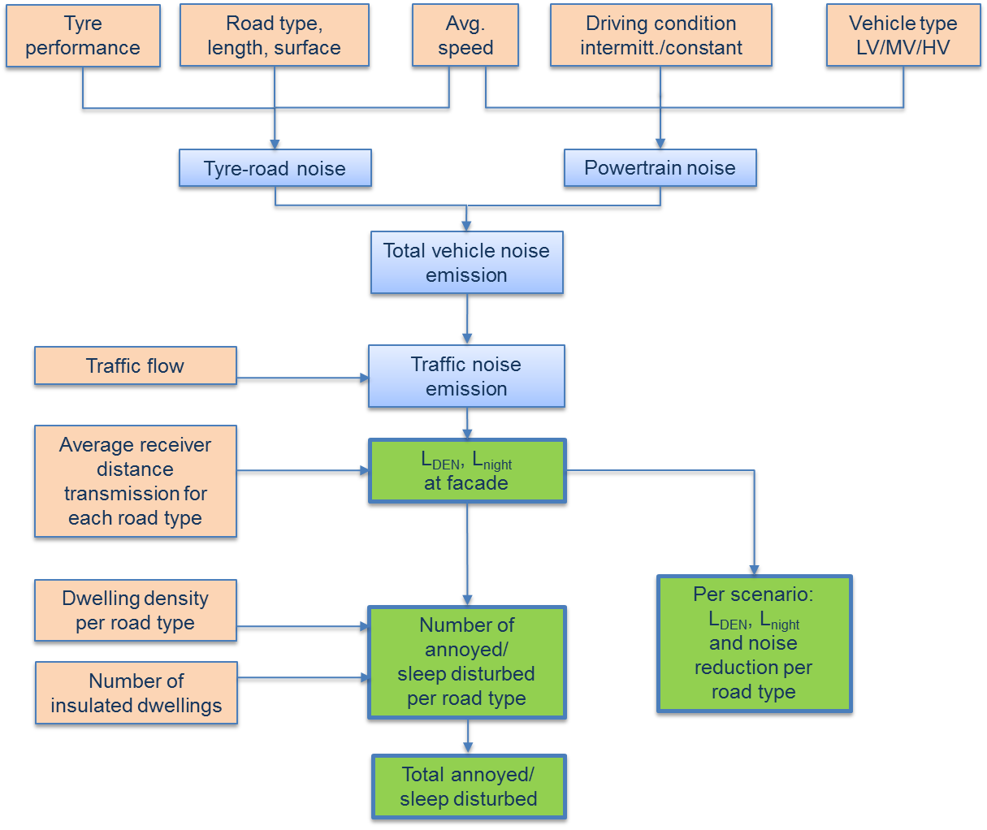
Model for Policy Indicator
Based on EU and NL traffic noise prediction methods
Use tyre label, vehicle limits and infra parameters
Predict average L_{den} and L_{night} at façade for each road type
EU dose-effect relationships for percentages annoyed and sleep disturbed

Slide 6
Road data and traffic characteristics

Slide 7
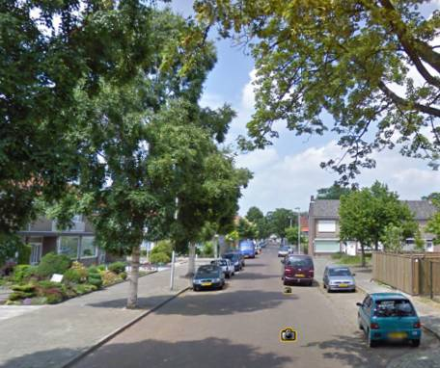
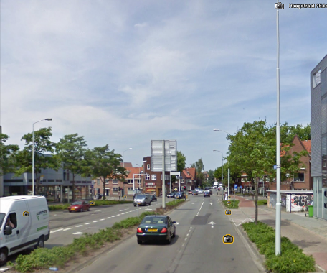
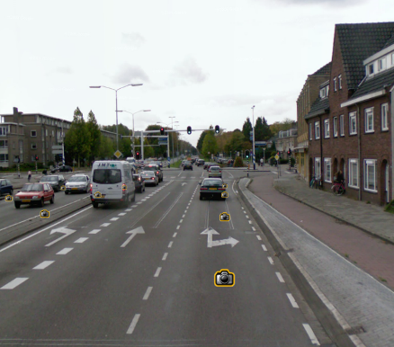
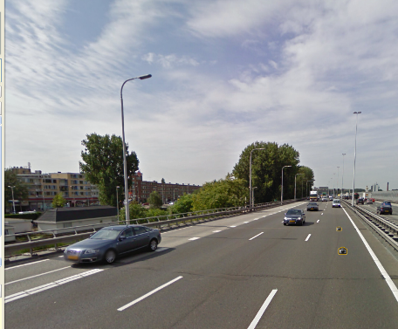
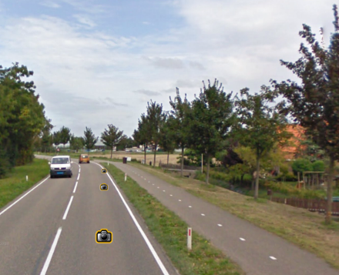
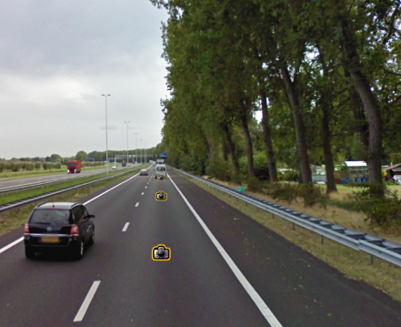
Road types
Residential road
- intermittent
- free flow
Main road
- intermittent
- free flow
Arterial road
free flow
Urban motorway
free flow
Rural road
free flow
Rural motorway free flow

Slide 8
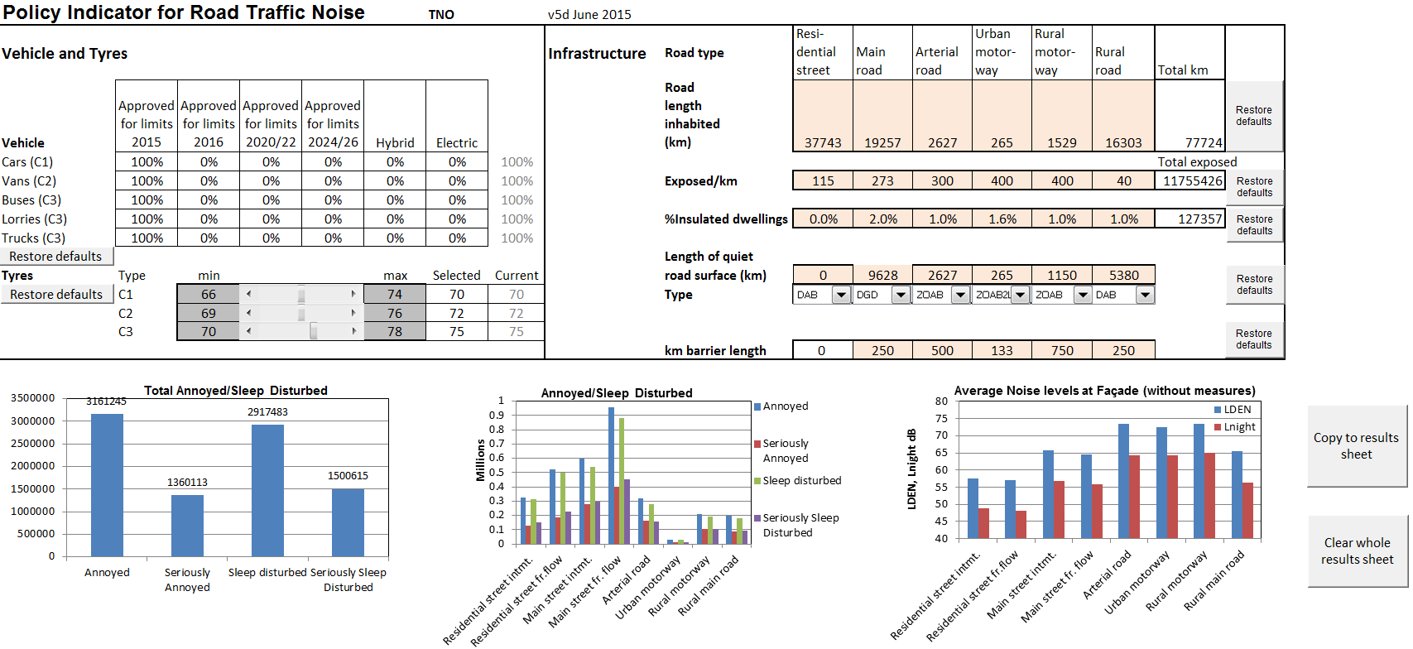
Spreadsheet overview

Slide 9
Scenarios for 2030
Scenario | Description
1. Situation in 2015 | Fleet composition, road infrastructure, mitigation measures and demographics in the Netherlands in 2015.
2. 2030 including 1% growth | 1% growth in traffic, no extra measures and autonomous intake of quieter vehicles and tyres, with a fleet distribution as in Table 3.
3. 2030 Sc.2 + quiet vehicles | Scenario 2 with 3 dB quieter vehicles compared to the EU-limits for 2024/2026 (Table 2).
4. 2030 Sc.2 + quiet tyres | Scenario 2 only with quieter tyres. Tyres 2 dB quieter than the limits for 2020 proposed by the Netherlands (Table 4).
5. 2030 Sc.2 + quiet road surfaces | Scenario 2 with wider application of quiet road surfaces only (2-layer ZOAB with fine top layer), on all roads with dwellings and speed limit of 50 km/h or more, except calmer streets in residential areas.
6. 2030 Sc.2 + all measures | Combination of scenarios 2,3,4 and 5.

Slide 10
EU limit values converted to emission for 3 vehicle categories and scen.3 quiet vehicles
(Table 2)

Slide 11
Fleet composition (scen.2) and tyre limits (scen.4)
(Table 3)
(Table 4)

Slide 12
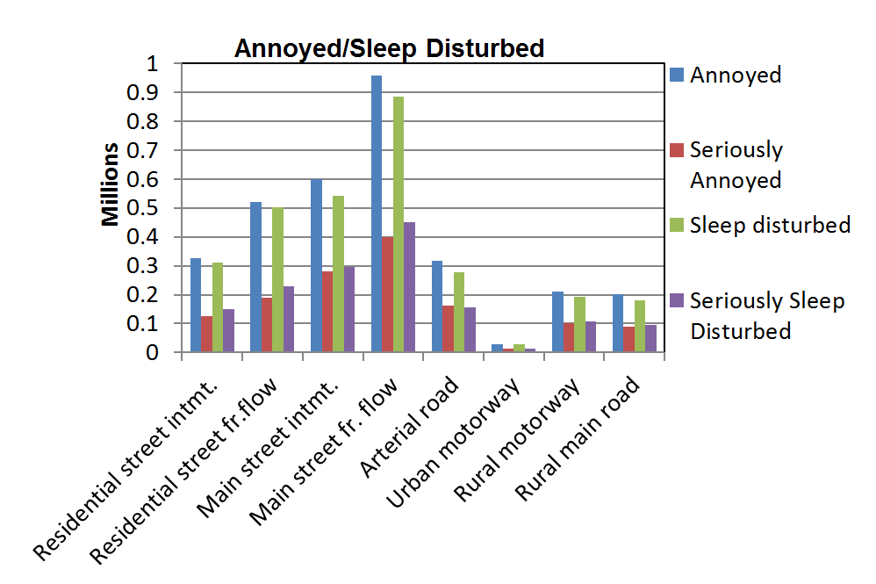
Analysis results
Numbers of annoyed and sleep disturbed for each road type in scenario 1, 2015

Slide 13
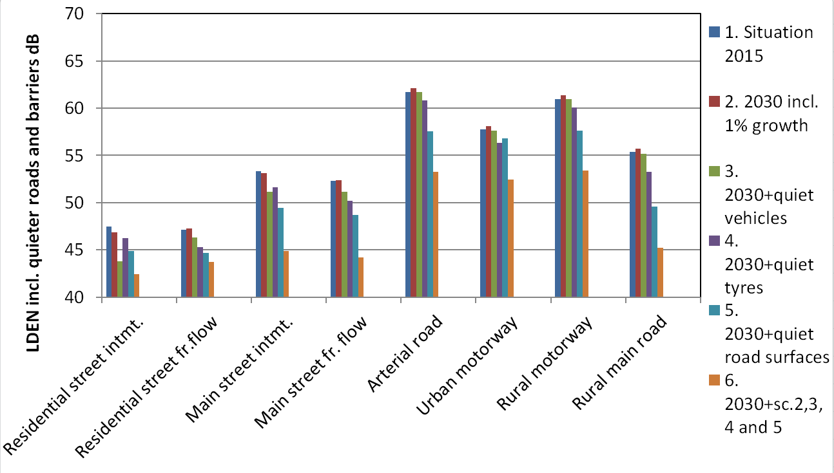
Façade noise levels for each scenario and road type

Slide 14
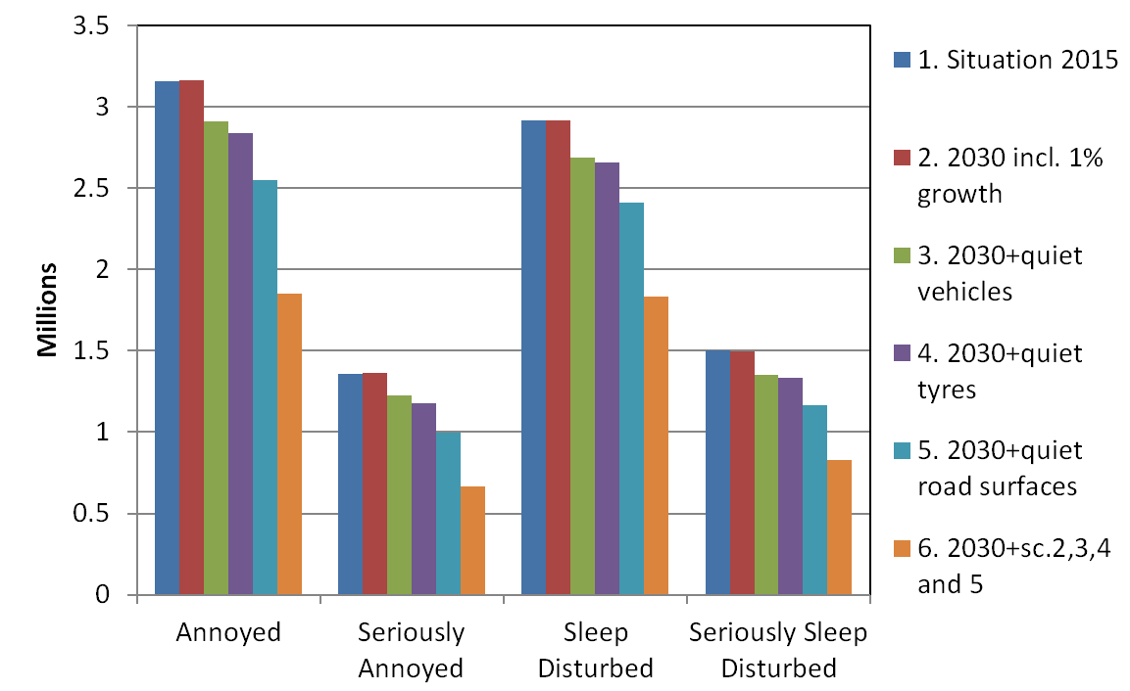
Total numbers annoyed and sleep disturbed for each scenario

Slide 15
Total numbers annoyed and sleep disturbed for each scenario and reductions
Scenario | Annoyed | Reduction from Sc.1 | Seriously Annoyed | Reduction from Sc.1 | Sleep Disturbed | Reduction from Sc.1 | Seriously Sleep Disturbed | Reduction from Sc.1
1 | 3161245 |  | 1360113 |  | 2917483 |  | 1500615
2 | 3165333 | -0.1% | 1364278 | -0.3% | 2914577 | 0.1% | 1499111 | 0.1%
3 | 2914022 | 8% | 1222993 | 10% | 2687540 | 8% | 1354446 | 10%
4 | 2840506 | 10% | 1176935 | 13% | 2660222 | 9% | 1335718 | 11%
5 | 2550716 | 19% | 995040 | 27% | 2411667 | 17% | 1166955 | 22%
6 | 1854576 | 41% | 664176 | 51% | 1832317 | 37% | 831292 | 45%

Slide 16
Discussion
Both individual and combined mitigation measures can be assessed
Besides noise limits, the public can also be encouraged to buy better tyres. Calculations with the Policy Indicator show that the Dutch awareness campaign 'Choose the best tyre' makes sense.
Voluntary change to quieter vehicles can be incentivised, such as by introducing a vehicle noise label.
The Policy Indicator shows that both tightening limits and incentivising quiet tyres and quiet vehicles is effective
The European Commission has the obligation to
  evaluate and revise the Regulation on General Safety 661/2009 including tyre noise
  perform an assessment of a vehicle noise label in relation to the Regulation on Vehicle Noise 540/2014

Slide 17
Conclusions
The Policy Indicator can be used to underpin focused and integral policies for noise emission derived from health-related targets.
It has been applied for the Netherlands, showing potential reduction of upto 50% in annoyed and sleep disturbed people if tighter limits for vehicles and tyres are introduced and road surfaces are improved.
NL proposals for tighter vehicle and tyre noise limits are underpinned by the results
Incentivising quieter tyres and vehicles is both effective for public health and cost-effective
The Policy Indicator could also be applied for the whole EU, showing a far larger impact for tens of millions of people

Slide 18

Thank you for your attention!

