Slide 1
Remote Control Parking (RCP)
Informal document GRRF-80-18
80th GRRF, 15-18 September 2015, Agenda item 8(b)
A safe and comfortable parking solution

Slide 2
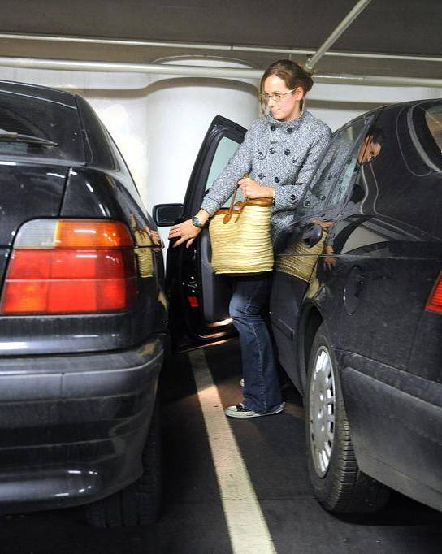
Outline
Motivation
Functional/system description
The technical concept
Legal Aspects

Slide 3
Motivation for RCP
Benefits
Automated parking on public parking space or in private garages
Comfortable, because it is easy to get in and off the car
The driver controls the manoeuvre by actuating a dedicated control on the key/smartphone, while continuously monitoring the manoeuvre (direct view) from a close distance
The vehicle preforms the parking manoeuvre using its own sensors only if control signal is received from the key/smartphone
The vehicle will be brought to an immediate halt when the control signal is no longer being received (e.g. driver stops actuating the control, the remote controller is not in proximity of the vehicle)
Relief, especially for persons with reduced mobility
Driver has an extensive overview of the parking scenario and can better overlook the situation
Avoidance of parking damages (e.g. when opening the door)

Slide 4
Functional Description
Automated parking by actuation of a control on a remote control
Driver does not exercise steering control (e.g. joystick). Vehicle only follows automatically the on-board generated trajectory by using its own sensors.
Driver is in control at all times
Permanent control by the driver is required and necessary
Vehicle stops as soon as the control is released
Driver is outside of the vehicle and must remain in close proximity around the vehicle as to monitor the parking manoeuvre permanently
Low vehicle speed (< 10 km/h)
Due to low speed, the minimal risk condition (vehicle comes to a halt) is reached immediately

Slide 5
Example for the Technical Concept / System Description
Measuring the parking lot and monitoring the vehicle’s close surrounding by a suitable sensor technology
Remote control as the interface and access authority for the RCP-function
Remote control
Driving authority as parallel process
Control unit(s) for remote parking
Automatic gearbox with
shift-by-wire and
electromechanical
parking lock
Electromechanical
parking brake
ESC/
brake
Electronic Throttle Pedal
Electromechanical
Power Steering

Slide 6
UN-R Regulations for RCP
UN-R 79 fulfilled:
The driver remains permanently in primary control of the vehicle (see 2.3.4)
ACSF - the speed of 10 km/h is not exceeded (see 5.1.6.1)
The requirements defined in Annex 6 („special regulations for the safety aspect of complex electronic vehicle control system“) are fulfilled
UN-R 13-H fulfilled
The requirements defined in Annex 8 („special regulations for the safety aspect of complex electronic vehicle control system“) are fulfilled
Other UN-Regulations are not specifically related to the function Remote Control Parking
ü
ü
ü

Slide 7
Traffic Regulations / Vienna Convention
Vienna Convention Article 8
Para. 1 Every moving vehicle or combination of vehicles shall have a driver. Conformity: Driver is not required to be seated inside the vehicle. In case of RCP the driver „drives“ from outside the vehicle.
Para. 5 Every driver shall at all times be able to control his vehicle or to guide his animals.
Conformity: Driver can at all times immediately stop the parking manoeuvre by releasing the control. Analogy: Lead a horse from X to Y.
Vienna Convention Article 13
Para. 1 Every driver of a vehicle shall in all circumstances have his vehicle under control so as to be able to exercise due and proper care and to be at all times in a position to perform all manoeuvres required of him.[…]
Conformity: see Art. 8.5 – Driver is able to have his vehicle under control at all times during parking manoeuvres.
ü
ü
ü

Slide 8
Summary
The function Remote Control Parking is safe and offers a significant benefit to the driver
All existing regulations are complied with
The function is attractive and requested by customers

