Slide 1
Task Force on Electro-magnetic Compatibility (TF EMC) Status report of TF to GRE-77 Tuesday, 4. April 2017
Submitted by TF EMC
Informal document GRE-77-21
(77th GRE, 4-7 April 2017, agenda item 7 (b))

Slide 2
TF EMC Status Report
TF EMC had its 5th meeting on Monday, 20th March 2017.
Document available on the UNECE TF workspace.
TF EMC will report on:
Current development of R10.05
Drafting roadmap for the new supplement to R10.05
Future development of R10 based on OICA ideas
TF EMC will ask for approval of two special modifications.

Slide 3
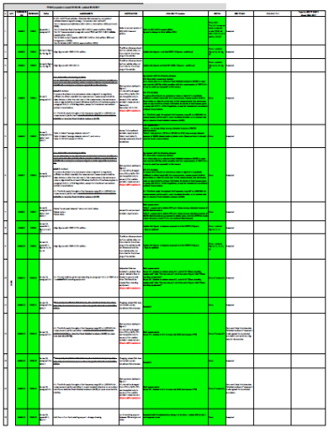
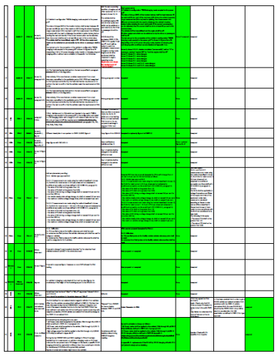
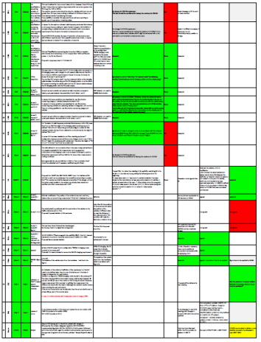
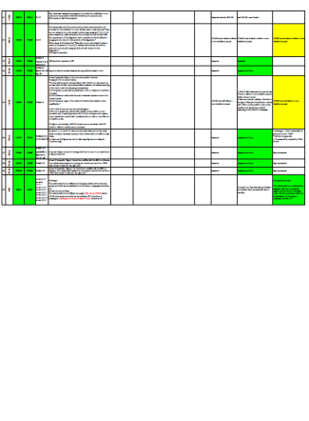
TF EMC Status Report – R10.05 Current Development
(Proposals from China, Italy, France, Spain and OICA)
60 modification proposals were discussed
51 modifications were incorporated in the informal working draft supplement of R10.05.
4 of the proposals will be on the roadmap for a R10-06 version.
3 topics have to be finalized with the CPs until July 2017, including TPs
2 proposals were not accepted due to contradiction to international standards

Slide 4
TF EMC Status Report – R10.05 Development Details
(Modification overview)
Focus of the work on the current version of the R10:
correction of technical and editorial errors, especially for the REESS test setups to be in line with CISPR and ISO standards; additionally to the last report, all figures for Annex 11, 12, 14, 15 and 16 were updated
Correction of inconsistencies – developed by the implementation of REESS ESA contents in R10.05
Two major changes were identified by the TF EMC to be reported and asked to be accepted by the GRE:
Change of the R10.05 narrow band limit to be consistent with CISPR 12
Elimination of clause 3.1.9

Slide 5
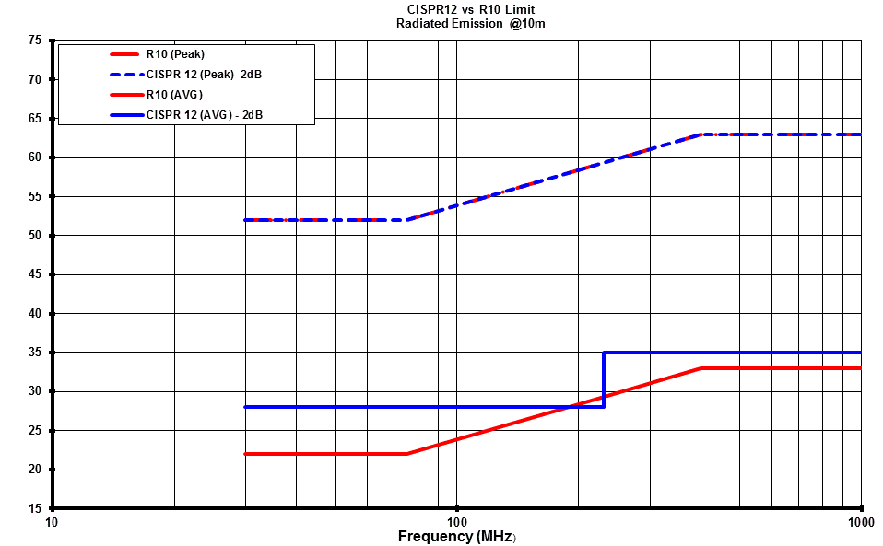
TF EMC Status Report – R10.05 Development Details
(Change of the R10-05 narrow band limit consistent with CISPR 12)
It has been precised that in order to get a R10-05 vehicle narrowband emission limit consistent with the CISPR 12 vehicle narrowband limit, the new R10.05 limit should be the CISPR12-limit minus 2dB to take into consideration this 2dB more stringent requirement as defined in CISPR 12 for type approval.
For information: This figure shows also the consistence between the R10-05 and CISPR12 broadband peak limits.
The proposal for new R10-05 narrowband limit is shown in blue, in comparison to the present R10-05 narrowband limit in red.

Slide 6
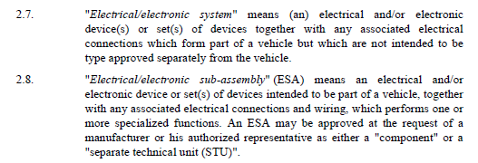
TF EMC Status Report – R10.05 Development Details
(Elimination of clause 3.1.9)
Justification
clause 3.1.9. of R10.05 might be interpreted not allowing to perform ESA type approval on REESS equipment, because it refers to E/E-Systems.
In fact this clause 3.1.9 has been added in R10.04 because there was NO description of REESS equipment ESA-test in R10.04.
When R10.05 has been issued to include specific REESS-equipment ESA test, this clause 3.1.9 should have been deleted, because it was in contradiction with the fact to have all this specific REESS equipment REESS ESA test available.

Slide 7
TF EMC Status Report – Drafting Roadmap
Preparation of a new Supplement to R10.05 (no major technical changes).
Distribution of the current draft (under finalization) to TF EMC in the course of January 17.
Review of the document and further discussion within TF EMC until end of March. 
Propose an informal document for GRE-77 (4-7 April 2017), as draft Supplement 2 to R10.05 -> available on UN-Serverspace 
Adoption of the working document at GRE-78 in October 2017.

Slide 8
TF EMC Status Report – Future Development of R10
(OICA ideas)
Like proposed at GRE-76, a roadmap for the further development of ECE R10-06 is under preparation by OICA

