Slide 1
Euro-Asian Transport Links Project, Phase III
WP.24, 61st session 19-21 November 2018

Slide 2
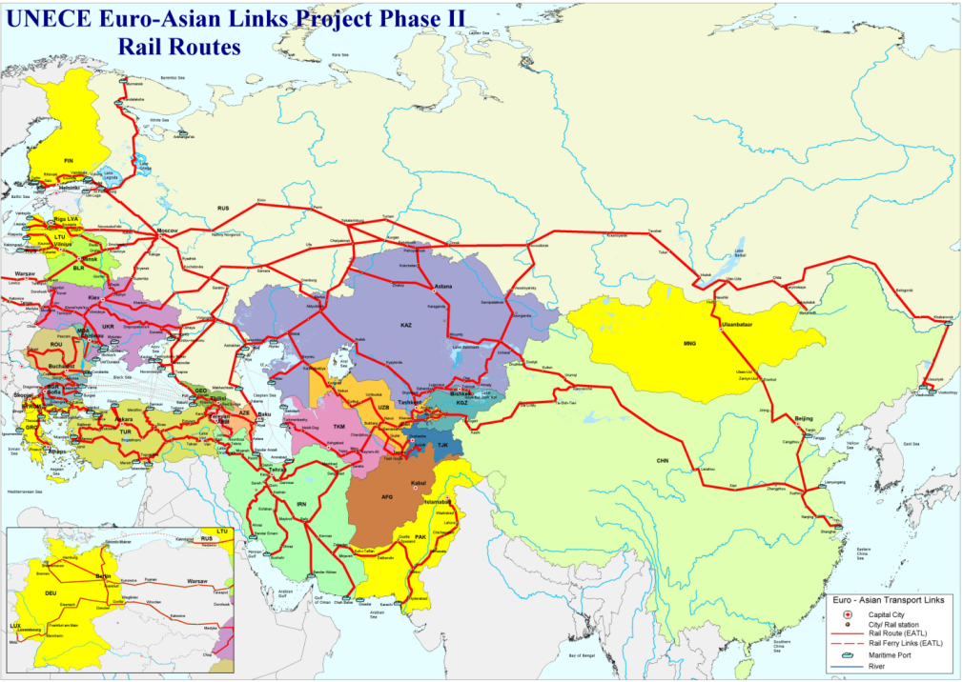
Goal of the Phase III
Identify measures to enhance the operational capacity of the inland transport links between Europe and Asia

Slide 3
Activities
2014
2015
2016
2017

Slide 4
Report of the phase III
I. Euro-Asian trade routes and freight flows;
II. Initiatives, project and studies along EATL routes;
III. Main obstacles hampering the development of Euro-Asian Transport Links;
IV. Euro-Asian Transport Links; Looking into the future; and
V. Conclusions and recommendations.

Slide 5
Findings
Economic growth and growth of international trade is not driving the increase in freight flows as before

Slide 6
Findings
Markets created new opportunities (e.g. e-commerce) that can drive freight flows on inland routes between Europe and Asia
Integrated supply chain management
Flexible routing
Regular service
Intermodality
Role of nodes

Slide 7
Findings
Railway transport is developing on EATL routes – importance of block trains
But
There is a need to make railway more competitive ie.:
remove existing infrastructural gaps, and
more importantly
To adjust to requirements of modern supply chains
Integrated supply chain management
Flexible routing
Regular service
Intermodality
Role of nodes

Slide 8
Findings
Road transport does not operate on long distance
Development and implementation of a mechanism for long distance road transport was necessary - Role of International Agreement under Shanghai Cooperation Organization
Implementation of same standards (axle road, weight and dimensions) and availability of standard-compliant infrastructure
Road transport role? local/regional to complement long-distance rail?
Integrated supply chain management
Flexible routing
Regular service
Intermodality
Role of nodes

Slide 9
Findings
Continuous progress and development has been made (numerous projects)
However
More progress and development is necessary!
Where? Address non physical barriers
Bottlenecks: border crossings (delays mainly to process inefficiencies), availability of permits, visa procedures,
legal regimes, poor service, little flexibility for routing, uncompetitive and changing tariffs
Integrated supply chain management
Flexible routing
Regular service
Intermodality
Role of nodes

Slide 10
Way forward
EATL have their strengths and there are opportunities for further development
at the same time
EATL have their weaknesses and there are threats
What to do?
Build on strengths,
Address weaknesses,
Seize opportunities, and
Minimize threats
Integrated supply chain management
Flexible routing
Regular service
Intermodality
Role of nodes

Slide 11
Way forward
Remember: Each EATL route is as good as its weakest point
COOPERATION!
COORDINATION!
What to do?
Build on strengths,
Address weaknesses,
Seize opportunities, and
Minimize threats
Inflexible routing -delay
Missing link -delay
Efficient crossing
Inefficient crossing - long delays
Efficient crossing
Integrated supply chain management
Flexible routing
Regular service
Intermodality
Role of nodes

Slide 12
Way forward
What to do?
Build on strengths,
Address weaknesses,
Seize opportunities, and
Minimize threats
COOPERATION!
COORDINATION!
Inflexible routing-delay
Missing link-delay
Efficient crossing
Inefficient crossing - long delays
Efficient crossing
Cooperate and coordinate to: harmonize transport policies, facilitate procedures and standards along routes, continue to improve infrastructure
Integrated supply chain management
Flexible routing
Regular service
Intermodality
Role of nodes

Slide 13
Thank you
Lukasz.Wyrowski@unece.org Tel: +41 22 917 40 53

