Slide 1
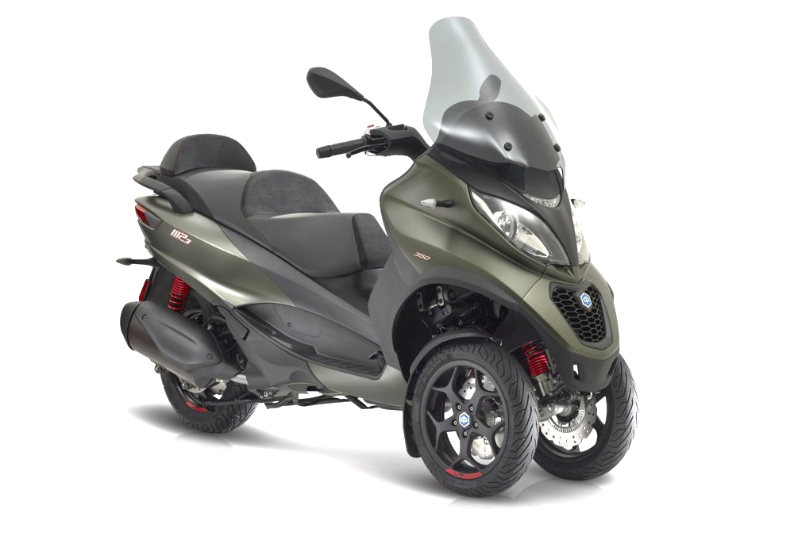
GRB-69-16, informal document by IMMA
ASEP for L5 vehicles with CVT/AT
Issue with the proposed Supplement the 08 series of amendments to UN R9,
as in GRB-68-22 (= WP29-2019-006)
Background of IMMA proposal for revised exemption window, as in GRB-69-14

Slide 2
Required
ASEP test zone
ASEP Test 1
Current Exemption
zone
Required
ASEP test zone
ASEP Test 2
Proposed
Exemption zone extension
Non
exempt
Proposed
Exemption zone extension
To align the parameters for exemption of vehicles “with variable gear ratios or automatic transmission with non-lockable gear ratios” in Annex 6, §1.2 with the test conditions for “ASEP Test 1” (Annex 6, 3.3.2) and “ASEP Test 2” (Annex 6, 3.3.3), in order to close potential gaps between the applicable engine rpm range for the ASEP tests and the engine rpm range for exemption from ASEP testing.
Not closing these gaps would result in a situation where some vehicles “with variable gear ratios or automatic transmission with non-lockable gear ratios” would not be excluded from ASEP testing, but would also not be able to remain within the conditions for ASEP Test 1 and ASEP Test 2.

Slide 3
Test result Vehicle
L5 with CVT
PMR = 83,1 W/kg

Slide 4
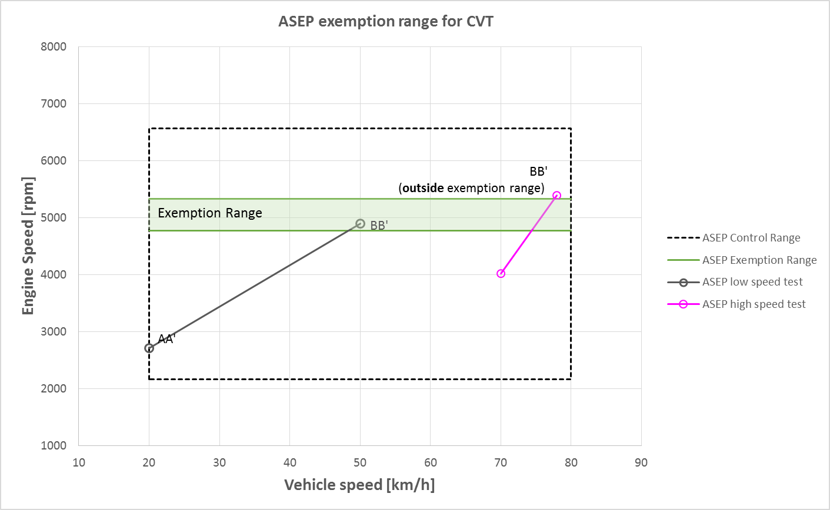
L5 with CVT and PMR = 83,1 W/kg
Verification of ASEP exemption
With originally proposal exemption window (as in GRB-68-22)
BB’ outside exemption range:
Vehicle not exempted from ASEP testing

Slide 5
IMMA proposal for revised exemption window (= GRB-69-14)
UN R9, Annex 6, paragraph 1.2., amend to read
Vehicles with variable gear ratios or automatic transmission with non-lockable gear ratios are exempted from the requirements of this Annex, if the vehicle manufacturer provides technical documents to the Type Approval Authority showing, that the vehicle's engine speed at BB' does neither exceed 1.15*nBB'_ref (nBB' + 0.05 * (nrated – nidle)) nor fall below 0.85*nBB'_ref (nBB' – 0.05 * (nrated – nidle)) for any test condition inside the ASEP control range defined in paragraph 2.5. below, where nBB’_ref is calculated in accordance to paragraph 3.3.1. of this Annex.(nBB' is the average engine speed at BB' from the two valid acceleration tests according to paragraphs 2. and 3. of Annex 3.)

Slide 6
L5 with CVT and PMR = 83,1 W/kg
Verification of ASEP exemption
With IMMA proposal for revised exemption window (as in GRB-69-14)
4294
5810
BB’ inside exemption range:
Vehicle exempted from ASEP testing

