Slide 1
Transposition of GTR15 (WLTP) into UN Regulations Update for GRPE from WLTP Transposition Task Force June 2018
Informal document GRPE-77-21
77th GRPE, 6-8 June 2018
Agenda item 3(b)

Slide 2
Background
Transpose GTR15 and GTR19 into a new ‘UNR WLTP’ regulation
Level 2 to contain most stringent requirements from across all regions
Subject to full mutual recognition: TA shall be accepted by all CPs
Regional levels (Level 1a, 1b etc. ) to contain regional requirements
Optional acceptance by other CPs
Complementary update to UNR 83 is critical for EU to become a Contracting Party to UNR WLTP and is therefore an essential element of the wider ‘transposition project’
Implications for UNR 101 to be determined
Approach to transposition still under discussion
Please see document “GRPE-76-24e” for a more detailed introduction and description of the work being undertaken by the Transposition Task Force in developing a new UNR WLTP and new 08 series of UNR 83

Slide 3
Development of ‘UNR WLTP’

Slide 4
Options for different levels
Principles
Level 2 to contain most stringent requirements from across all regions
Subject to full mutual recognition: TA shall be accepted by all CPs
Regional levels (Level 1a, 1b etc. ) to contain regional requirements
Optional acceptance by other CPs
Regional variations (options) have been identified for GTR15 and GTR19
Options also for Durability and COP (in the short-term)
An analysis of the options is provided in documents:
WLTP-23-03e_Appendix01_CP option.xlsx
WLTP-23-03e_Appendix02 - UNR WLTP Structure and Content Draft
Consideration of the options and agreement on the requirements of Level 2 (the Mutual Recognition level) is the major focus of the Task Force

Slide 5
Development of regulatory texts
Structures for the different levels of UNR WLTP are being developed
Structure of the 08 series of UNR 83 is also being developed
Plan was to include RDE in 08 series of UNR 83. However we now need to consider implications of the potential new GTR for RDE
Durability and COP will be essential elements of ‘UNR WLTP’ – use current regional procedures in interim (e.g. EU COP in Level 1a and Japan COP in Level 1b) with harmonised procedures to follow
Detailed drafting meetings to be set up – for both UNR WLTP and UNR83 08 series.
Drafting ‘procedure/protocol/contributions’ to be agreed.

Slide 6
Discussion points for 77th GRPE
Durability and COP procedures being developed under WLTP IWG
Separate GTRs or Annexes to GTR15 or directly to UNR WLTP regulation?
How to handle future updates from the WLTP IWG for the Type 2, Type 3 and Type 6 tests in the UN Regulations?
No urgent decision needed. Included in order to raise awareness at GRPE.
Regulation 101 – how to take account of introduction of UNR WLTP?
Approach to transposition
Which Approach to move forward with?

Slide 7
Regulation 101

Slide 8
How to handle UNR 101
For over 30 years we’ve had criteria emissions legislation where fuel consumption and CO₂ values were a bi-product. With WLTP it is the other way around and we now have fuel consumption and CO₂ legislation where demonstration of criteria emissions compliance is a bi-product.
Europe combined the subjects of criteria emissions and fuel consumption and CO₂ emissions in one piece of legislation in 2007, UNR83 and UNR101 however remain separate.
We need to find solutions which cover both subjects, in all current and new UNRs to the satisfaction of all Contracting Parties to both Agreements without creating undue burden or problems for the industry.
Some ideas to prompt a constructive discussion are shown on the next slide and a list of the Contracting Parties to UNR83 and UNR101 on the following slide.
Source: Bill Coleman

Slide 9
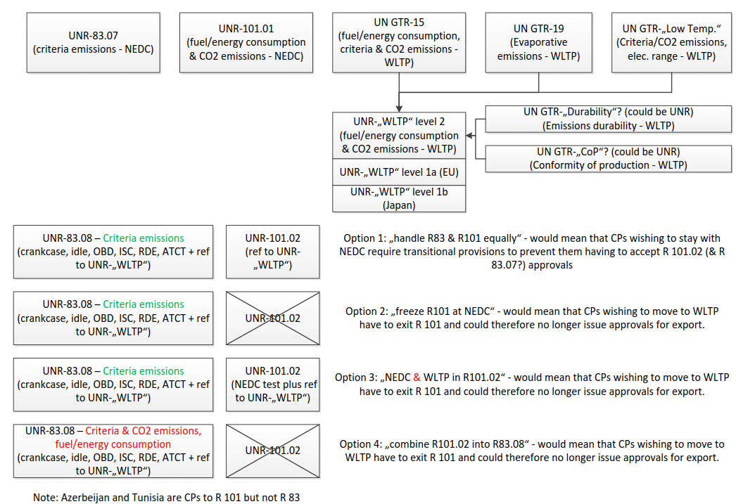
Source: Bill Coleman

Slide 10
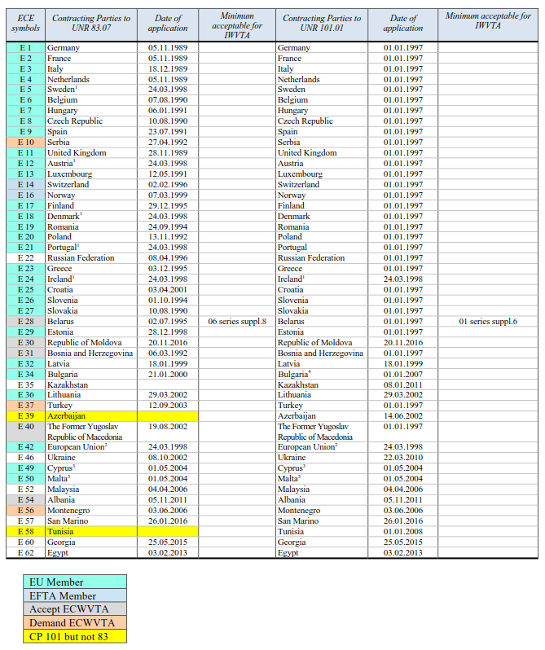
Source: Bill Coleman

Slide 11
Potential approaches to transposition

Slide 12
Principle of Transposition
Three different approaches to transposition have been considered by the Task Force (see WLTP-20-04e and IWVTA-25-11 for details)
Approach 1: Traditional approach to avoid “options”. Faithful to the 1958 Agreement.
UN R.00 covers regional level 1a; UN R.01 covers regional level 1b; UN R.02 covers top level
Pro: Fully in line with the new 1958 Agreement
Cons: Long lead in time (18 months) before all levels are in force + High administrative burden.
Solution(?): If Legal Office OLA were to accept simultaneous notification and entry into force
Approach 2: ‘Untraditional approach’ - to speed up process
UN R.00 covers all regional levels 1a, 1b; UN R.01 covers top level 2
Pro: Shorter lead in time and reduced adminstrative burden compare to Approach 1.
Con: Could become complicated (potentially unworkable?) after rounds of amendments are made; also, the base version UN R.00 would contain options at choice of CPs
Approach 3: Untraditional approach using two sets of special provisions
UN R.00 covers all levels (top level 2 as well as the regional levels 1a, 1b, …)
Pro: Shortest lead in time. Con: against the spirit of the 58 Agreement.

Slide 13
Approach - Way Forward
Request to OLA prepared by the Task Force and the UNECE Secretariat.
Request was discussed at WP.29 in March 2018 and to be sent to OLA in April 2018.
Based on the level of detail of the information provided, OLA unable to provide a definitive response
Further discussions required - Task Force / UNECE / OLA
UNECE Secretariat’s preferred approach remains as Approach 2
Can GRPE provide guidance on this?

Slide 14
Next steps
Confirm the Approach to be used for transposition
Confirm the process for introducing updated Durability into 1958 and 1998 agreements
Confirm the process for introducing updated COP into 1958 and 1998 (?) agreements
Confirm the ‘way forward’ for UNR 101
Confirm how to handle RDE
Finalise structures for UNR WLTP (Levels 1 & 2) and UNR 83 08 series
Agree content of regional levels (Levels 1a and 1b) and Level 2
Develop detailed regulatory texts
Plan is to have an Informal UNR WLTP for 78th GRPE January 2019 and a Working Document for 79th GRPE June 2019.

Slide 15
Contact information
Rob Gardner, TRL Ltd on behalf of the European Commission (Task Force Leader)
rgardner@trl.co.uk
Alessandro Marotta, European Commission
Alessandro.Marotta@ec.europa.eu

