Slide 1
UNECE IWG on EPPR for L-category vehicles
Status Report
Informal document GRPE-77-25
77th GRPE, 6-8 June 2017,
Agenda item 8(b)
Adolfo Perujo
Chairman IWG EPPR (L-cat)

Slide 2
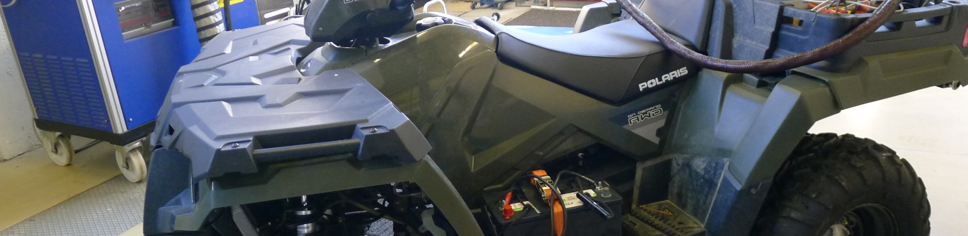
Outline
Background
State of play
      GTR2
      OBD2
Next Steps /Roadmap
Past and next meetings

Slide 3
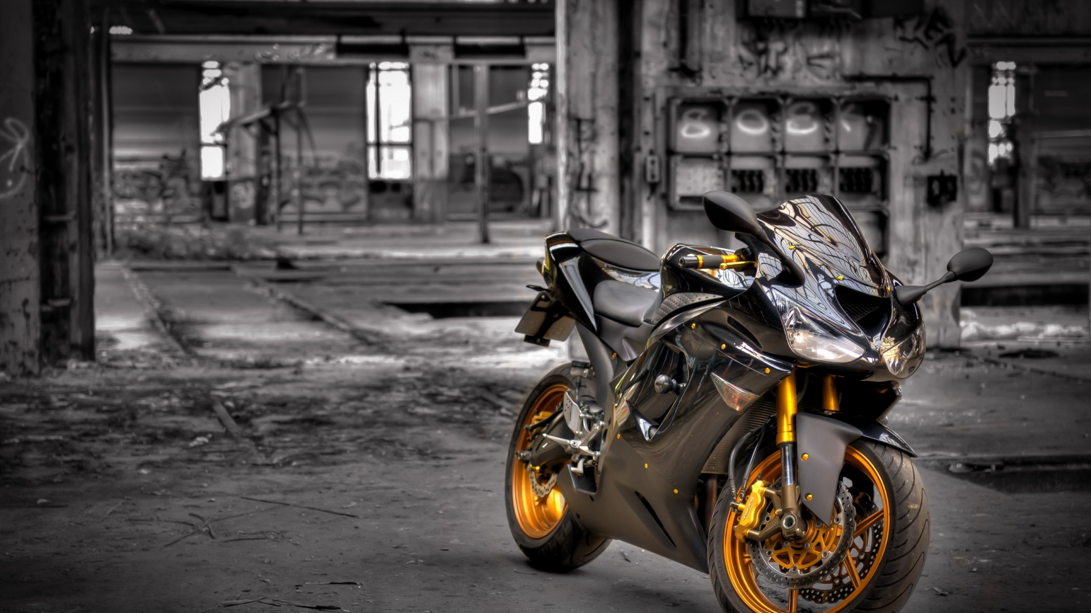
Background
ToR and mandate
Priority to work under 1998 Agreement but will also work under 1958 Agreement
Amend GTR No2 and develop new GTRs with respect to Environmental and Propulsion unit Performance Requirements
Create synergies with 58th Agreement and where possible develop common requirements in form of UN Reg(s)
Exchange information on current and future regulatory requirements for ‘light vehicles’
Adopted at WP29 Nov 2013
Extended at WP29 Jun 2015 (2016 to 2020) (ECE/TRANS/WP.29/AC.3/36/Rev.1)

Slide 4
Background
Topics to be covered by EPPR
Environmental performance:
    Type I: Tailpipe emissions test after cold start (revision);
    Type II: Tailpipe emissions test at (increased) idle / free acceleration;
    Type III: Emission test of crankcase gases;
    Type IV: Evaporative emissions test;
    Type V: Durability testing of pollution control devices;
    Type VII: Measurement of CO2 emissions, fuel consumption, electric energy consumption and electric range determination;
    Type VIII: On-board diagnostics environmental verification tests.
Propulsion unit performance:
    Unified rules and test procedures to measure power and torque for propulsion technologies fitted on L-category vehicles
    unified measurement of maximum design vehicle speed and/or power for restricted L-category vehicles should be developed and agreed upon.
GTR2
GTR17
GTR18

Slide 5



GTR2
Stay of Play
GENERAL REQUIREMENTS
TEST TYPE I, EXHAUST EMISSIONS AFTER COLD START
TEST TYPE II, TAILPIPE EMISSIONS AT (INCREASED) IDLE AND AT FREE ACCELERATION
TEST TYPE VII, ENERGY EFFICIENCY
COMMON ANNEXES
Informal document submitted to the GRPE for information to the CP and stake holders [GENERAL REQUIREMENTS TEST TYPE I & TEST TYPE II]

Slide 6
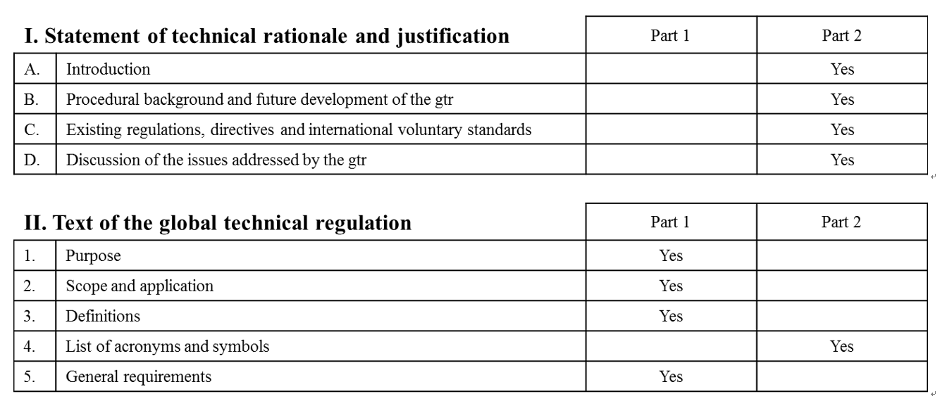
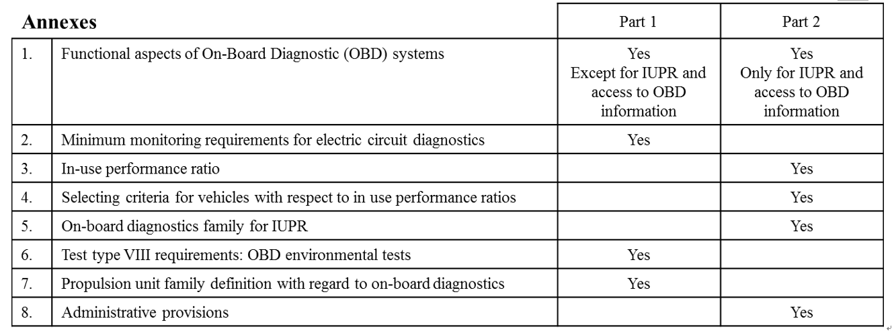
Progress of OBD2 Correspondence Group
Phase 1
Phase 2
Progress percentage;90%
(open item;1)
Progress percentage;90%
(open item;1)
Phase 1
Phase 2
June
Progress percentage;0%
(Wait for India’s proposal)
June
(Up to 5.3.11.2 )
Progress percentage;65%
(open item;8)
Phase 1
Phase 2
June
Progress percentage;90%
(open item;2)
Regarding Point 6&7 list of the Type VIII tests will be verified for
it’s scope and completion in time schedule by India.

Slide 7
Assignments by July 10th, 2018
By July 10th, representatives of each stakeholder coordinate opinion within the members of stakeholder and notify Vice-Chair of concrete proposal.
Red frame item(limited to open item)
Blue frame item
Phase 1
Phase 2
(Up to 5.3.11.2 )
(From 5.3.11.2)
Phase 1
Phase 2

Slide 8

EPPR Roadmap

Slide 9

Meetings

Slide 10


