Slide 1
WORKSHOP
Working Party on Rail Transport (SC.2)
Eurasian Intermodal Carriage by Rail
CCTT Secretary General
Gennady Bessonov
25th November 2019, Palais des Nations, Geneva

Slide 2
ССTT – International Coordinating Council on Trans-Eurasian Transportation
ССTT Chairman
CEO – Chairman of the Board, RZD OJSC
CCTT Secretariat
CCTT Vice-Chairmen
CCTT members (95 members from 24 countries)
Railways
National Freight Forwarders Associations
Consulting
CCTT Vice- Chairman
CCTT Vice- Chairman
CCTT Vice- Chairman
CCTT Vice-Chairman
Seaports and stevedoring companies
Marketing
Operators and forwarders
Chairman of the Board, KTZ
Mass media
GETO
President
TSIOAJ
President
ARF (АРЭ)
President
State organizations, municipalities
Shipping companies
Insurance
Cargo owners
Telecom / IT
NATIONAL FORWARDING ASSOCIATIONS
(Standing Members)
On a rotating basis
RF Ministries
Security
RF FCS
2

Slide 3
ССTT Working Groups (CCTT WG)
2
N
4
S
ССTT WG on improving the competitiveness of the «North-South» ITC
CCTT WG ITD
Working group on IT Development
1
3
5
W
E
CCTT WG for the development of Far Eastern multimodal transportation
WG to improving the competitiveness of the "East - West“ ITC
CCTT WG HITL
Working group
on harmonization of international transport law

Slide 4
CCTT AREAS OF ACTIVITY ON DEVELOPMENT OF MULTIMODAL CONTAINER TRANSPORTATION:
Coordination of railways and seaports activity in the field of multimodal transport chains organization;
Creating conditions for increasing competitiveness and commercial attractiveness of transit transportation;
Assistance in organization of container services;
Generating transport and logistic products;
Monitoring and analysis of current state of transportation;
Analysis of existing technologies of organization of cargo transportation within each logistics product;
Interaction with international organizations on multimodality.
4

Slide 5
ACTIONS IN ENCREASING TRANSIT CONTAINER TRANSPORTATION COMPETITIVENESS: 1. Forming Entirely Through Rate for Transportation of Transit Cargo from Third Countries to Third Countries
1
4
5
2
3
6
7
8
1. Sea freight
2. Stevedoring services
3. Port terminal services
4. Railway tariff
5. Platform rental
6. Cargo Security
7. Operator`s Fee
8. Miscellaneous
5

Slide 6
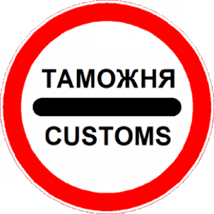
ACTIONS IN ENCREASING TRANSIT CONTAINER TRANSPORTATION COMPETITIVENESS: 2. Transit Time Reduction
Simplification of customs clearance of transit goods;
Introduction of innovative technologies;
Introduction of electronic document flow;
6

Slide 7
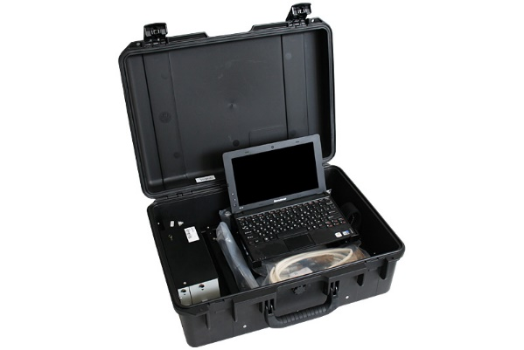
ACTIONS IN ENCREASING TRANSIT CONTAINER TRANSPORTATION COMPETITIVENESS: 3. Cargo Security With the Use of Emi
7

Slide 8
CREATION OF CONDITIONS FOR FORMATION OF TRANSPORT AND LOGISTIC PRODUCT
Consumers of transport and logistics product (cont. transportation)
TLP Analysis - Price-Quality Ratio
UNESCAP
Transport and Logistics Product - Container Train (TLP-CT)
UNECE
WCO
Information Support
OTIF
Carriers and Rolling Stock Operators
Legal support
CIT
Tariff conditions
UIC
Technological support
OSJD
Normative and technical support
EEC
Infrastructure
Rolling stock
Proposals for improving transport and logistics product
ССTT
Speed
Regularity
Through rate
Reliability
Transparency
8
Notes:
Прежде чем начать свое выступление я бы хотел обратить Ваше внимание на важность координации действий при формировании транспортного продукта.
На слайде можно увидеть как предложение транспортного продукта для клиента порой оказывается не востребованным просто в силу недопонимания между участниками процесса перевозки, а также возникающими препятствиями уже при отправлении поезда, вследствие чего заказчик вынужден доплачивать за дополнительный сервис.
Если речь идет о международных транзитных перевозках, то таких препятствий становится еще больше.
Для решения выше обозначенных и прочих задач создаются международные некоммерческие организации ориентированные на обеспечение роста международных перевозок в евразийском сообщении, взаимодействие участников транспортного рынка, разработку и внедрение современных технологических решений.
Одной из таких организаций является Координационный совет по транссибирским перевозкам (КСТП).

Slide 9
TRENDS OF VOLUMES OF TRANSIT CONTAINER TRANSPORTATION
IN RUSSIA IN MAIN DESTINATIONS (2010-2018, Thous. TEU)
total
East-West-East

Slide 10
CONTAINER TRANSIT
CHINA - EUROPE
Source: RZD OJSC
10

Slide 11
RESULTS OF MULTIMODAL CONTAINER TRANSPORTATION THROUGH KALININGRAD PORT
Transit time from Kaliningrad port:
Trelleborg
Rostock
Hamburg
Stockholm
Стокгольм
16 hours
20 hours
36 hours
Göteborg
Гётеборг
Trelleborg
Калининград
Треллеборг
Distance by train from Braniewo Station to:
Kaliningrad
Гамбург
Гданьск
Hambourg
Gdańsk
Braniewo
Роксток
530 км
Браниево
340 км
530 км
1000 км
Берлин
Rostock
Berlin
340 км
Бремерхафен
1 000 км
Bremerhaven
Лодзь
Łódź
Berlin
Duisburg
Łódź
Дуйсбург
530 km
Duisbourg
Source: UTLC ERA

Slide 12
RZDL CONTAINER ROUTES
Source: RZDL

Slide 13
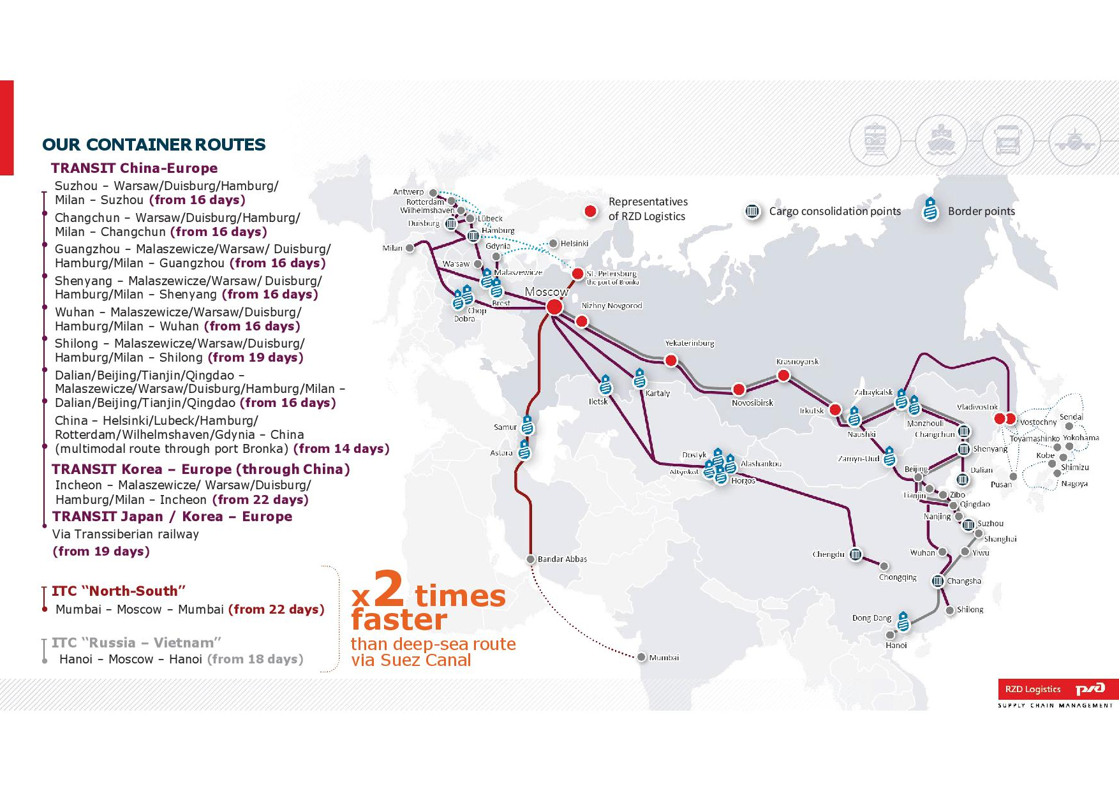
RZDL: TRANSIT CONTAINER SERVICES
Source: RZDL

Slide 14
ATTRACTION OF ADDITIONAL CARGO VOLUMES TO TRANSSIB FROM JAPAN
Association of Trans-Siberian Intermodal Operators of Japan (TSIOAJ)
ССTT Secretariat
TRANS RUSSIA AGENCY JAPAN CO. LTD.
JAPAN TRANS SYSTEM INC.
TOYO TRANS LLC
JAPAN TRANSCITY CORP.
NISSIN CORP.
KAMIGUMI CO., LTD.
VANTEC HTS FORWARDING, LTD.
AZUMA SHIPPING CO., LTD.
ISEWAN TERMINAL SERVICE CO., LTD.
SENKO CO., LTD.
MITSUBISHI LOGISTICS CORP.
SANKYU INC.
NIPPON EXPRESS CO., LTD.
CCTT/TSIOAJ Business Forums in Tokyo since 2015
Test shipment (December 2016)
Analysis and development of proposals to increase cargo volumes transportation from Japan via TSR
14

Slide 15
‘TRANS-SIBERIAN LANDBRIDGE’ – EXPRESS CONTAINER SERVICE TO / FROM EUROPE
Source: RZDL

Slide 16
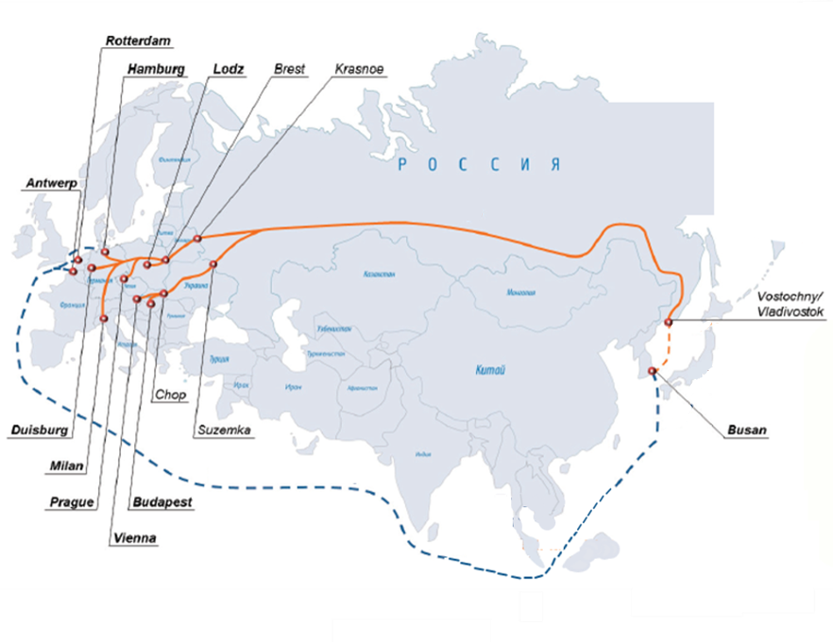
2020: LAUNCH OF REGULAR MULTIMODAL TRANSPORT SERVICE: R. KOREA - BREST - EUROPE VIA TSR

Slide 17
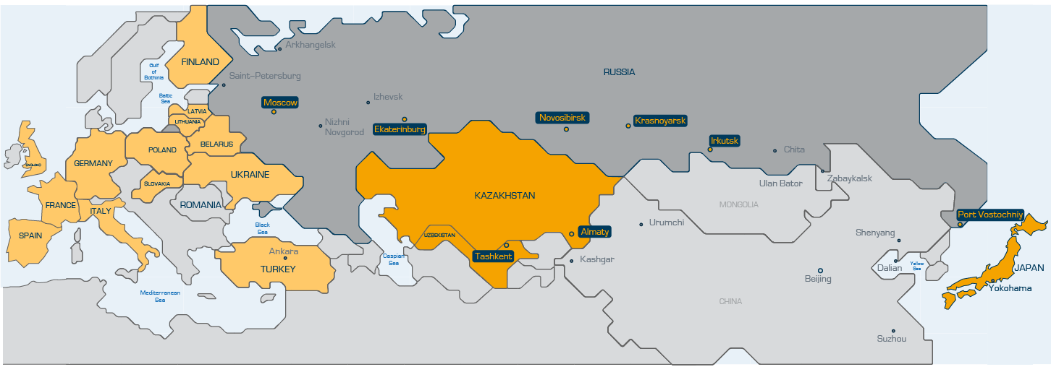
TransContainer Main Routes: from Yokohama to Russia, Kazakhstan, Uzbekistan via Port Vostochny
Destination | Estimated transit time | Cost
Novosibirsk (in block train) | 20 days | $2 574
Almaty (in block train) | 21 days | $5 771
Ekaterinburg (in block train) | 22 days | $2 980
Irkutsk | 23 days | $2 644
Tashkent (in block train) | 23 days | $7 214
Moscow (in block train) | 24 days | $3 049
The rates include:
- Sea freight from Yokohama port to Vostochny port on FILO conditions; - Transshipment at Vostochny port;
- Provision of container and flatcar owned by TransContainer; - railway tariff.
The rates do not include :
- Terminal handling charges at Yokohama port;
- Charge for shift escort and security;
- Terminal handling charges upon arrival at destination station.
Source: TransContainer
17

Slide 18
CCTT Project: Multimodal Trans-Eurasian Routes’ Transport Network

Slide 19
THANK YOU FOR YOUR ATTENTION
CCTT Representative Office in Russia
125009, 24/2 Tverskaya, 2 floor, 4 entrance. Moscow, Russia
Tel/Fax: (495) 232-55-51; (495) 234-00-22 e-mail: info@icctt.com

