Slide 1
Informal document GRSG-117-34
(117th GRSG, 08-10 October 2019,
agenda item 7
Submitted by the expert from Japan on behalf of
VRU-Proxi Informal Working Group
Status report of “Reversing Motion”
in VRU-Proxi Informal Working Group.
JAPAN,
on behalf of
VRU-Proxi Informal Working Group.

Slide 2
Status of VRU-Proxi Informal Working Group
Working Document (ECE-TRANS-WP.29-GRSG-2019-16e ) submitted.
Informal Document to update WD was planned for explanation in this GRSG session.
VRU-Proxi 11th session was held on 24-26 September.
Line by line review of updated WD and discussion had been proceeded.
Regarding hot discussion at the session, IWG reached the conclusion that
it is still too premature to finalize the draft of the regulation in this GRSG session.
Today, we will explain about recent status and invite all of you to further discussions.

Slide 3
Summary of proposed regulations (1)
Proposal for a new UN Regulation on the approval of devices for reversing motion and motor vehicles with regard to the driver’s awareness of vulnerable road users behind vehicles
Scope
All categories of M and N.
Exemption;
- No consensus on language on exemptions, if any.

Slide 4
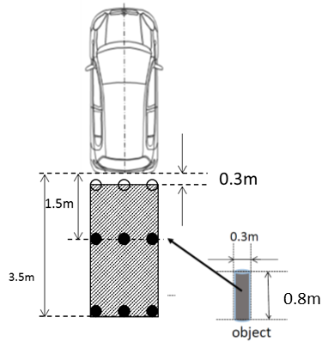
Summary of proposed regulations (2)
Multi modal approach
Indirect vision
(Rear-View Camera, close-proximity rear-mounted mirror*, if appropriate in combination with conventional R46 devices)
Detection systems (e.g. ultrasonic system)
Direct vision through back window
Combinations of methods or devices
Field of view for direct vision and/or indirect vision devices
0.8m height x 9 poles
1st row: 15cmX15cm patch on any part of pole
2nd and 3rd row: Whole pole
1 row to be seen by 1 device
* Still under discussion which vehicles may use this
and under which conditions it should be allowed.

Slide 5
Summary of proposed regulations (3)
Part I Components, Part II Installation
Impact test of device mounted on rear of vehicle: [Not needed]
Mirrors (still no consensus)
Interior (fitted at the top of the rear window on the inside of the vehicle), Exterior mirror.
Rear-View Camera
Image quality, Display object size
Overlays, Screen change (still no consensus)
Deactivation (still no consensus)
System latency
Detection system
Detection area: 0.2m~1.0m *Equivalent for 3.5m by vision
Detection latency: 0.6s
Auditory/Optical/Haptic information : 2 of 3 methods

Slide 6
Remaining key discussion points
Exemption from the scope.
Solo tractor etc.
System response time after start (for Rear-View Camera.)
Door open, ignition, gear etc. considering MT, AT vehicles for Rear-View Camera integrated with IVI system.
Overlays
Transparency, contents etc.
Deactivation
“Driver’s modified view” includes switched off or not.
Direct view by turning around of the driver and including vehicle with or without (additional) Close-proximity rear view mirror.
Only for certain vehicle length, single seating row, … etc.
Test procedure (fine-tuning only, broad consensus on test approach)

Slide 7
Schedule
2019
October, November E-mail and/or Web discussions
November 24-26 VRU-Proxi 12th meeting @ Brussels, Belgium
PLEASE ATTEND THIS MEETING, ESPECIALLY CPs.
December Final preparation of Working Document
2020
January Submit Working Document to 118th GRSG
February 5-7 VRU-Proxi 13th meeting @ Osaka, Japan
March 30-April 3 Proposal to 118th GRSG (TOR of IWG)
If you have any comments or questions for the draft regulation, please let us know. And also, we welcome you to join further discussions.
Contact: Reversing Motion TF chair Akinari HIRAO, Ph. D.
a-hirao@mail.nissan.co.jp

Slide 8
Thank you for your attention.

