Slide 1
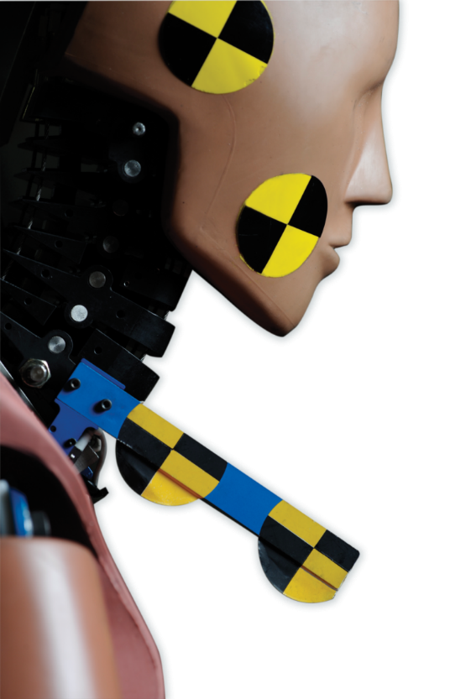
Informal document: GRSP-66-41
(65th GRSP, 10 - 13 December 2019,
agenda item 2)
Introduction to Revision of GTR 7
Formal Document
ECE/TRANS/WP.29/GRSP/2019/26
(superseding GRSP/2019/5
and GRSP-65-24)

Slide 2
Background
At 64th GRSP in December 2018 the updated draft proposal for GTR 7 phase 2 doc GRSP/2018/27 (ammended by by 64-37 rev. 1) was introduced and discussed.
In the following month comments have been received from interested parties and included in GRSP/2019/5.
GRSP/2019/5 still contained square brackets and some issues (especially injury criteria limits) where no agreement had been reached.

Slide 3
Background
The 18th IWG GTR 7 Meeting was hold on 24th / 25th April 2019 in Bergisch Gladbach (Germany)
During the meeting agreements were reached on:
Text of the preamble
Text of regulation especially
Injury criteria
Some minor modifications/corrections were needed after the meeting but were included in informal document GRSP-65-24 (now included in GRSP/2019/26).

Slide 4
Latest proposal for injury criteria
(as agreed during 18th IWG meeting)
Summary of recommendations for GTR 7
NIC 25
Upper and Lower Neck My I30I Nm
Upper Neck Fx I360I N
Lower Neck Fx as care point / monitoring, language in preamble! (§147 in GRSP-65-24)
My and Fx for flexion and extension!

Slide 5
BioRID TEG
As a result of the 18th IWG meeting the BioRID TEG was reconstituted and had its 17th WebEx meeting on 6th of May with the main task to reach an agreement on certification procedures including corridors
Concerns raised from some strakeholders with regard to Pot A
collect data from different labs until mid of June 2019.
data analysis until mid July 2019.
WebEx to discuss results and proposal …..
Addendum to Mutual Resolution M.R.1.

Slide 6
BioRID TEG
Recommendations of the BioRID TEG during the 19th webex on 12th September 2019 (TEG ID 19-9):
keep all corridors as they are with the exception of
Pot A and
Adjust Pot A at mean and keep the same corridor width
keep jacket and pelvis compression for monitoring purposes only
bumper compression to be added to drawings
Review all certification criteria after 3 years
Remove C4 mount
Shoe weight confirmed to be: 0.57 +/- 0.1 kg (check PADI)

Slide 7
Status / Recommendation
At the 65th GRSP the content of document ECE/TRANS/WP.29/GRSP/2019/5 and 65-24 were introduced (Doc 65-32) and discussed.
The IWG asked for final comments on the content of documents for inclussion in the final proposal for this December session.
ECE/TRANS/WP.29/GRSP/2019/26 is the final proposal of the IWG for approval by GRSP during this session.
The proposal for the inclusion of the BioRID UN test tool in the Mutual Resolution 1 for WP.29 is still under final review.

Slide 8
Thank you for your attention!
Bernd Lorenz
Bundesanstalt für Straßenwesen (BASt)
Brüderstraße 53
D-51427 Bergisch Gladbach
lorenz@bast.de

