Slide 1
Future Certification of Automated Driving Systems
Informal document GRVA-02-27
2nd GRVA, 28 January – 1 February 2019,
Agenda item 5(a)
2019/01/28 - 2019/02/01, GRVA-02
Submitted by the experts of OICA

Slide 2
Introduction

Slide 3
Introduction
With the introduction of automated driving systems the number of software-based functions and thereby complexity will continue to increase.
Compared to conventional vehicles, the potentially affected safety-areas and variances of scenarios will increase and cannot fully be assessed with a limited number of tests that are performed on a test track or test bench
The aim of this presentation is to propose a new innovative certification scheme allowing to demonstrate the level of safety and reliability which allows for safe market introduction of automated/autonomous vehicles
The concept and building blocks for a future certification of automated/autonomous driving systems that are discussed in this presentation could be applied both under a type approval or self-certification regime
Application of a regulation under a self-certification regime requires precise descriptions of the procedures and tests to be applied by the manufacturer
This presentation is based on ECE/TRANS/WP.29/GRVA/2019/13 and several documents that OICA submitted under the activities of WP.29 IWG ITS/AD (see back-up)

Slide 4
General Challenges/Premises for a suitable Approach to Regulate Automated Driving
It is important to consider that WP.29 GRVA is aiming at regulating new technologies of which the majority is not available on the market yet
→ lack of experience should not be neglected and tackled with reasonable strategies (e.g. generic safety-approaches/requirements) in order to guarantee the highest possible level of safety.
It will be difficult to regulate each and every topic in detail from the early beginning
→ need to prioritize the different topics
→ start with a first set of requirements and develop further as the experience and data on new technologies grow
Technology for Automated/Autonomous Driving Systems will continue to evolve rapidly over the next years
→ need flexible structures that can be applied to the different kinds of L3-L5 systems instead of limiting the variation/innovation of different kinds of systems by design restrictive requirements
→ Regulating “function by function” would require frequent updates/ upgrades of regulations and would therefore not be practical. Furthermore, it could easily become highly design restrictive
Need to find a pragmatic way for industry and authorities that on the one hand leaves “controlled” flexibility and on the other hand defines reasonable requirements/principles to allow evolution of the new technology within the agreed safety principles over the next years
structure should allow to add output of research initiatives and lessons learned at a later stage

Slide 5
“Classical” Certification Approach

Slide 6
“Classical” Certification Approach
Example: Tires UN-R 30 and 54; UN-R 117
Tire tests (“classical approach”):
Mechanical strength: Load/speed performance tests
Rolling sound emission values in relation to nominal section width and category of use
Adhesion on wet surfaces (wet and snow grip index)
Rolling resistance
The “classical certification approach” typically defines a limited number of performance criteria and physical certification tests to set-up the necessary safety-level as a prerequisite for market entrance
Such tests are performed on test tracks or on a test bench, requirements were refined over years
Approach is well suited for systems with limited complexity, limited interactions with other systems and clearly defined system boundaries (typical for mechanical systems/components)

Slide 7
Existing Extension of the “Classical” Certification Approach
Example: Performance of a braking system (UN-R 13-H)
Braking Tests (“classical approach”):
Min. deceleration: 6,43 m/s² and 2,44 m/s² for the fallback secondary braking system
Stopping distance in relation to initial speed: 60 m for 100 km/h
Parking brake to hold the laden vehicle stationary on a 20% up or down gradient
When ABS, ESP and Brake-Assist were regulated, it was realized that the “classical approach” was not able to address all safety-relevant areas of electric/electronic systems due to the high number of potential failures/scenarios:
This led to the introduction of the process- and functional safety oriented audits: Annex 8 for safety of complex electronic vehicle control systems
Introduction of simulation as acceptable simulation-approach for ESP
→ It should also be noted that at the time UN-R 13-H was updated regarding electronic control systems like ABS and ESP, such technologies were already deployed for some years and technically standardized (long-term-experience was available)

Slide 8
Further Extension of the “Classical” Certification Approach
Why the testing of the automated driving systems requires new elements:
The number of software-based functions and thereby the system complexity will continue to increase with automated driving systems. Compared to the complex electronic control systems, the potentially affected safety-areas and variances of scenarios will further increase and cannot fully be assessed with a limited number of tests that are performed on a test track or test bench.
The existing audit-approach used for electronic control systems both in safety systems (e.g. ABS, ESP) and driver assistance systems (L1, L2) should be further extended and upgraded to tackle L3-L5 systems.
Why elements of the “classical” approach are still necessary:
Testing of existing conventional safety-regulations should continue with the “classical approach” also for vehicles that are equipped with automated driving systems.
Furthermore, classical certification elements (track testing) are an essential part of the multi-pillar approach (see from slide 14). Additions are needed to appropriately cover the software related aspects – they will augment and not replace the classical certification approach.

Slide 9
“Multi-Pillar” Certification Approach

Slide 10
Concept for certification
Overall impression of system behavior on public roads
Assessment of system‘s ability to cope with real world traffic situations with a standardized checklist
„Driving license test“ for automated driving system
Guidance through given set of situations which shall be passed
Real- World- Test Drive
Physical Certification Tests
Audit and Assessment
Matching of audit/assessment results with real world behavior
Assessment of system behavior in fixed set of challenging cases, which either aren‘t testable on public roads or cannot be guaranteed to occur during the real world test drive.
Reproducibility of situations is given
Audit of development process (methods, standards)
Assessment of safety concept (functional safety, safety of use) and measures taken
Check of integration of general safety requirements and traffic rules
Use of simulation results (high mileage approval, capability to cope with critical situations, which aren‘t testable on proving grounds or in public)
Assessment of development data/field testing, OEM-self-declarations
Simulation
Certification depends on all pillars – partial assessment doesn‘t have significance
Scope of work should reduce with every step (audit/assessment: largest scope – real world test drive: final confirmation)
Safety for test witnesses and other road users – no endangering tests on public roads
Concept can be augmented by additional “pillars” in terms of requirements/methods/tools as needed (lessons learned)

Slide 11
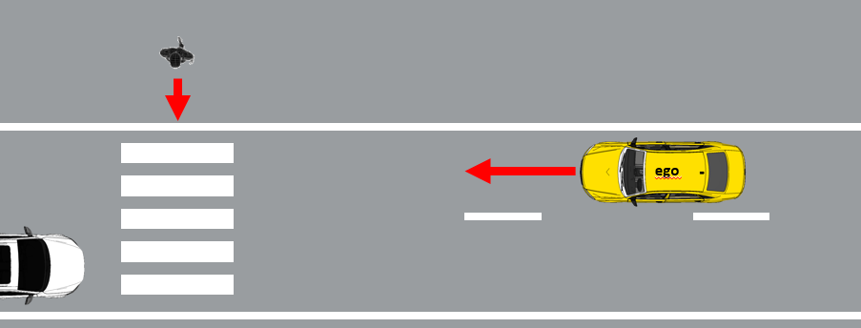
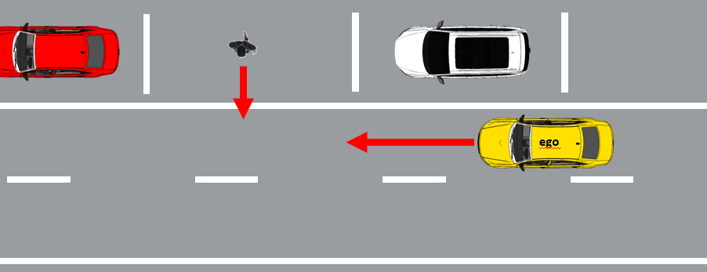
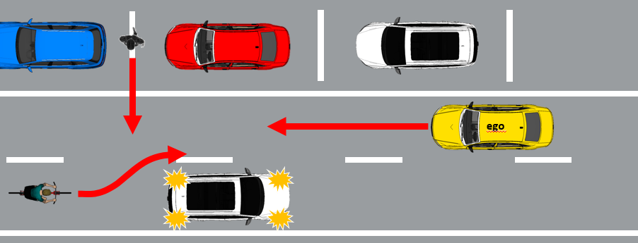
Example of the different pillars’ functions
Typical traffic scenarios
Real World Test Drive
Pedestrian crossing a crosswalk
Critical traffic scenarios
Physical Certification Tests
Scenario probability of occurrence in real world traffic
Obstructed pedestrian crossing
Edge case scenarios
Audit and Assessment (e.g. simulation)
low probability, but high efforts to identify and confirm performance!
Complexity/risk of scenario
Obstructed pedestrian crossing + cyclist overtaking

Slide 12
Concept for certification – the pillars and their individual purpose
Audit/Assessment
Understand the system to be certified
Assess that the applied processes and design/test methods for the overall system development (HW and SW) are effective, complete and consistent
Assess system’s strategies/rest performance to address (multiple) fault-conditions and disturbances due to deteriorating external influences; vehicle behavior in variations of critical scenarios
Simulation: Test parameter variations (e.g. distances, speeds) of scenarios and edge-cases that are difficult to test entirely on a test track
Physical Certification Tests
Assess critical scenarios that are technically difficult for the system to cope with, have a high injury severity (in case the system would not cope with such a scenario) and are representative for real traffic
Compare with critical test cases derived from simulation and validate simulation tools
Real World Test Drive
Assess the overall system capabilities and behavior in non-simulated traffic on public roads and show that the system has not been optimized on specific test scenarios
Assess system safety requirements like e.g. HMI and ODD
Assess that the system achieves a performance comparable to an experienced driver
Simulation

Slide 13
Concept for certification of automated driving systems Level 3-5
Why the new approach can generate an equivalent/higher safety-level compared to the “classical” approach:
The multi-pillar approach recognizes established process and functional safety oriented audits for certification of complex electronic vehicle control systems as a foundation.
Consequently, this new approach requires manufacturers to give evidence that their system has been designed and tested in a way that complies with established safety principles, different traffic rules, and ensures safe performance both under fault-conditions and arbitrary external influences.
Furthermore, the new approach evaluates specific complex situations on a test track.
To complement the assessment, the new approach includes a real-world-drive test in real world traffic (non-simulated).

Slide 14
Deriving the scope of work

Slide 15
Deriving the scope of work
Safety Elements
Guideline CP A
Safety Elements
Guideline CP B
Safety Elements
Guideline CP …
Compare Safety Elements
Synthesize Safety Elements
Element 1
Element 2
Element ...
Allocate work and responsibilities to be covered by the multi-pillar approach
→ Some general safety-frameworks on national level are already available. They are not design-restrictive and could be further explored for regulatory use at UNECE
→ Shared global understanding of safety elements endeavored by OICA/AAPC

Slide 16
Back-Up

Slide 17
References
This presentation is based on
ECE/TRANS/WP.29/GRVA/2019/13
GRVA-02-09
and on several documents that OICA submitted under the activities of WP.29 IWG ITS/AD and under the former TF AutoVeh including its subgroups 1 and 2: - ITS_AD-12-11 - TFAV-02-05 - TFAV-SG1-02-08 -SG1-03-10 - ITS_AD-13-05-Rev1 - TFAV-SG1-01-02 - TFAV-SG2-02-07 - ITS_AD-14-07 - TFAV-SG1-01-03 - TFAV-SG1-01-04 - TFAV-SG1-01-05 - TFAV-SG2-01-02

