Slide 1
Sustainable Transport:
A Critical Driver to Achieve the Sustainable Development Goals
17 June 2020
Alice Yiu
Policy Advocacy and Strategic Communications, SLOCAT Partnership

Slide 2
SLOCAT Partnership on Sustainable, Low Carbon Transport
Powering the sustainable, low carbon transport revolution with ambition, solutions and collaboration
International, multi-stakeholder ecosystem of 90 entities
Primary focus:
Land transport All mobility modes
Geographic footprint:
Global South
3 mutually-reinforcing work streams
Knowledge and Policy Analysis
Advocacy and Engagement
Dialogue and Networking
www.slocat.net
Notes:
SLOCAT is the international multi-stakeholder partnership that enables collaborative knowledge and action for sustainable, low carbon transport and brings the voice of the movement into international climate change and sustainability processes. Our Partnership engages a vibrant international, multi-stakeholder ecosystem of over 90 entities across transport sectors associations, knowledge and academia, governments, multilateral organisations, NGOs, philanthropy and industry; as well as a large community of world-class experts and change-makers.

Slide 3
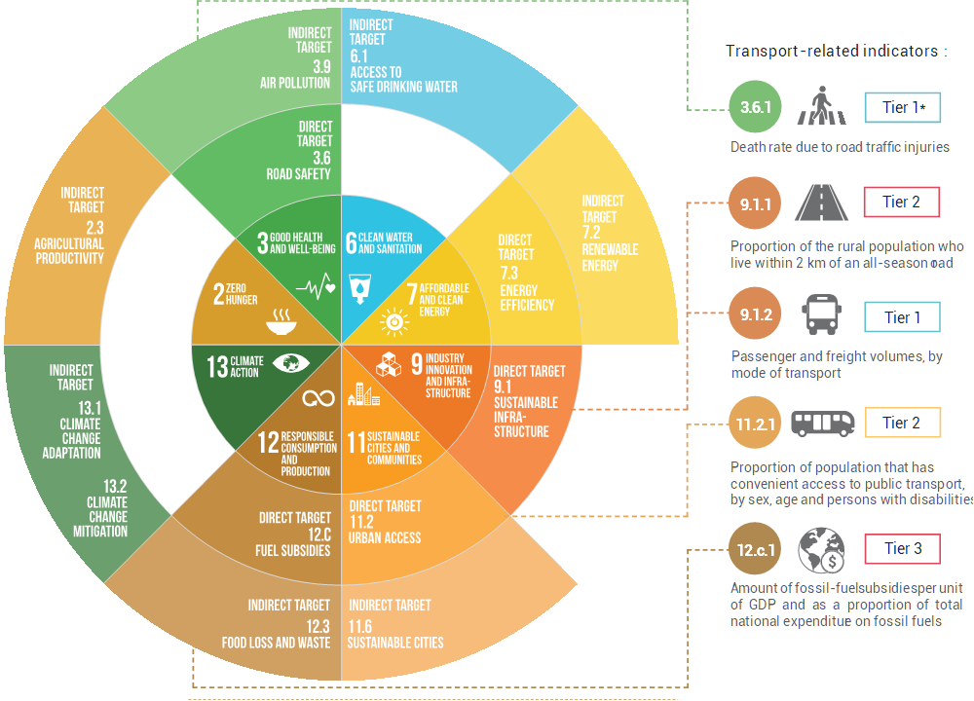
Notes:
Sustainable transport is a cross-cutting theme in the 2030 Agenda for Sustainable Development. It directly supports the achievement of at least half of the 17 SDGs and makes indirect contributions to all of them. In addition, transport is directly related to five SDG indicators on road safety, rural access, passenger and freight transport, public transport and fossil fuel subsidies, among which, Indicator 12.c.1. on fossil fuel has recently been renamed (by removing the reference “as a proportion of total national expenditure” and was updated from Tier III to Tier I by the IAEG-SDGs in April 2020 (pending final approval at the 52nd session of the Statistical Commission in March 2021).

Slide 4
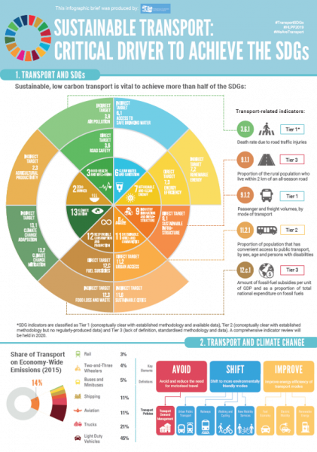
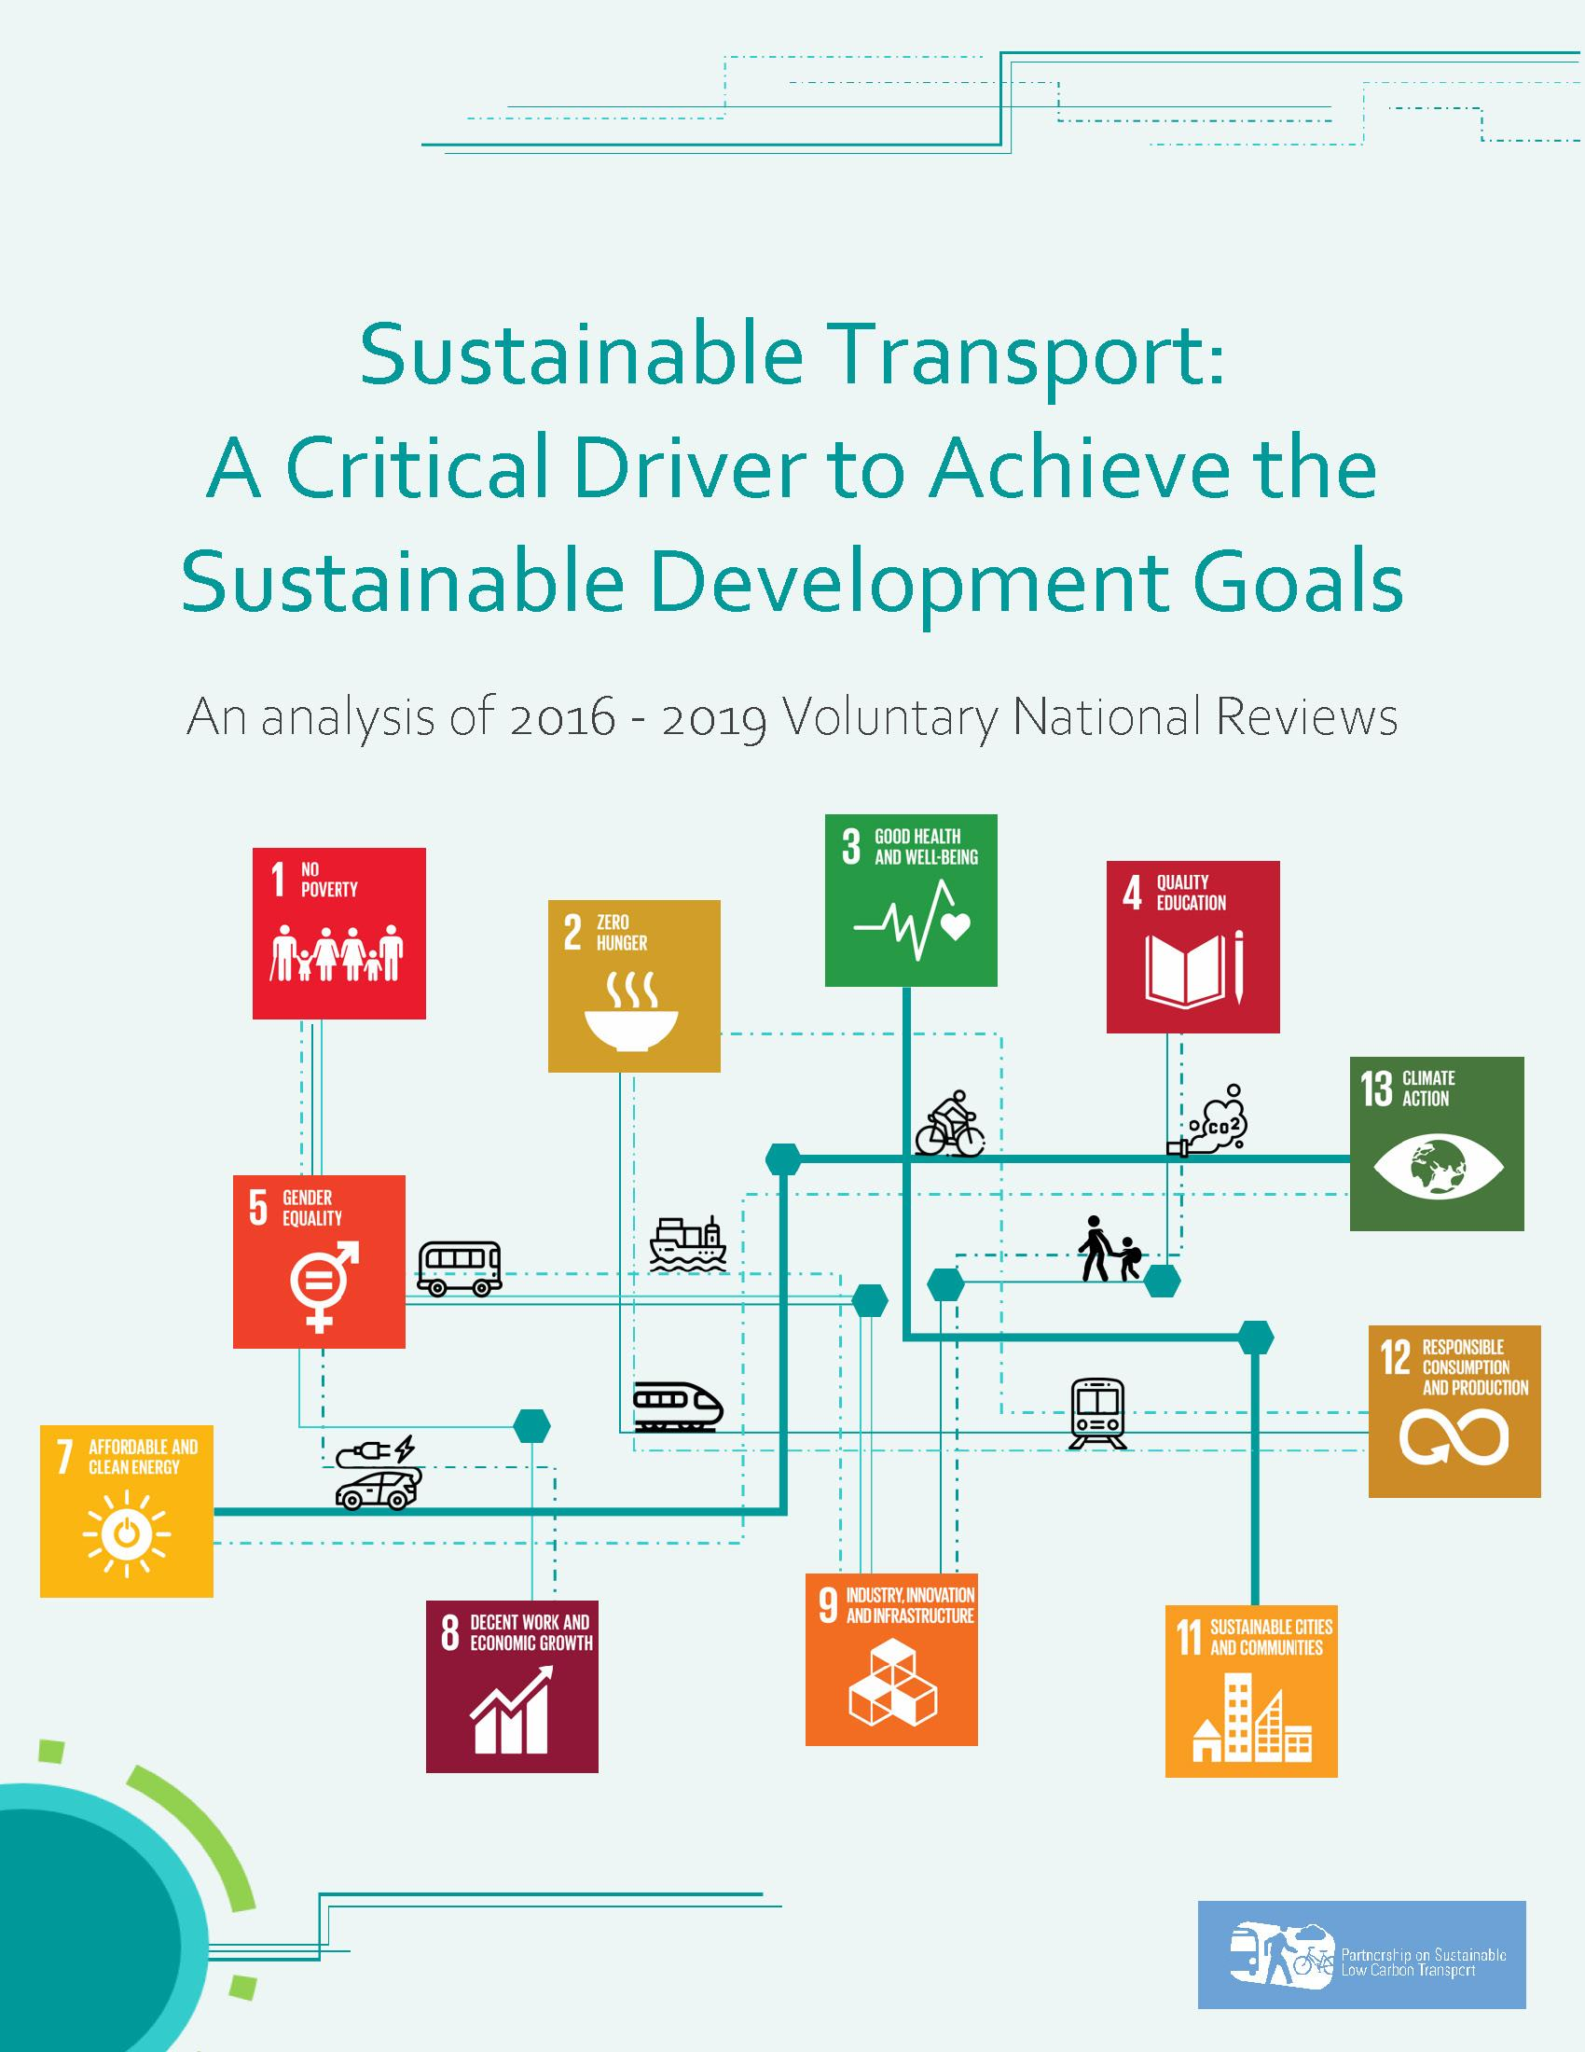
Voluntary National Reviews (VNRs)
SLOCAT Reports on transport and VNRs
www.slocat.net/vnr
Countries submit VNRs to the United Nations High-Level Political Forum on Sustainable Development (HLPF) annually since 2016
Facilitate sharing of experiences among countries
Accelerate implementation of the 2030 Agenda
Notes:
The 2030 Agenda encourages member states to submit Voluntary National Reviews (VNRs) to the United Nations High-Level Political Forum on Sustainable Development (HLPF), which has been convening annually since 2016 under the auspices of the United Nations Economic and Social Council (ECOSOC). The VNR process aims to facilitate the sharing of experiences among countries, including successes, challenges and lessons learned, with a view to accelerating the implementation of the 2030 Agenda.
Since the first HLPF in 2016, SLOCAT has been assessing transport references in the VNRs submitted each year. The assessment:
Provided a useful resource for policy-makers to better understand the role of transport in achieving the SDGs;
Outlined recommendations to policy-makers on goal-setting, implementing and reporting on sustainable transport progress;
Helped the transport community (and other relevant sectors e.g. energy, health) better understand the pattern, gaps and opportunities in reporting sustainable transport in the VNR process.

Slide 5
How many VNRs referred to the
transport sector from 2016 to 2019?

Slide 6
92% highlighted the transport sector
No. of VNRs with transport References
No. of VNRs without transport References
Notes:
Our work found that throughout the lifespan of the HLPF, countries have been reporting on transport as a vital sector to implement SDGs, showcasing on-the-ground implementation and best practices. Through the VNRs, countries contribute to offer leverage and momentum for the transport sector to move along a more sustainable path.
During the first quadrennial reporting cycle from 2016 to 2019, 92% of the submitted VNRs have highlighted progress made in the transport sector.

Slide 7
What did they report about transport?

Slide 8
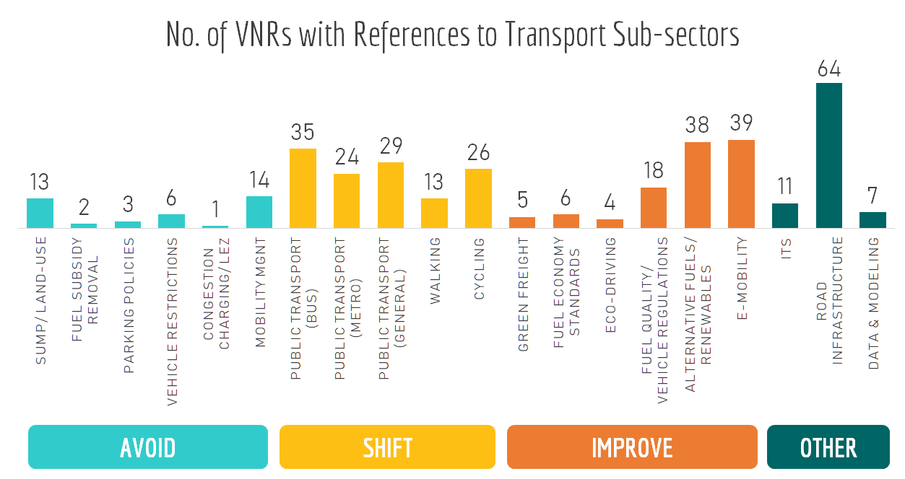
Notes:
Driving sustainable and inclusive growth requires a balanced package of sustainable mobility measures focusing on various segments of the sector as well as their operational functions and intended impacts.
The Avoid-Shift-Improve Framework entails three main avenues to promote mobility solutions in achieving sustainable and inclusive transport systems: avoiding unnecessary transport, while shifting to low carbon modes, and improving vehicle design, fuel efficiency and energy sources. During the first VNR reporting cycle, much attention has been paid, particularly by developing countries, to develop road infrastructure to improve urban-rural and regional linkages, accessibility (for both vehicles and pedestrians), and road safety. Considerable attention has also been paid to Improve measures of electric mobility and the use of clean fuels and renewables in transport. Many countries have also reported on Shift measures on public transport systems, a direct contribution to SDG indicator 11.2.1.
There is increasing over focus in the policy debate and donor community on improve strategies and measures. The over focus on improve measures, in particular electric cars, risks distracting attention from necessary long-term structural changes in business models, supply chains, city planning and behaviour. Avoid and shift measures (e.g. road space allocation for bus lanes) may well provide much more cost-effective results in access than many improve measures, although more research is needed on long- term cost effectiveness. This is likely to be particularly true for rapidly urbanising countries in the Global South.

Slide 9
Transport Indicators
Notes:
Driving sustainable and inclusive growth requires a balanced package of sustainable mobility measures focusing on various segments of the sector as well as their operational functions and intended impacts.
The Avoid-Shift-Improve Framework entails three main avenues to promote mobility solutions in achieving sustainable and inclusive transport systems: avoiding unnecessary transport, while shifting to low carbon modes, and improving vehicle design, fuel efficiency and energy sources. During the first VNR reporting cycle, much attention has been paid, particularly by developing countries, to develop road infrastructure to improve urban-rural and regional linkages, accessibility (for both vehicles and pedestrians), and road safety. Considerable attention has also been paid to Improve measures of electric mobility and the use of clean fuels and renewables in transport. Many countries have also reported on Shift measures on public transport systems, a direct contribution to SDG indicator 11.2.1.
There is increasing over focus in the policy debate and donor community on improve strategies and measures. The over focus on improve measures, in particular electric cars, risks distracting attention from necessary long-term structural changes in business models, supply chains, city planning and behaviour. Avoid and shift measures (e.g. road space allocation for bus lanes) may well provide much more cost-effective results in access than many improve measures, although more research is needed on long- term cost effectiveness. This is likely to be particularly true for rapidly urbanising countries in the Global South.

Slide 10
How can the VNRs unleash a more comprehensive vision and assessment
of sustainable, low carbon transport?

Slide 11
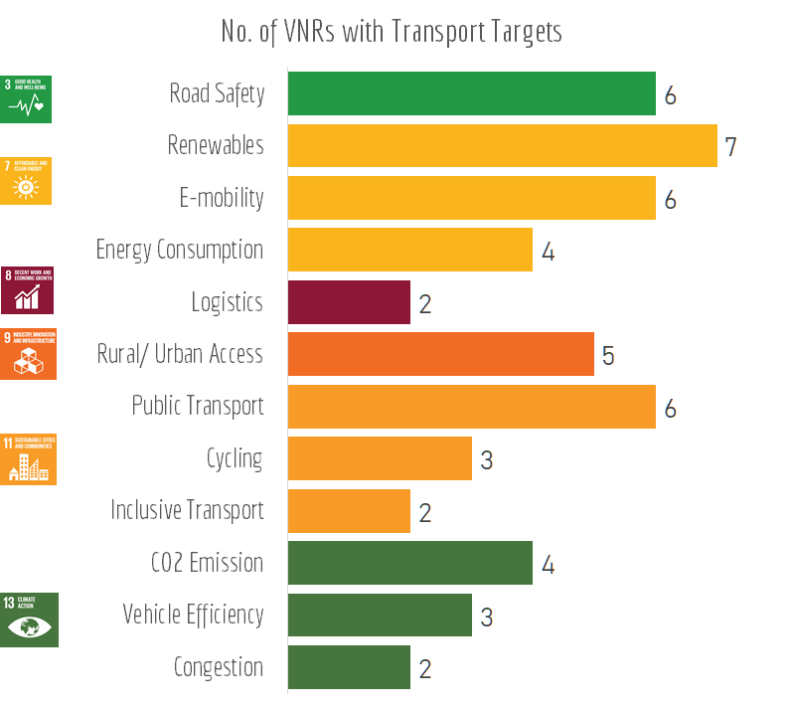
Setting specific, quantified targets
Notes:
In order to effectively demonstrate tangible progress on an integrated vision for sustainable transport and mobility, it is essential that countries set specific, quantified targets related to the transport sector (and sub-sectors) to establish clear visions and facilitate progress-tracking. During the first reporting cycle, 18% of the VNRs reported specific targets covering 12 areas in sustainable transport. The majority of targets are short-to-medium term targets (2020 and 2030), with five countries setting long-term targets for 2050. Robust coordination and support from SDG-lead agencies are required to maximise the contribution of the transport sector within the national development framework for short-/ medium- and long-term planning. Establishing such a harmonised long-term strategy with ambitious vision and specific targets could enable the implementation of transport measures to maximise wide sustainability impacts.

Slide 12
Setting specific, quantified targets
Transport Indicators
Notes:
In order to effectively demonstrate tangible progress on an integrated vision for sustainable transport and mobility, it is essential that countries set specific, quantified targets related to the transport sector (and sub-sectors) to establish clear visions and facilitate progress-tracking. During the first reporting cycle, 18% of the VNRs reported specific targets covering 12 areas in sustainable transport. The majority of targets are short-to-medium term targets (2020 and 2030), with five countries setting long-term targets for 2050. Robust coordination and support from SDG-lead agencies are required to maximise the contribution of the transport sector within the national development framework for short-/ medium- and long-term planning. Establishing such a harmonised long-term strategy with ambitious vision and specific targets could enable the implementation of transport measures to maximise wide sustainability impacts.

Slide 13
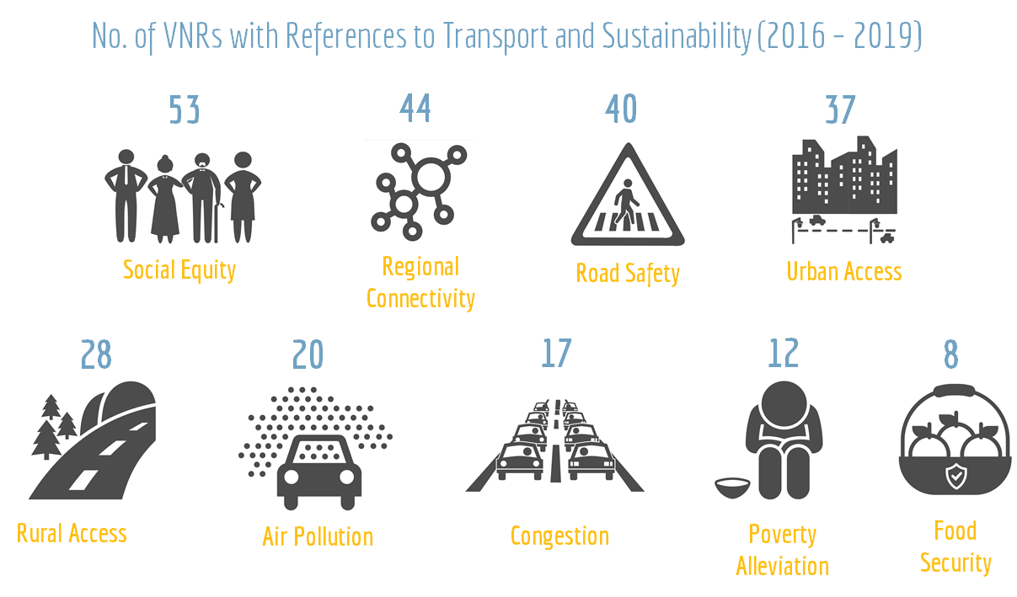
Reporting transport co-benefits
Notes:
As mentioned earlier, 92% of submitted VNRs have referred to progress made in the transport sector in the first reporting cycle; however, only about 30% have included references to the wide sustainability impacts of transport measures.
The linkages between transport and infrastructure- and energy-oriented SDGs are clear, but further attention must be paid to the social dimension of sustainable development, thus establishing a stronger case as to how transport contributes to the overarching goals of the 2030 Agenda on poverty alleviation, food security, social equity and ‘Leaving No One Behind’. The gap is likely due, among other reasons, to the difficulty of quantifying these impacts in local terms, the lack of local low carbon targets for transport, and the need for more awareness raising with key stakeholders. There is still a major concern among many developing countries that climate mitigation actions impose costs, and quantitative emission reduction targets will adversely affect economic development. If the sustainability aspects of transport interventions are not understood as an important driver for action at the local level, proponents will have a difficult time achieving the buy-in from policy-makers and mainstreaming them into existing national and local development policies.

Slide 14
Reporting transport co-benefits
Transport Indicators
Notes:
As mentioned earlier, 92% of submitted VNRs have referred to progress made in the transport sector in the first reporting cycle; however, only about 30% have included references to the wide sustainability impacts of transport measures.
The linkages between transport and infrastructure- and energy-oriented SDGs are clear, but further attention must be paid to the social dimension of sustainable development, thus establishing a stronger case as to how transport contributes to the overarching goals of the 2030 Agenda on poverty alleviation, food security, social equity and ‘Leaving No One Behind’. The gap is likely due, among other reasons, to the difficulty of quantifying these impacts in local terms, the lack of local low carbon targets for transport, and the need for more awareness raising with key stakeholders. There is still a major concern among many developing countries that climate mitigation actions impose costs, and quantitative emission reduction targets will adversely affect economic development. If the sustainability aspects of transport interventions are not understood as an important driver for action at the local level, proponents will have a difficult time achieving the buy-in from policy-makers and mainstreaming them into existing national and local development policies.

Slide 15
Citing case studies and reporting data
Transport is often discussed in broad and general terms in HLPFs
Limited attention to technicalities of actual implementation
Highlighting regional and local good practices, emphasising the Global South
Data reporting is voluntary; opportunities to offer robust tools and methodologies on transport sustainability impacts
Notes:
Sustainable transport, though related to various goals and represented in specific targets, does not have a standalone goal where it could be discussed in-depth. The format of the HLPF, where only a fraction of the goals is under discussion in any given year, means there is little space for examining cross-cutting topics like transport. The political nature of the HLPF means topics are discussed in broad and general terms, with many platitudes such as ‘enhancing progress’ or ‘meaningful participation’ and little attention to the technicalities of actual implementation. When the methods for achieving sustainable transport are well-established (for instance, the Avoid-Shift-Improve Framework), the sector gains little from generalities - what is necessary is to talk about how to start implementing these measures consistently around the globe.
The current VNR framework leaves reporting on transport goals up to the member states, who understandably focus on easily measured indicators such as road length. Obligating or at least encouraging reporting on indicators such as non-motorised travel would not only improve the relevance of VNRs to sustainable mobility, it would also stimulate data collection in member states, with benefits far beyond the VNRs alone.

Slide 16
Additional indicators on sustainable transport?
Electrification of public fleet
Bikesharing
Dedicated and safe sidewalks
Fuel economy standards
Universal design
in public transit facilities
Sustainable Urban Mobility Plans (SUMPs)/ National Urban Mobility Plans (NUMPs)
Green freight programmes

Slide 17
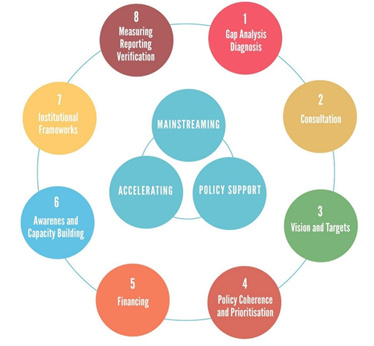
Resources on synergies between SDG and NDC implementation
Framework to Accelerate SDG Implementation in the Transport Sector
www.slocat.net/vnr
Ten Recommendations to Raise Ambition for Transport in NDCs
www.slocat.net/ndcs

Slide 18
Stay tuned
for upcoming new report on Transport and VNRs
in July 2020
www.slocat.net
alice.yiu@slocatpartnership.org
@slocatofficial

